Slide 2
Sit quietly
relaxing in God’s presence…
Become aware of the sounds
around you….
Breathe in
the life of the universe….
Breathe out gratitude….

Slide 3
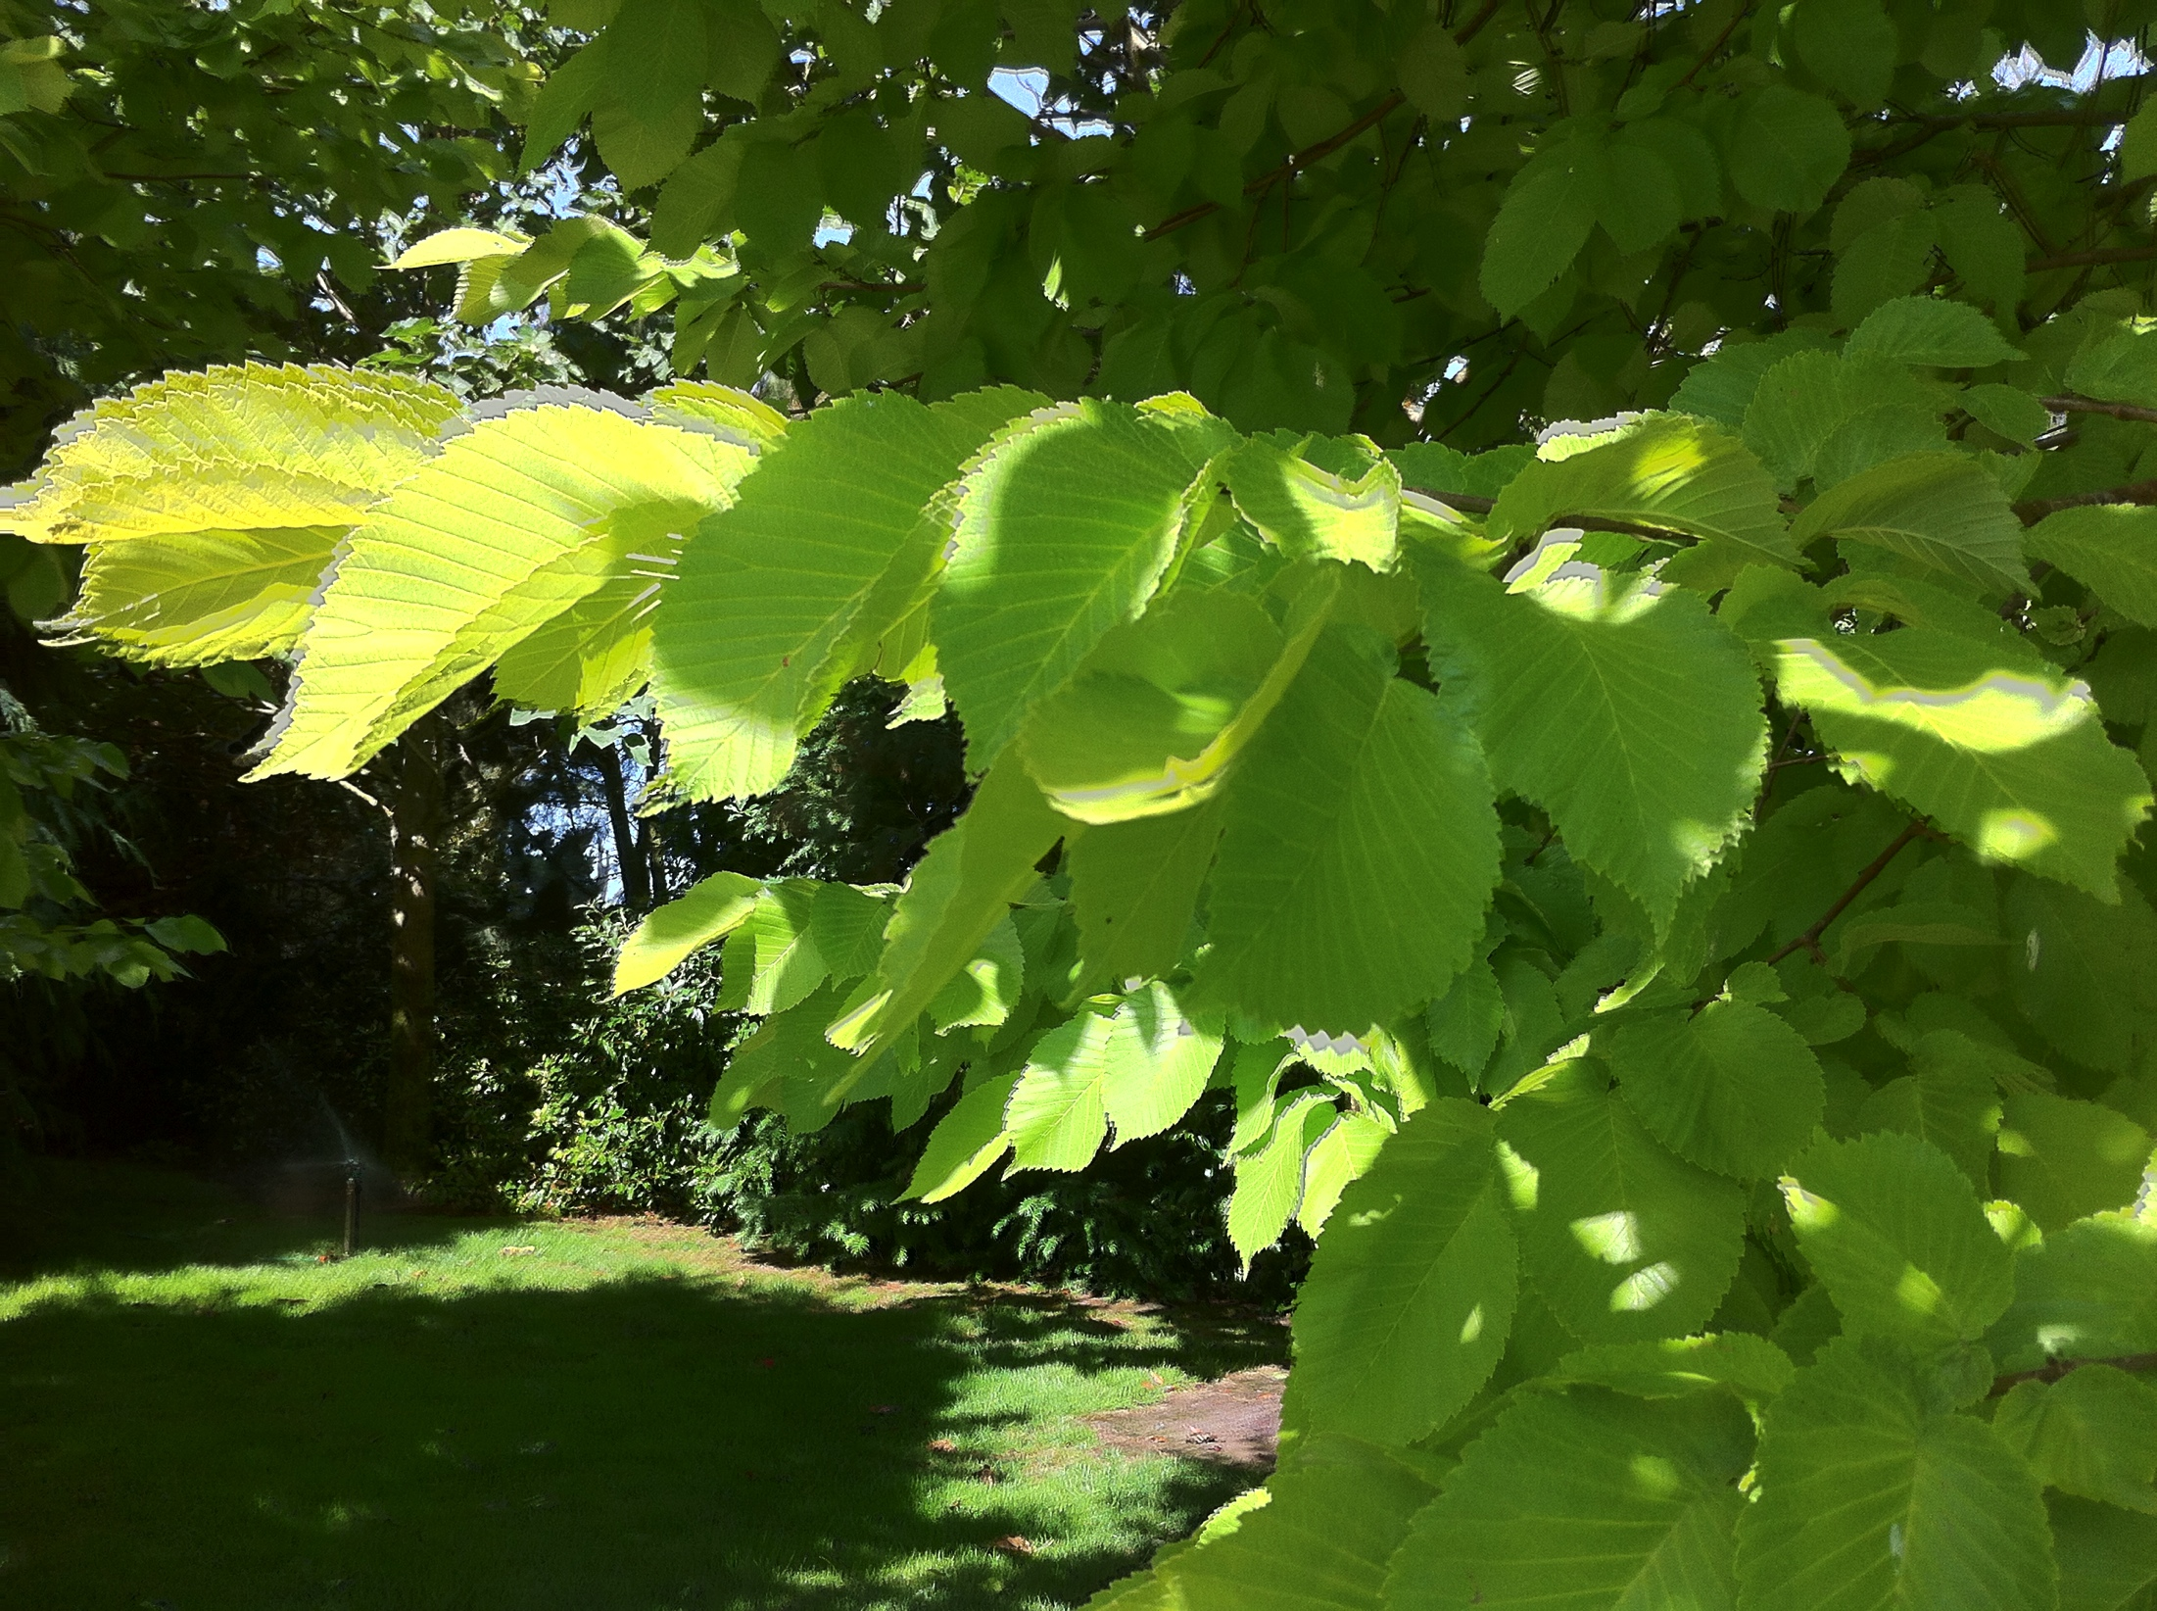

Let the poem & the images
speak to you
of
divine mystery

Slide 4
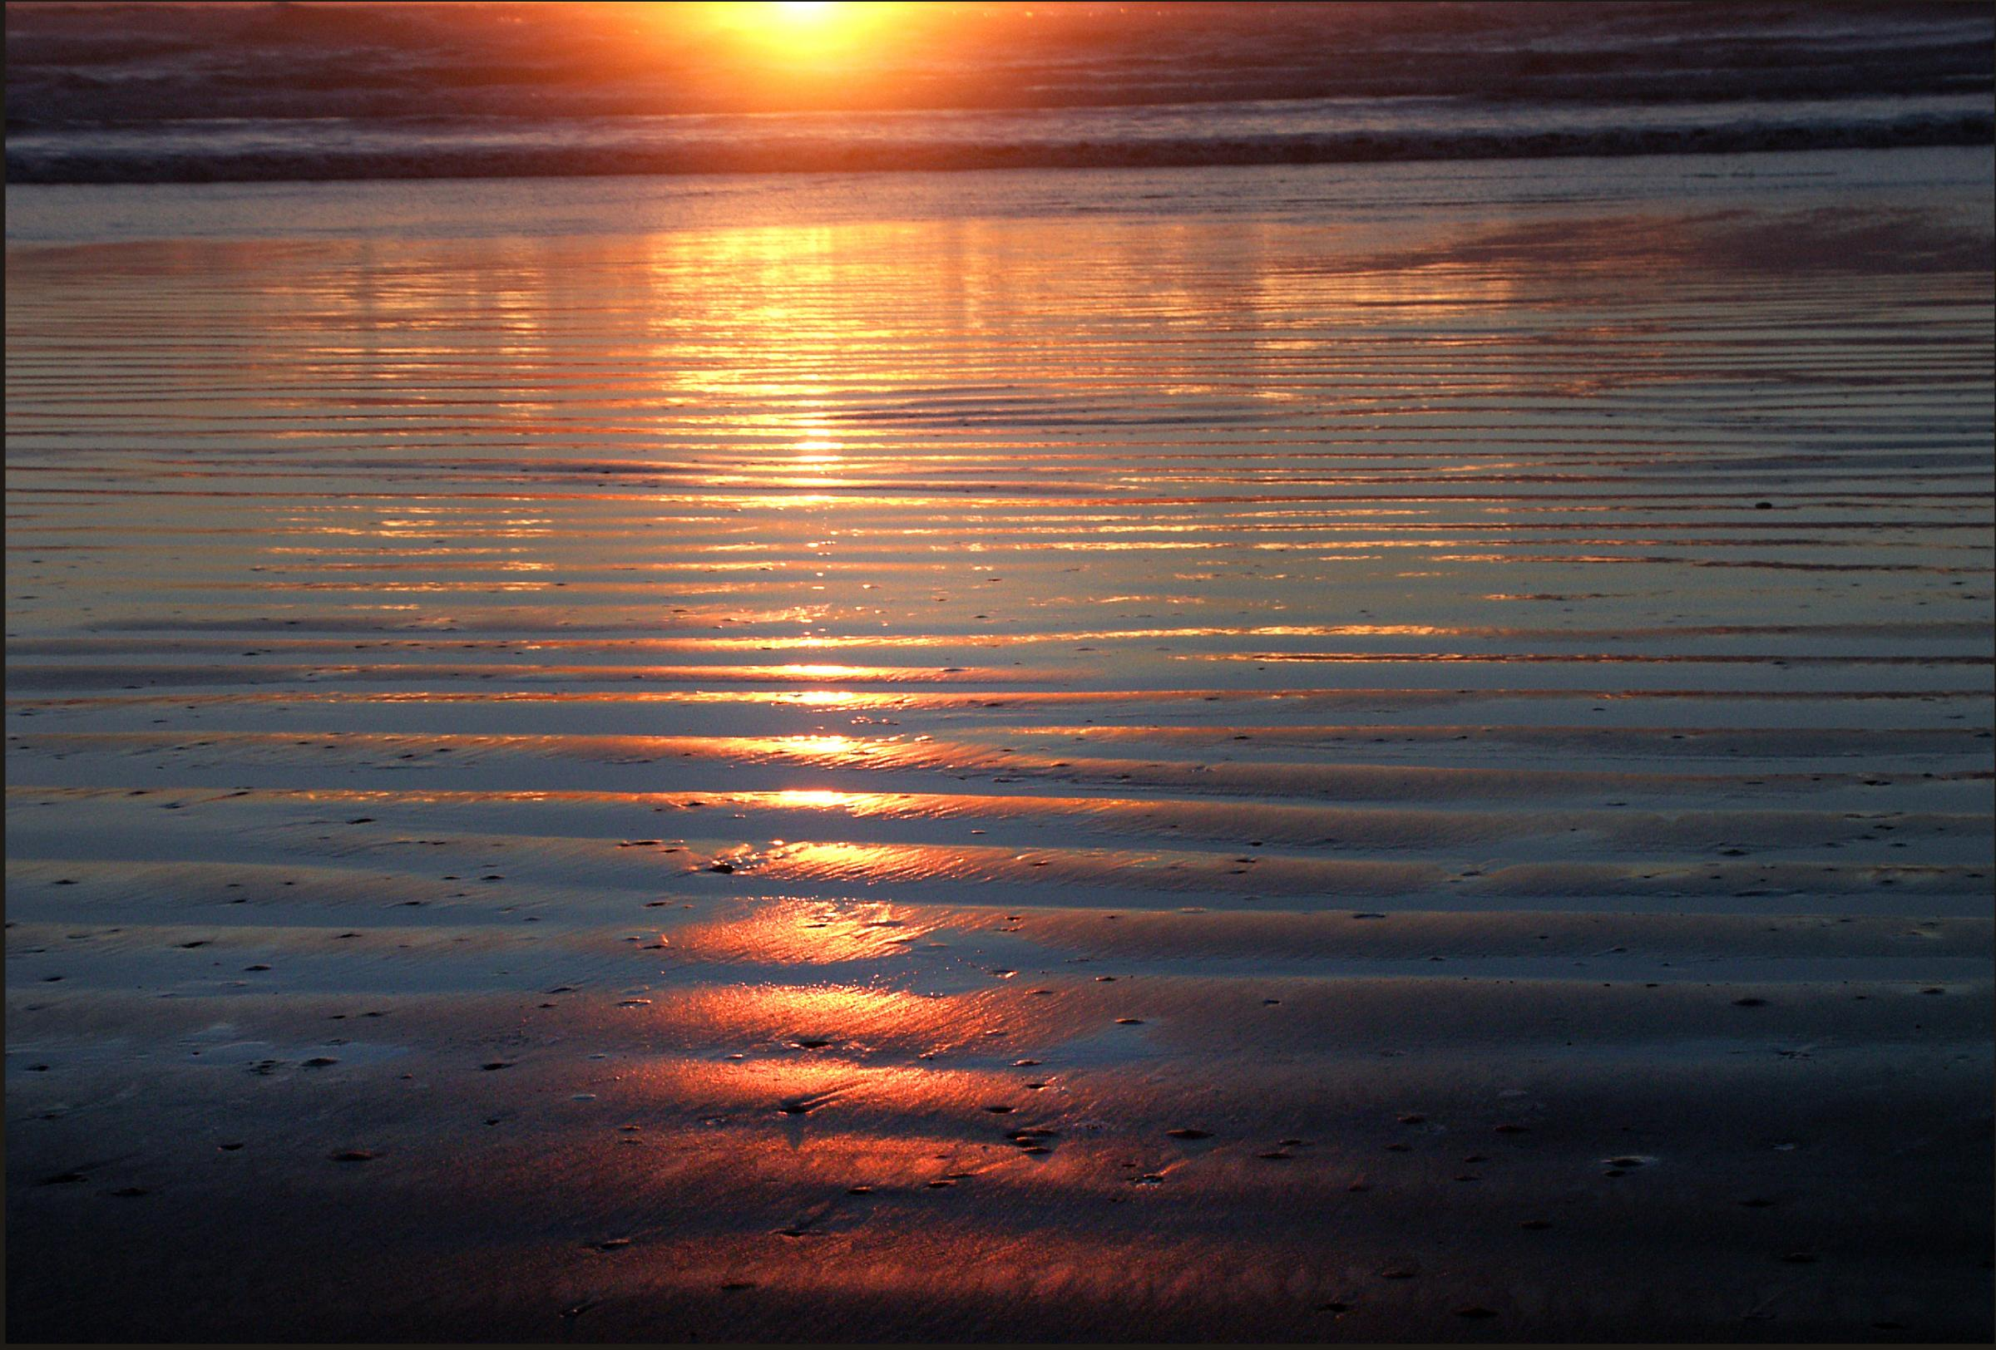
Sometimes, you need the ocean light,
and colours you’ve never seen before
painted through an evening sky.

Slide 5
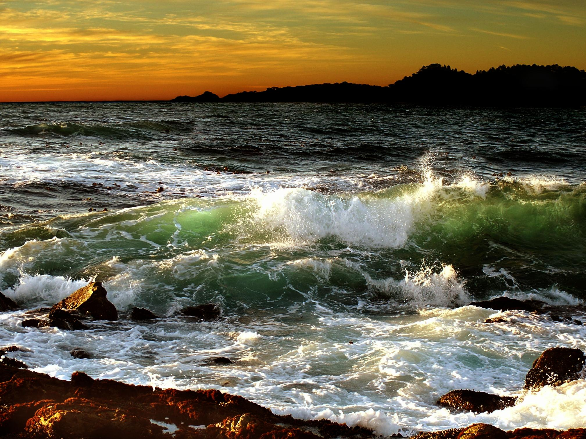

Slide 6
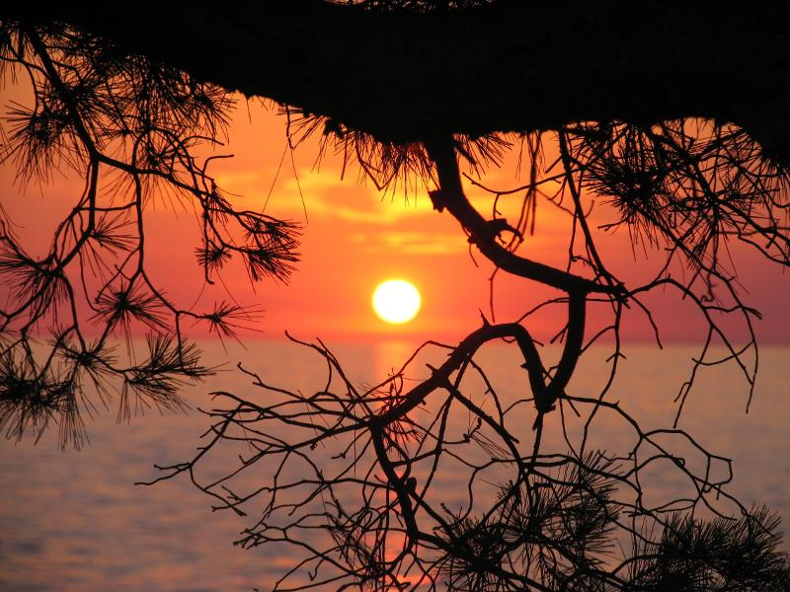

Slide 7
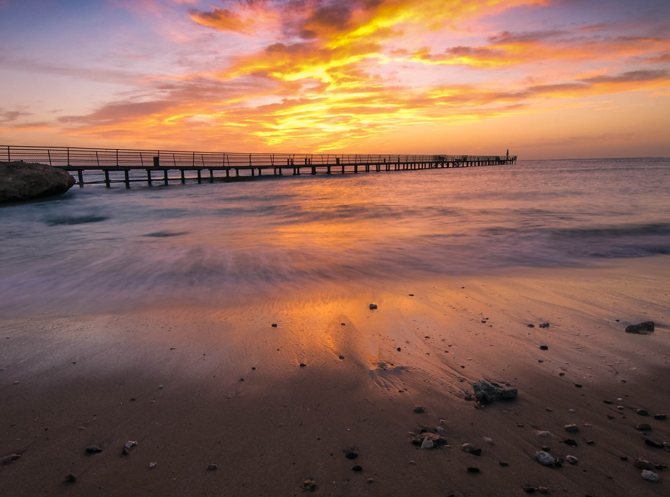

Slide 8
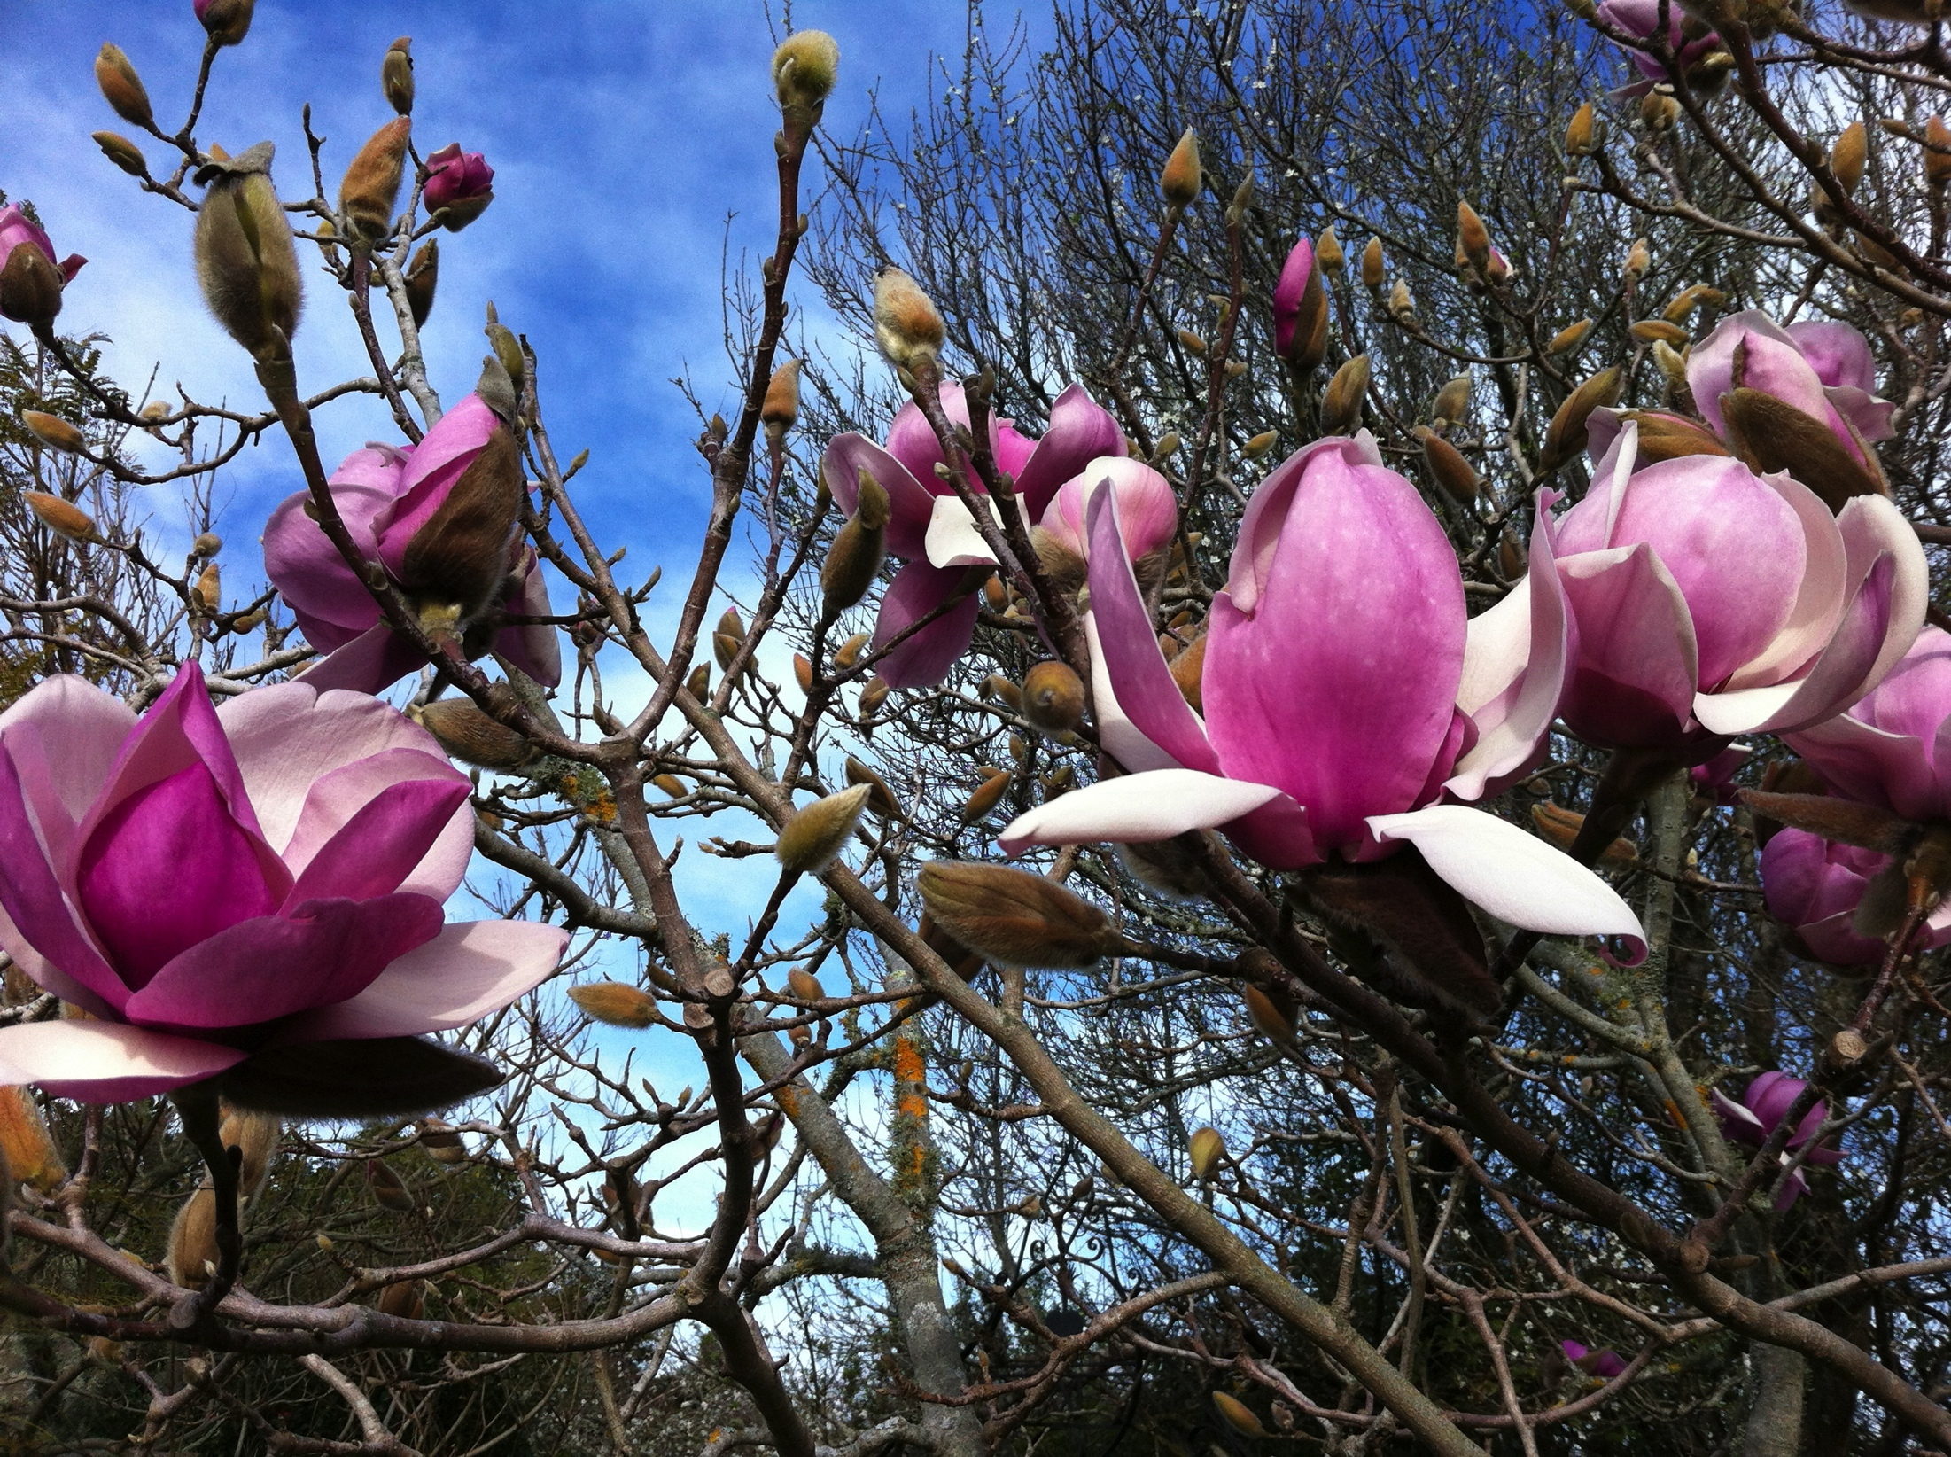
Sometimes you need your God
to be simple invitation,
not telling a word of wisdom.

Slide 9
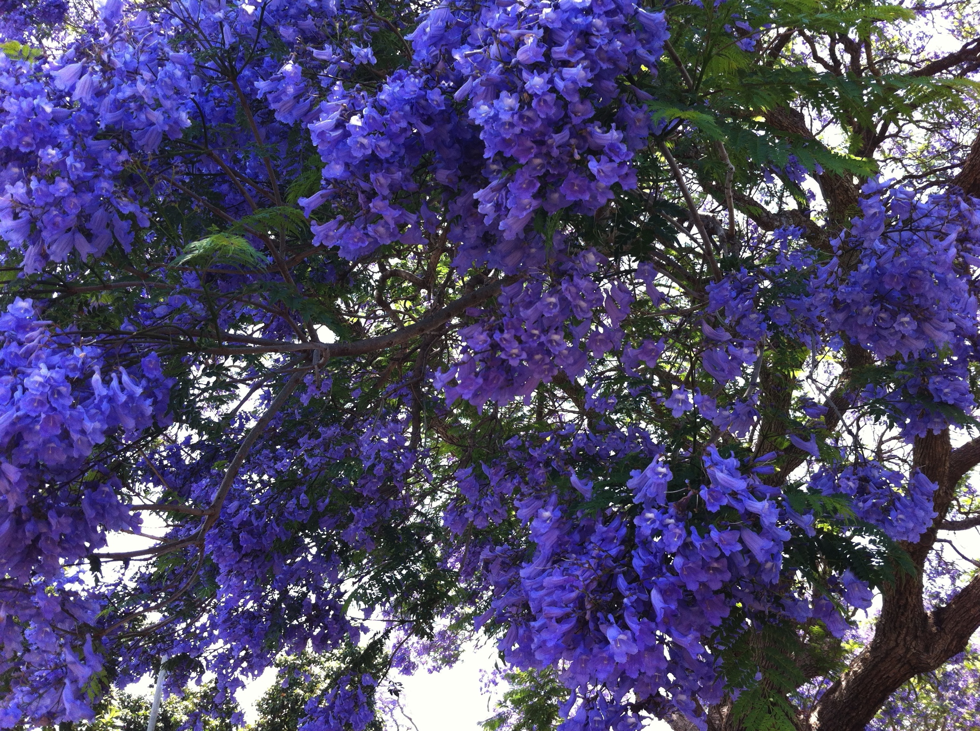

Slide 10
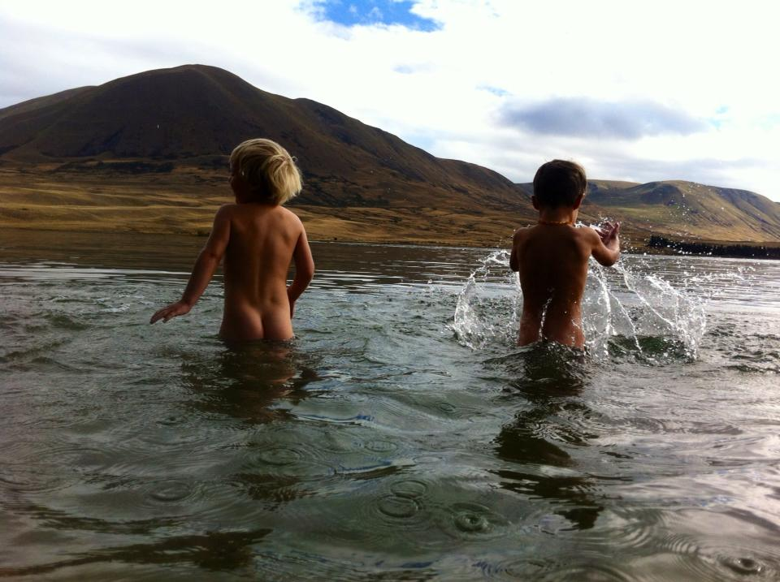

Slide 11
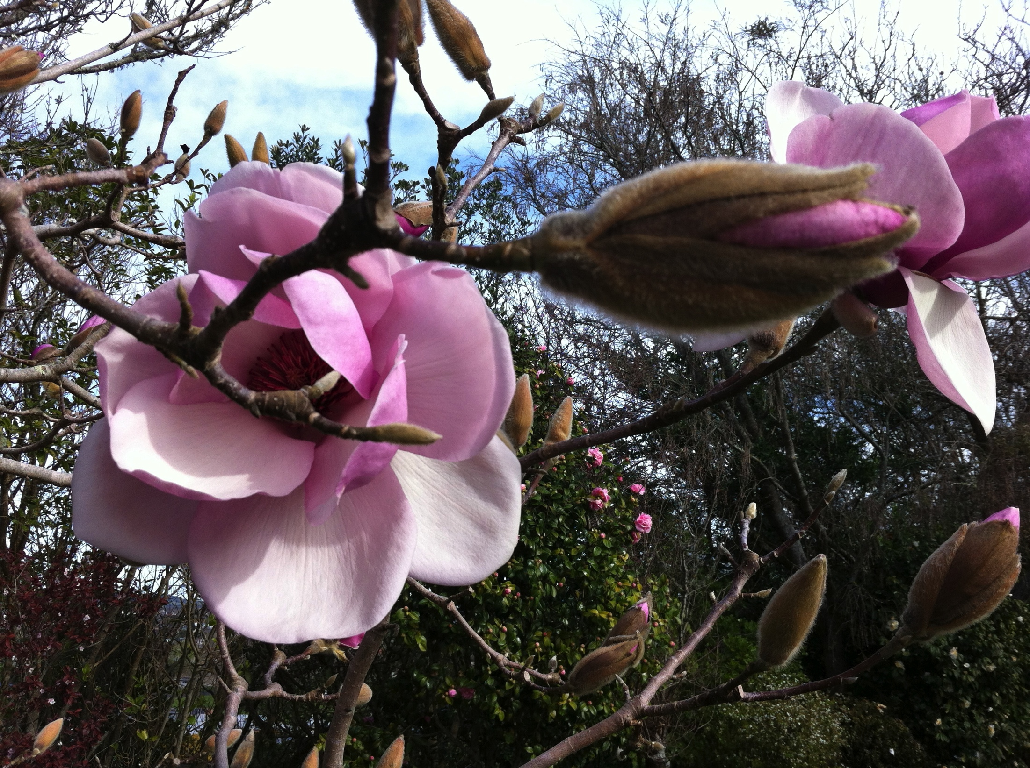

Slide 12
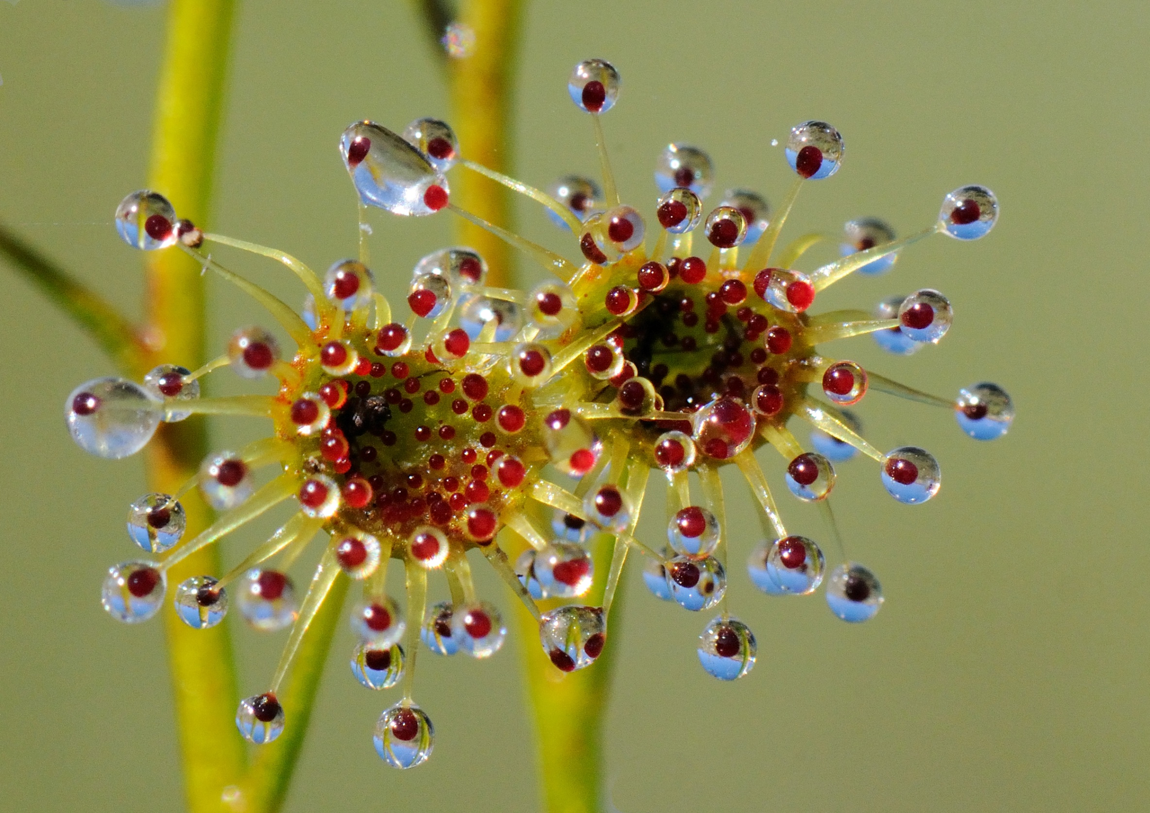
Sometimes you need only the first shyness
that comes from being shown things
far beyond your understanding,

Slide 13
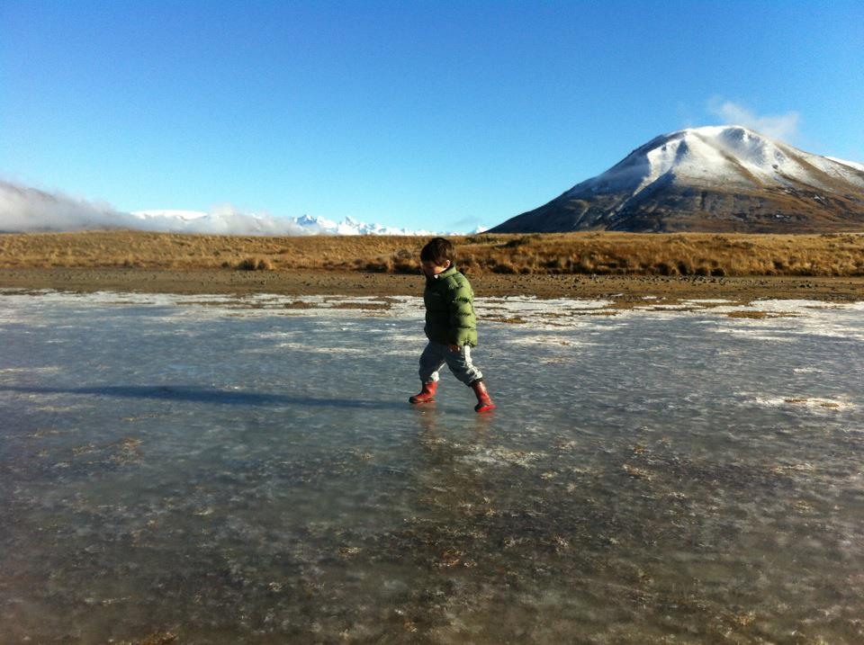

Slide 14
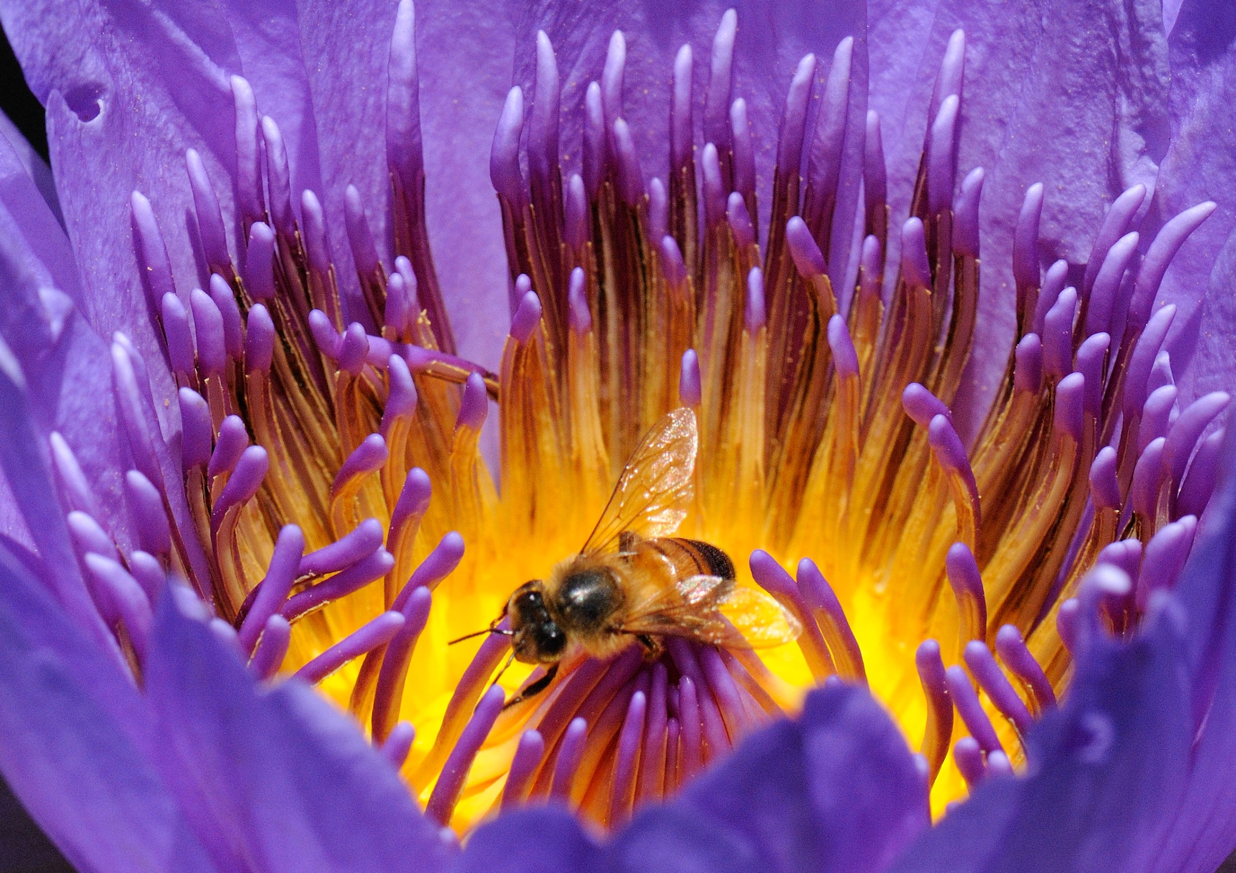

Slide 15
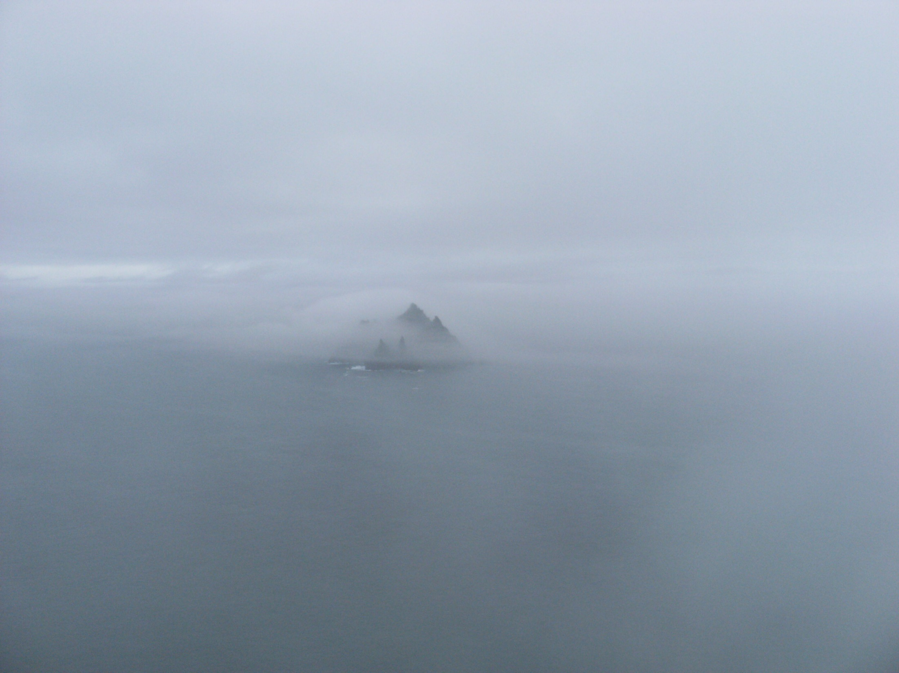

Slide 16
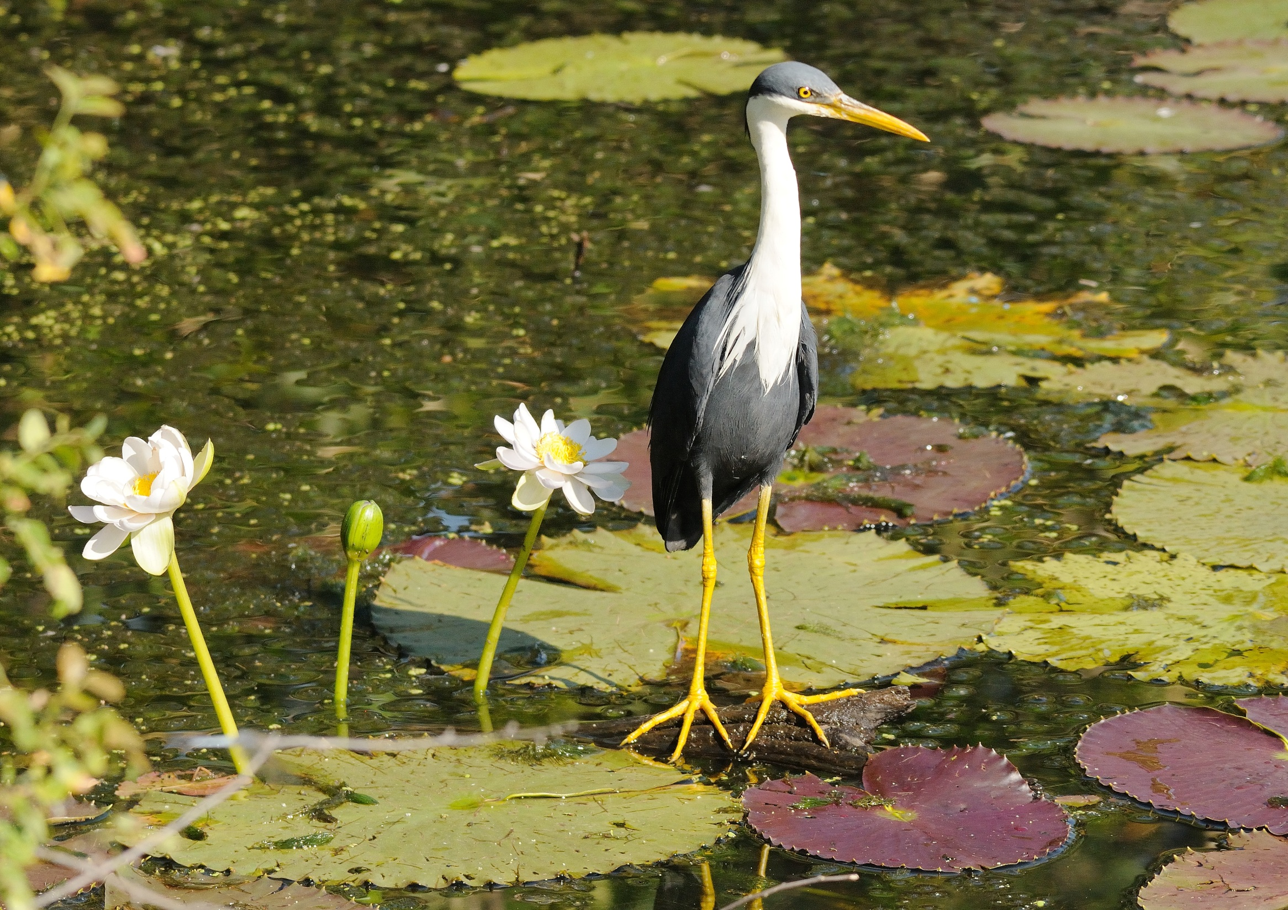
so that you can fly and become free
by being still and by being still here.

Slide 17
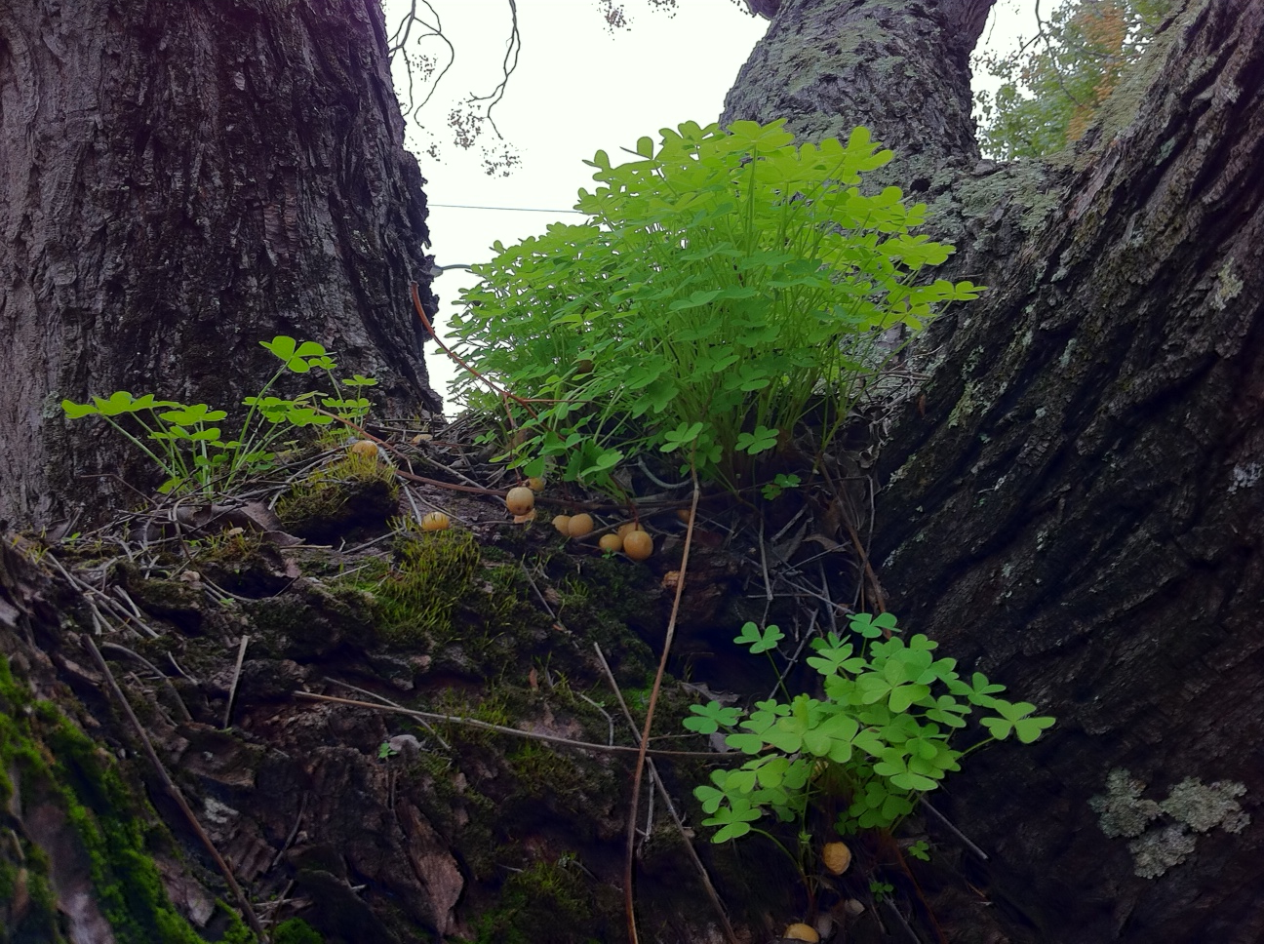

Slide 18
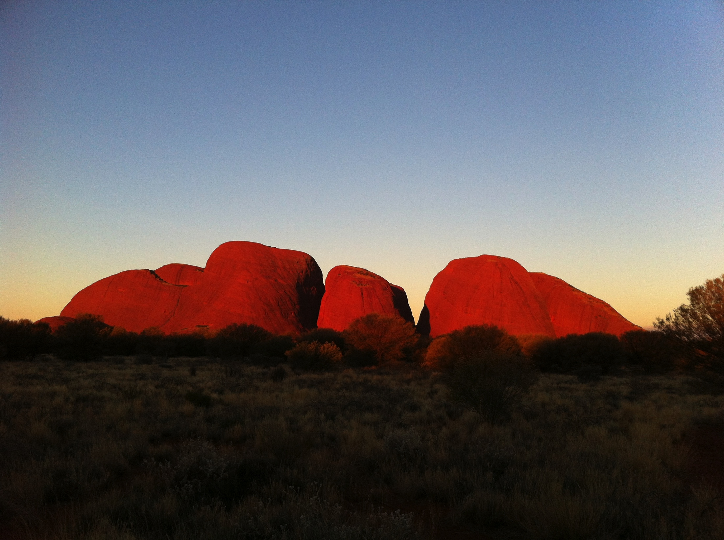

Slide 19
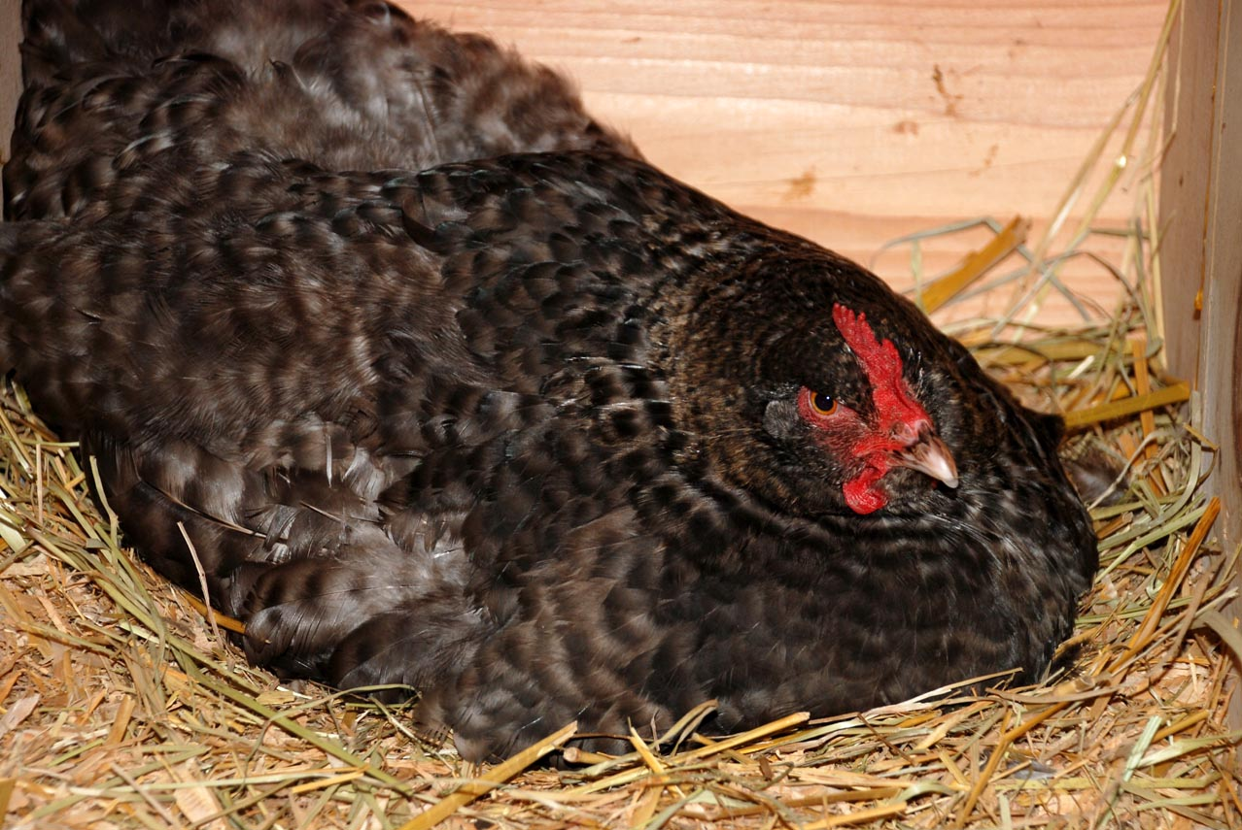

Slide 20
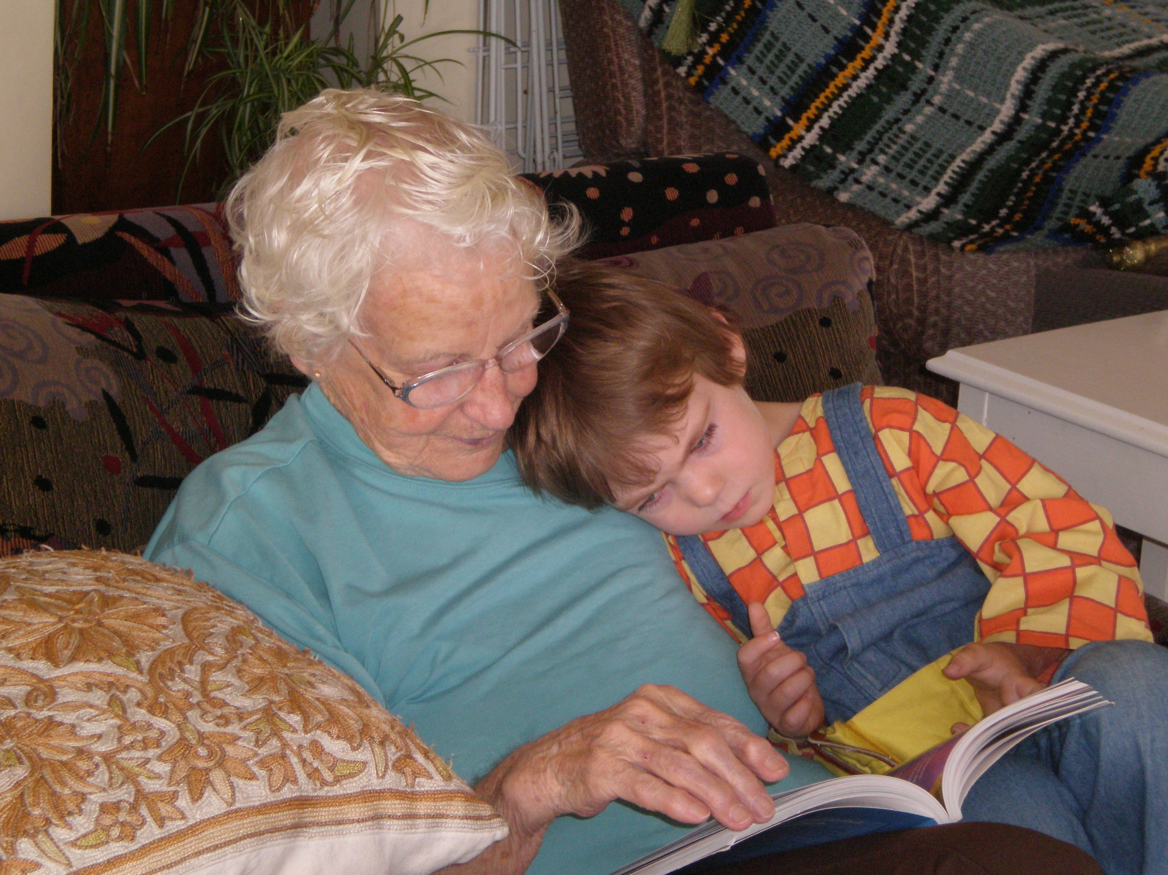
And then there are times you need to be
brought to ground by touch
and touch alone.

Slide 21
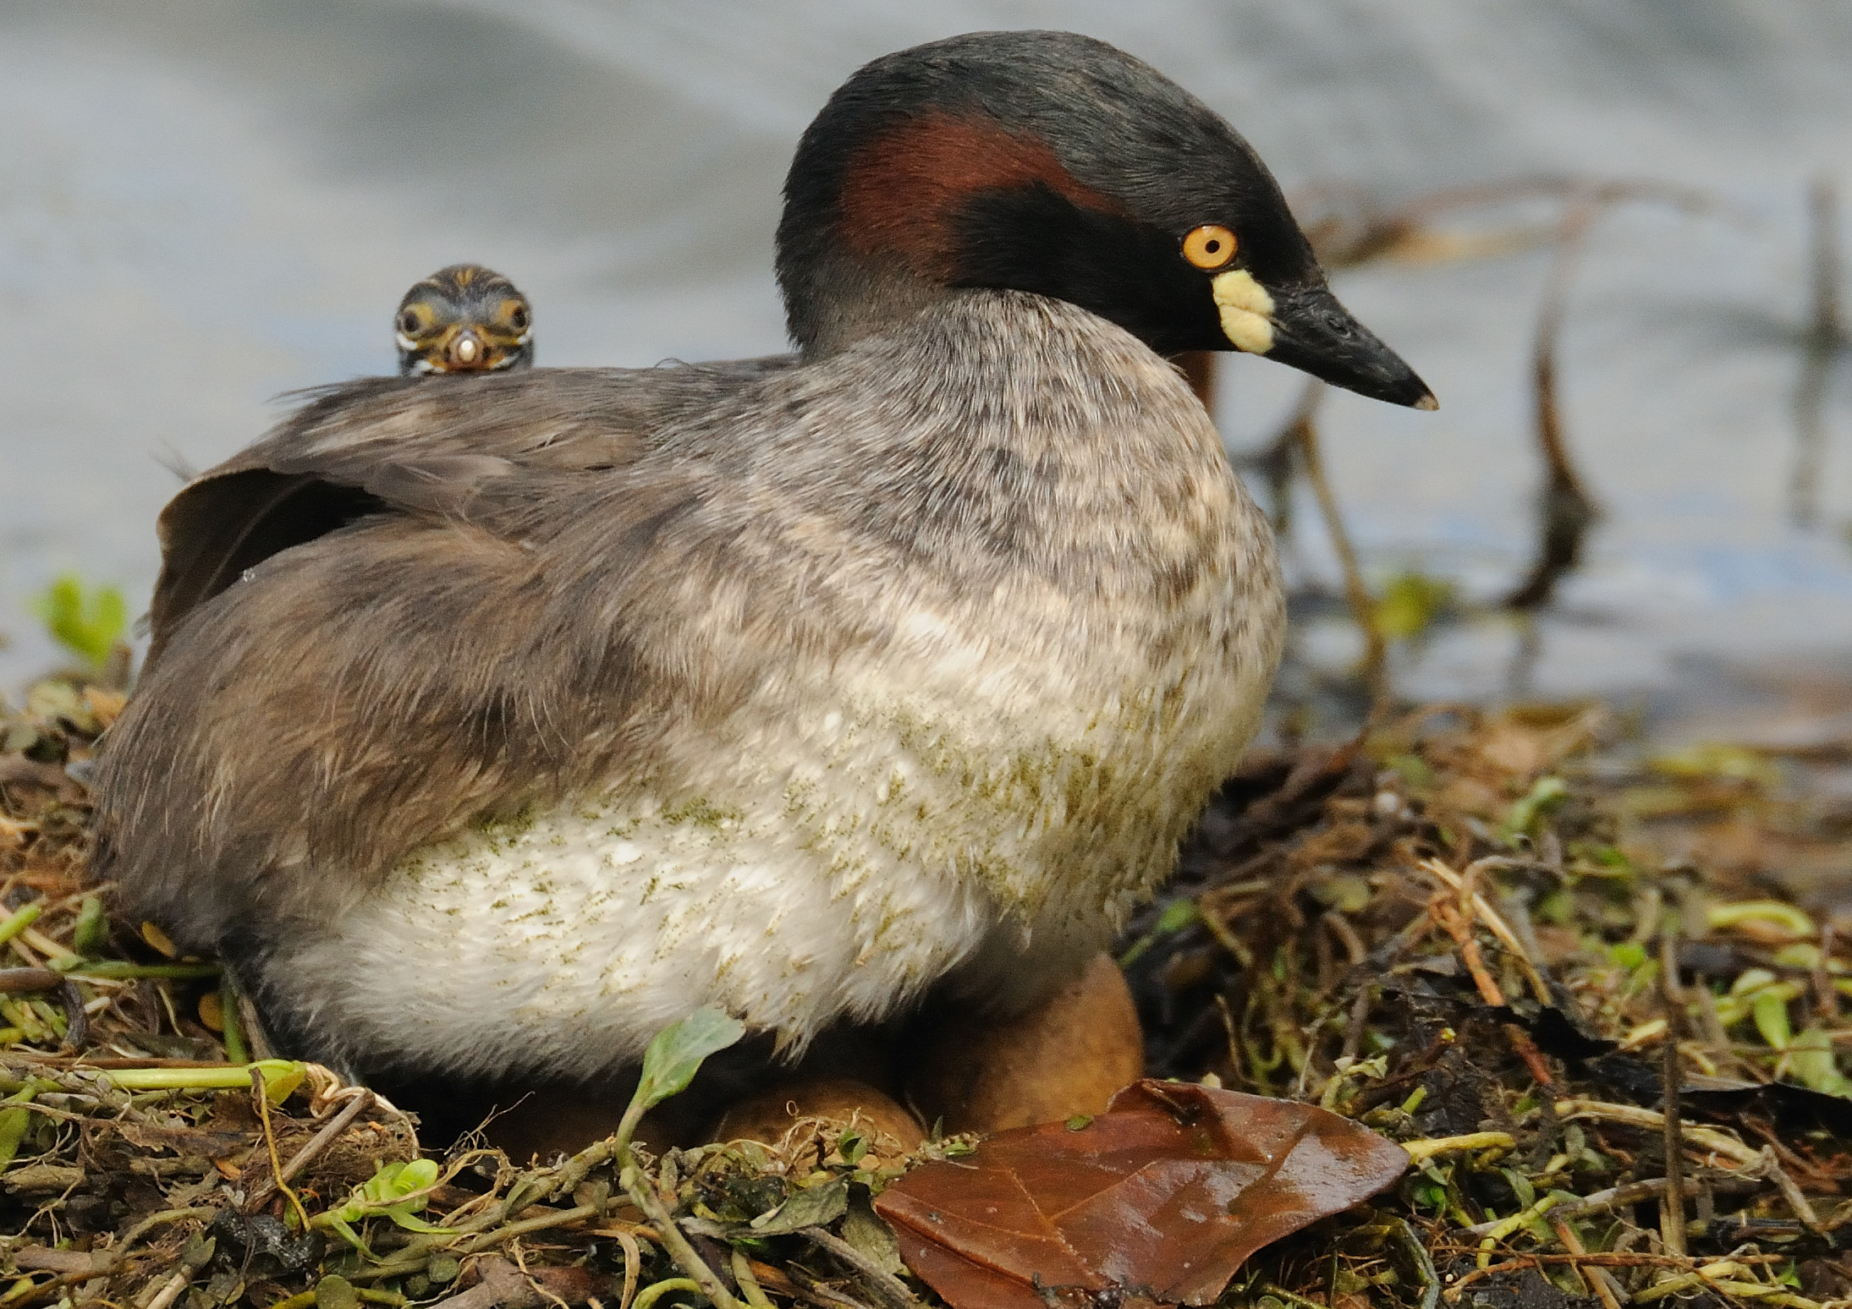

Slide 22
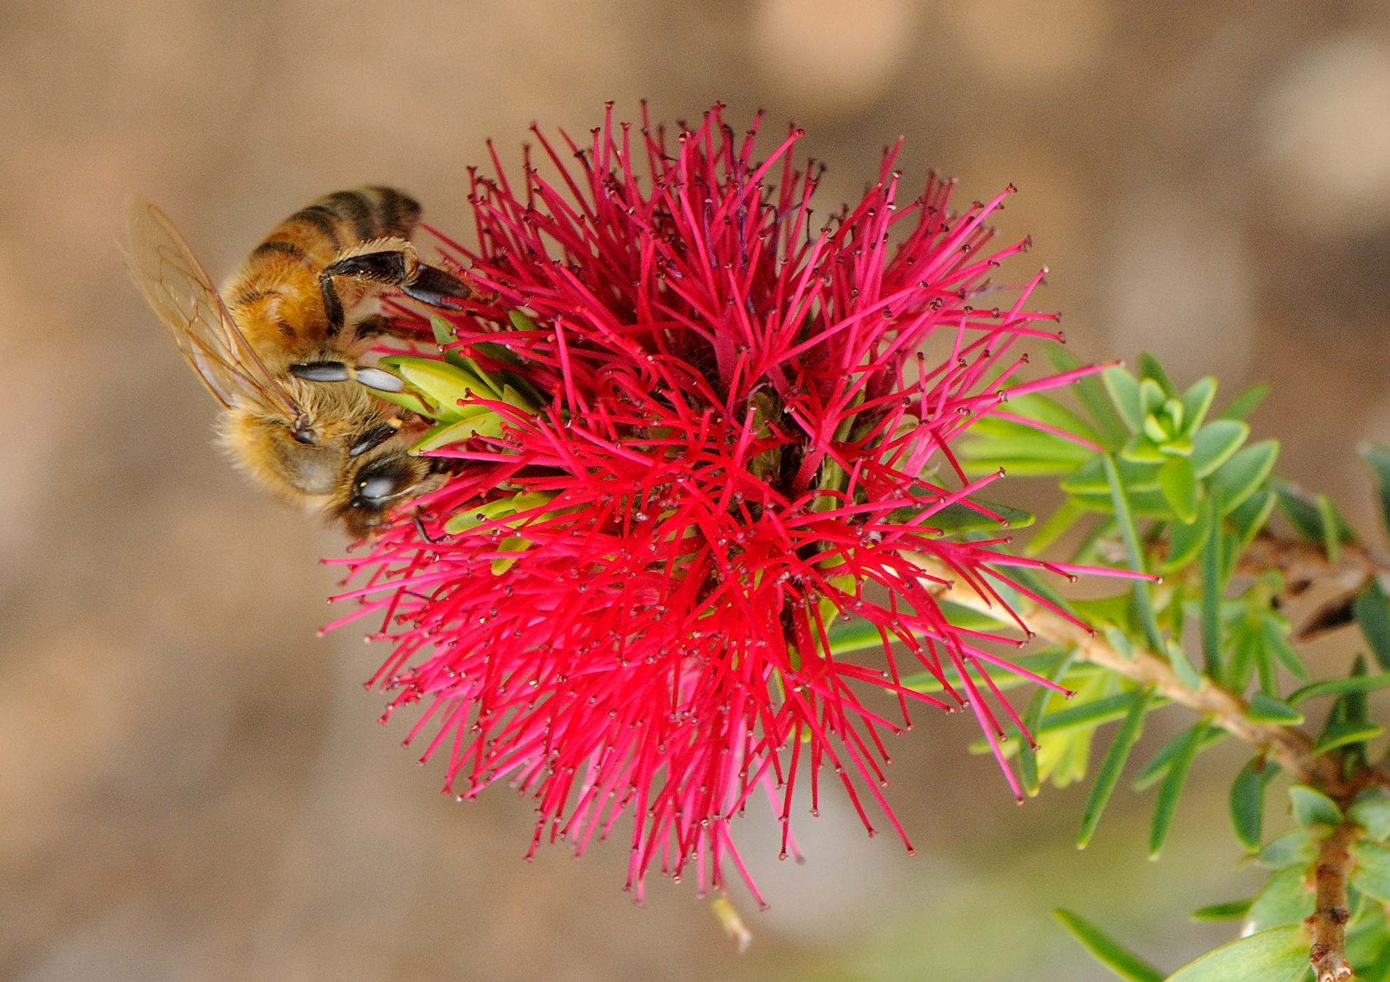

Slide 23
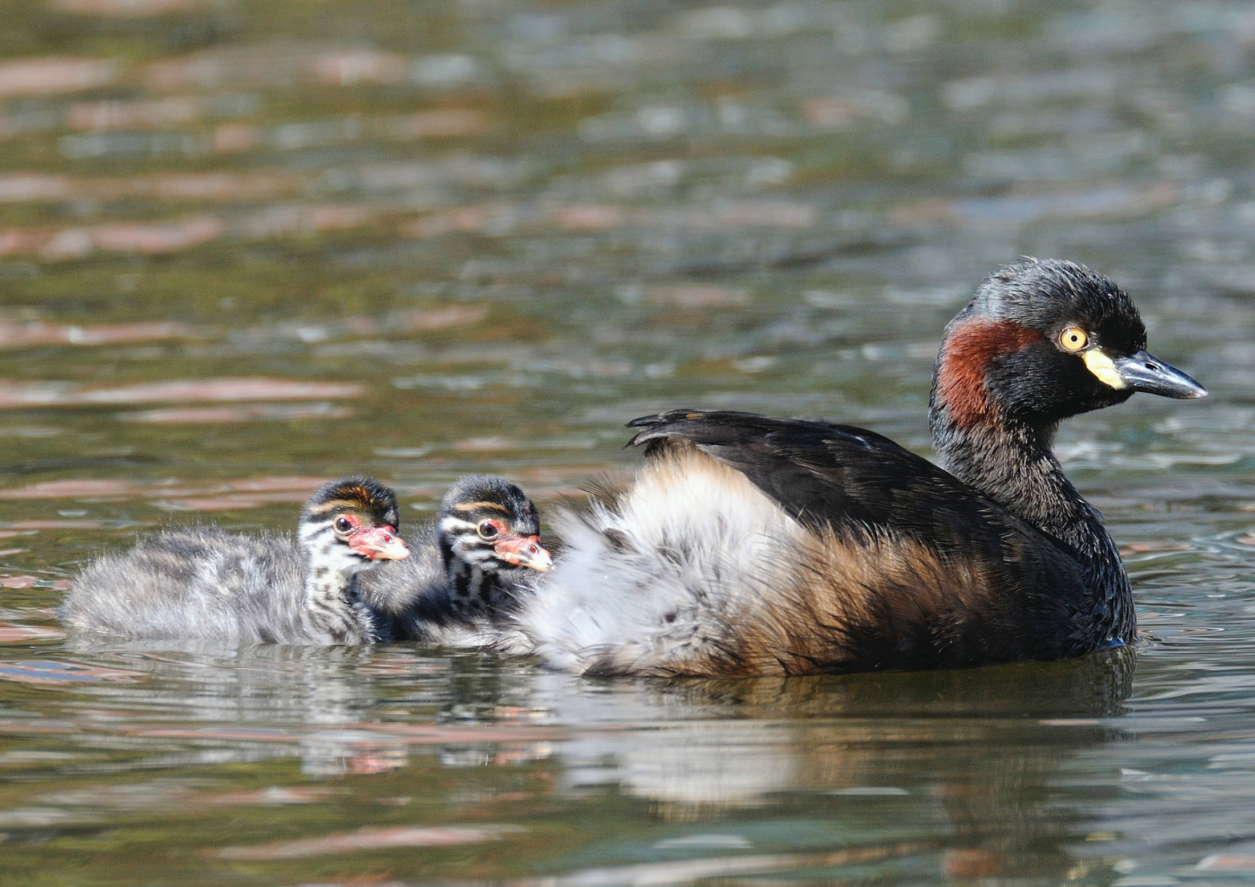

Slide 24
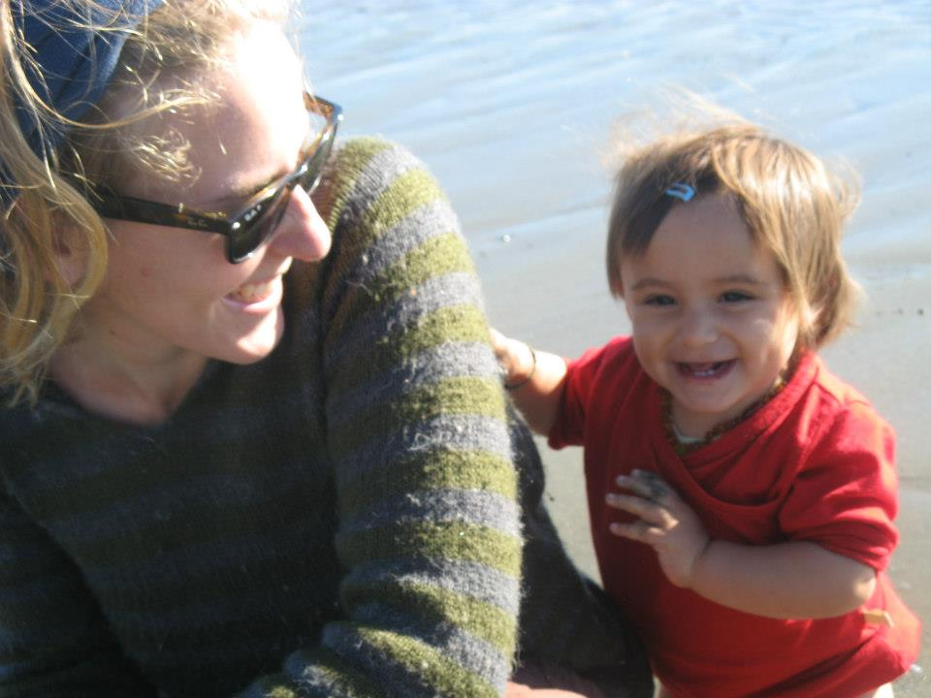
To know those arms around you
and to make your home in the world
just by being wanted.

Slide 25
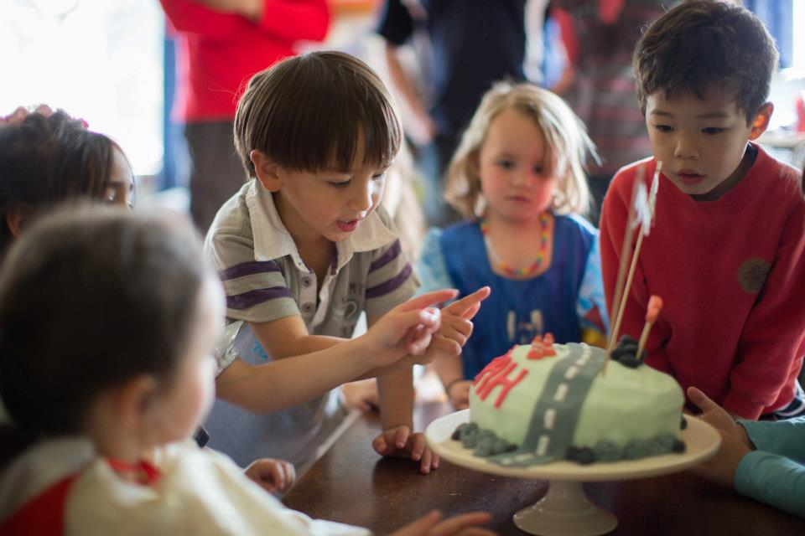

Slide 26
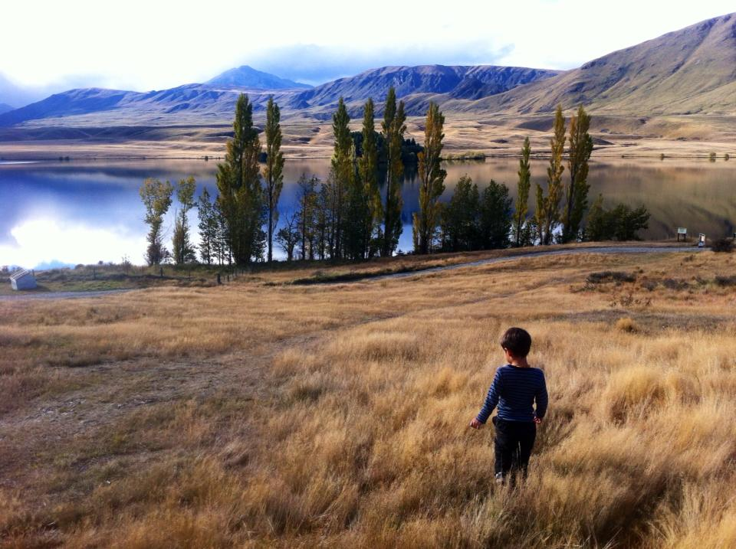

Slide 27
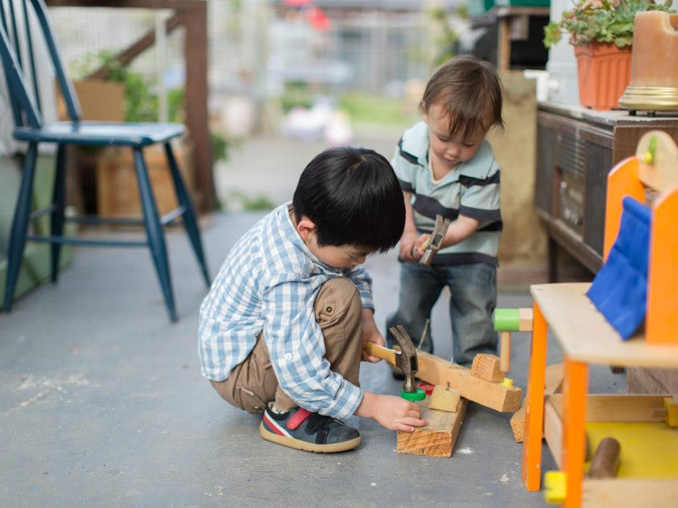

Slide 28
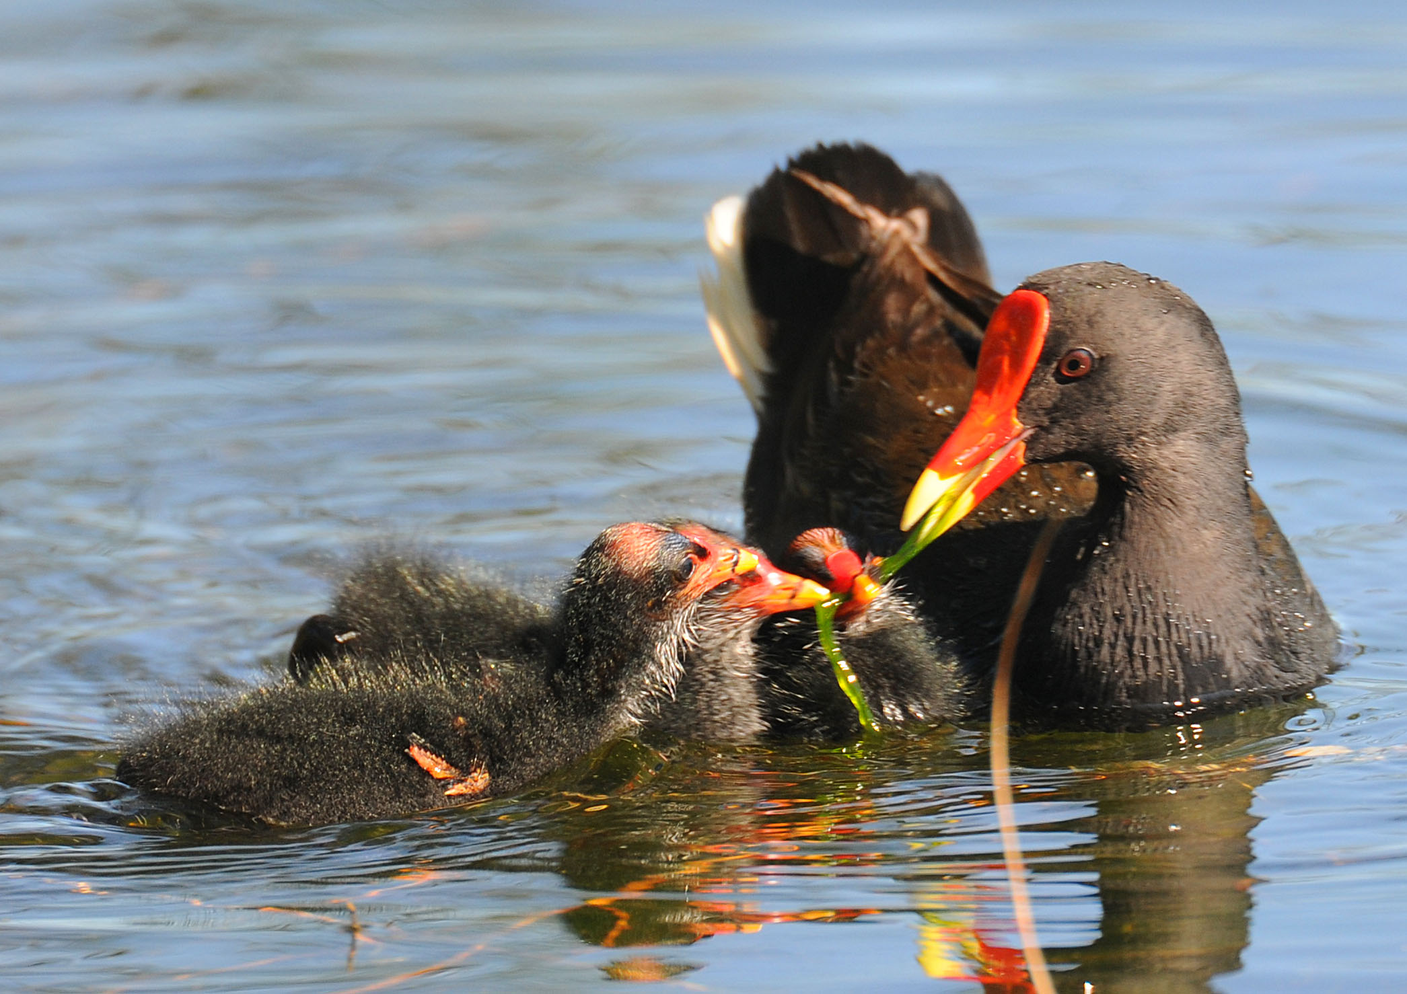
To see those eyes looking back at you,
as eyes should see you at last,

Slide 29
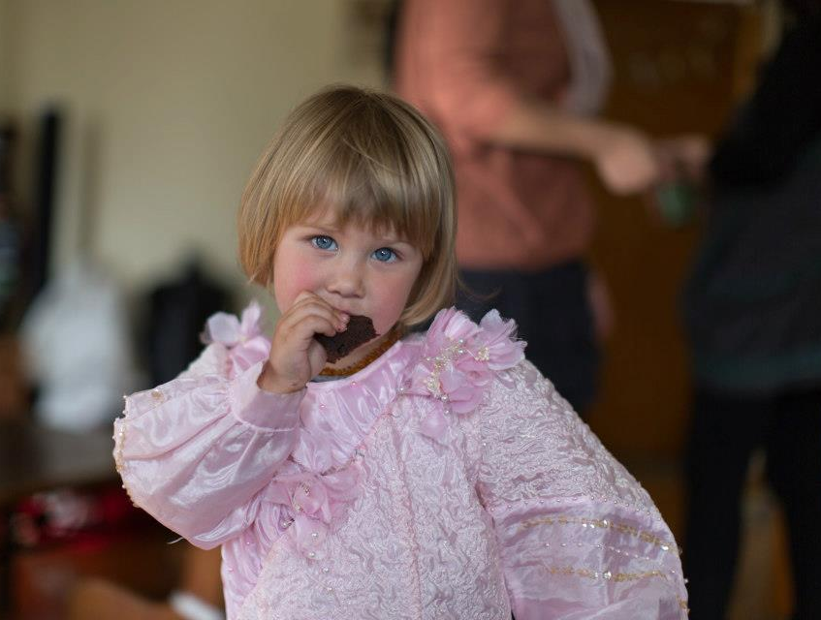

Slide 30


Slide 31
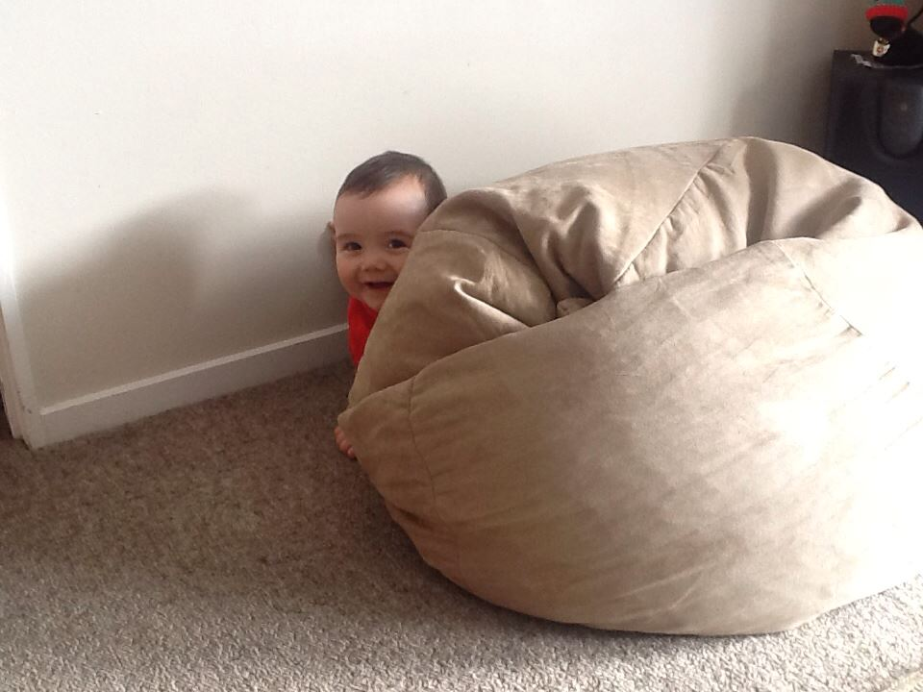

Slide 32
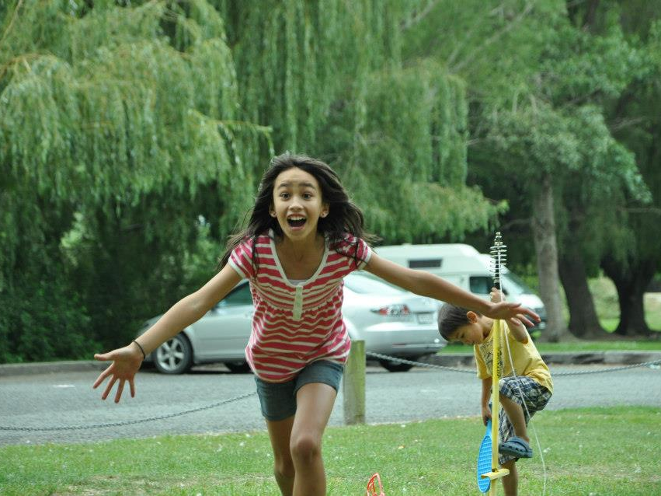
seeing you, as you always wanted to be seen,
seeing you, as you yourself
had always wanted to see the world.

Slide 33
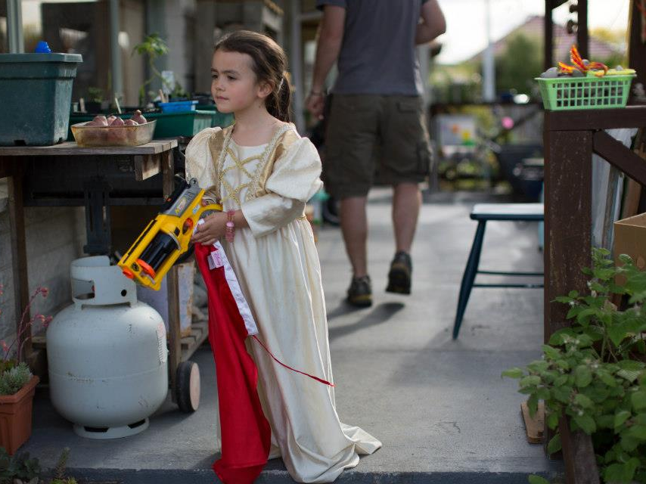

Slide 34
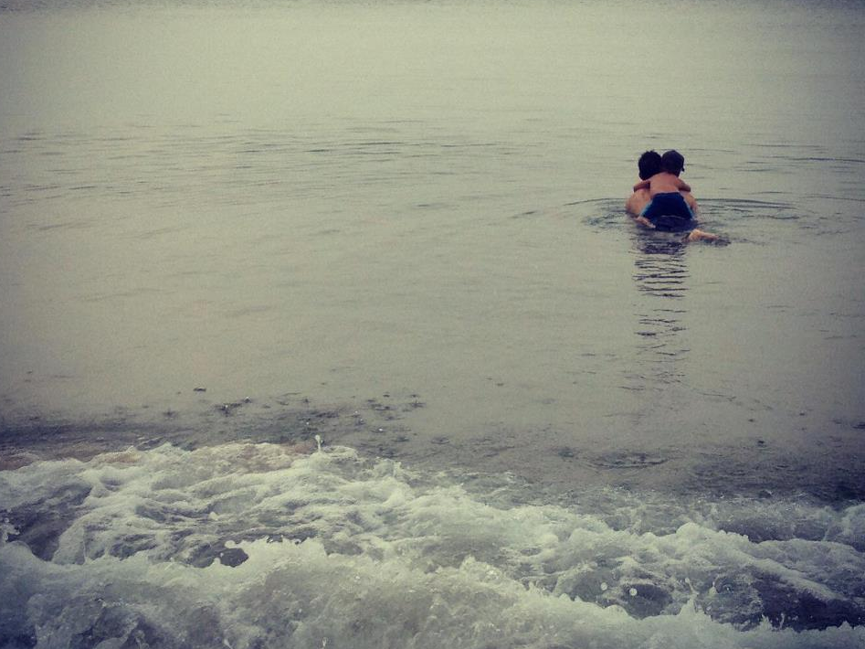

Slide 35
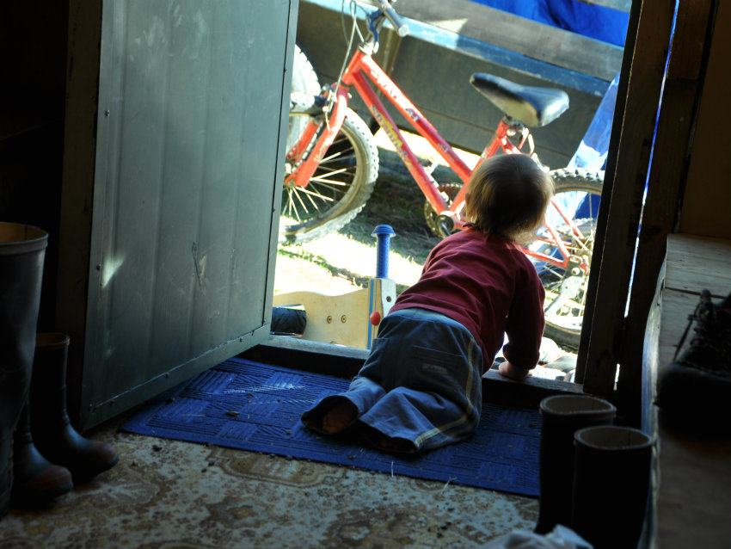

Slide 36
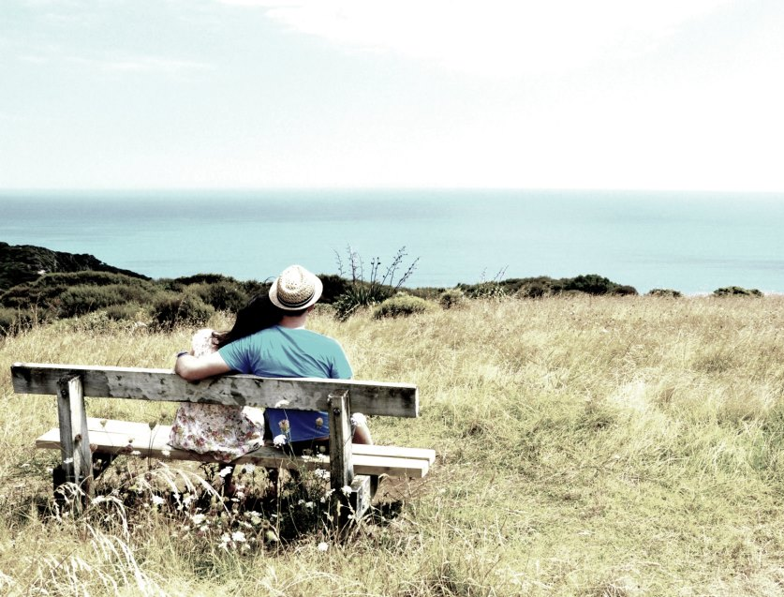

Slide 37
We acknowledge with gratitude
Poetry by
David Whyte, SECOND SIGHT in Pilgrim.
Many Rivers Press, Langley WA. 2012: 87

Slide 38
Photography by
Karen Scott rsj
Zak Holland
Fern Kelly
Shirley Holland
Andrea Holland Castaneda
Hayden Melville
Ann Gilroy rsj
Music
Cello Concerto in E minor, Op 85 Adagio

Slide 39
Presentation by
Ann L Gilroy rsj

