Slide 1
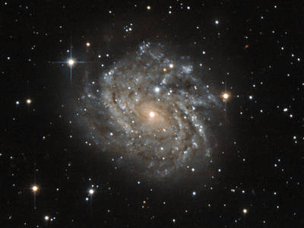

Slide 2
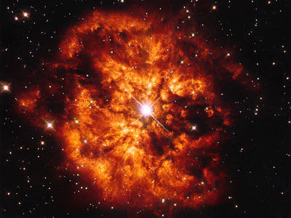
O Wisdom

Slide 3
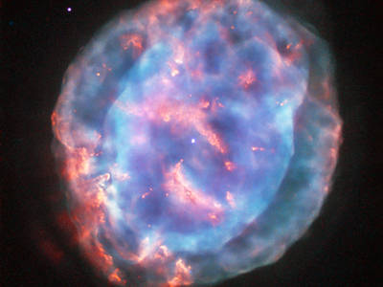
O Wisdom of our God Most High,

Slide 4
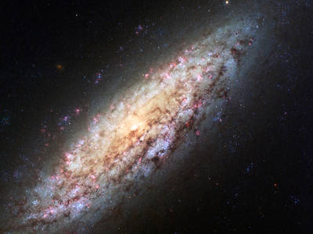
Guiding creation

Slide 5

Guiding creation with power and love

Slide 6
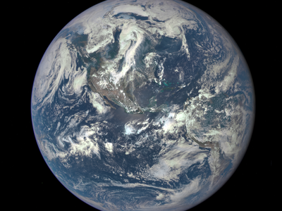
come to teach us

Slide 7
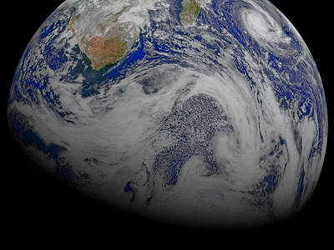
teach us the path of knowledge!

Slide 8
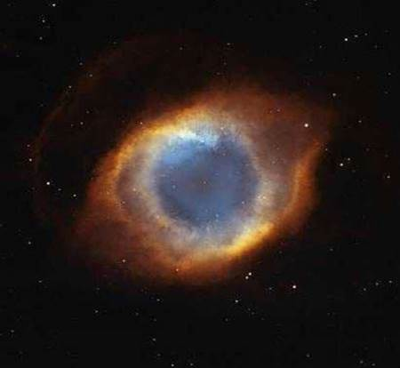
O Wisdom of our God Most High, guiding creation with power and love: come to teach us the path of knowledge!

Slide 9
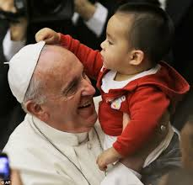
O Leader

Slide 10
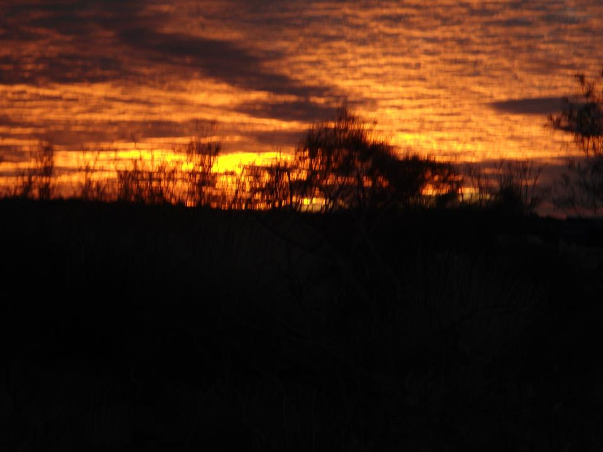
O Leader of the House of Israel

Slide 11
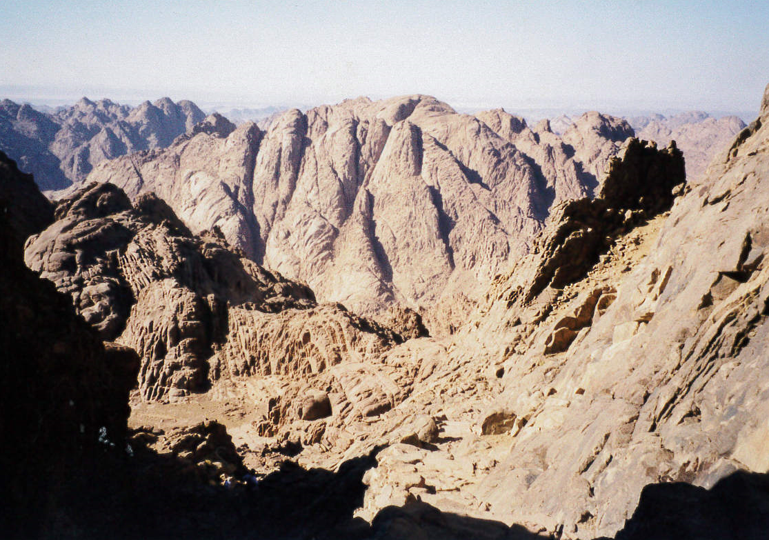
Giver of the Law to Moses on Sinai

Slide 12
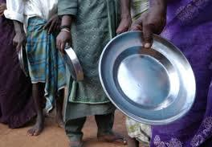
Come to rescue us

Slide 13
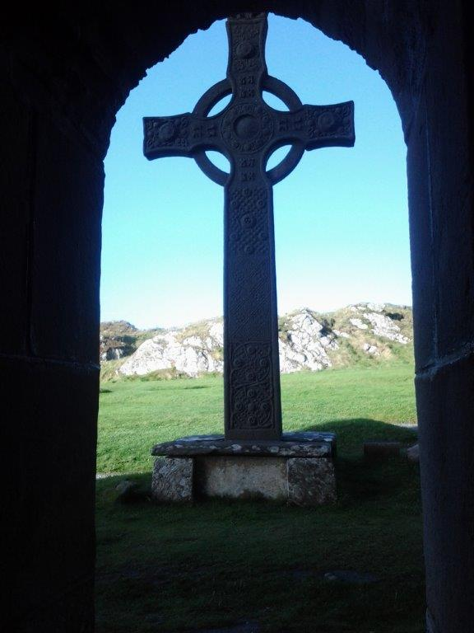
Come to rescue us with your mighty power!

Slide 14
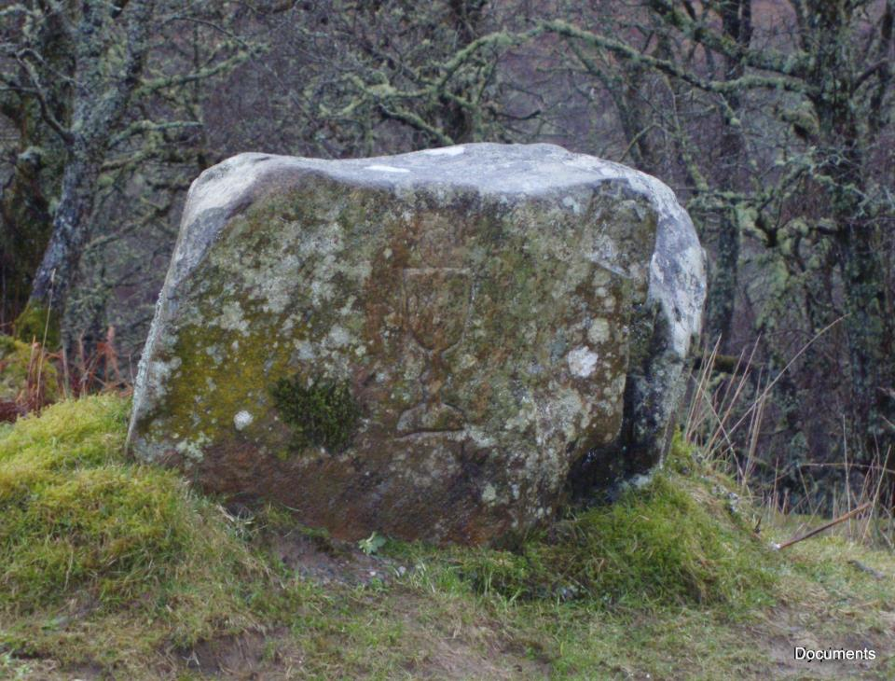
O Leader of the House of Israel, giver of the Law to Moses on Sinai: come to rescue us with your mighty power!

Slide 15
Acknowledgments and
Copyright
PowerPoint created by Niesha Allport rsj
Space images - NASA used with permission
Photos: Niesha Allport rsj, Anne Bond rsj,
Colleen Keeble rsj, Maria Hennekam rsj and
Public Domain Web images

