Slide 1
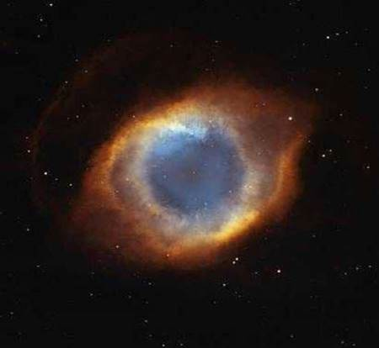

Slide 2
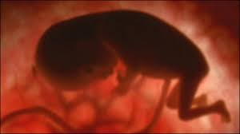
O Root of Jesse’s stem,

Slide 3
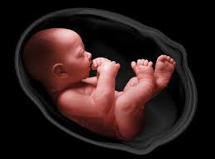
Sign of God’s love

Slide 4
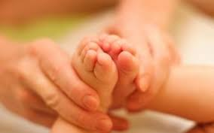
Sign of God’s love for all people

Slide 5
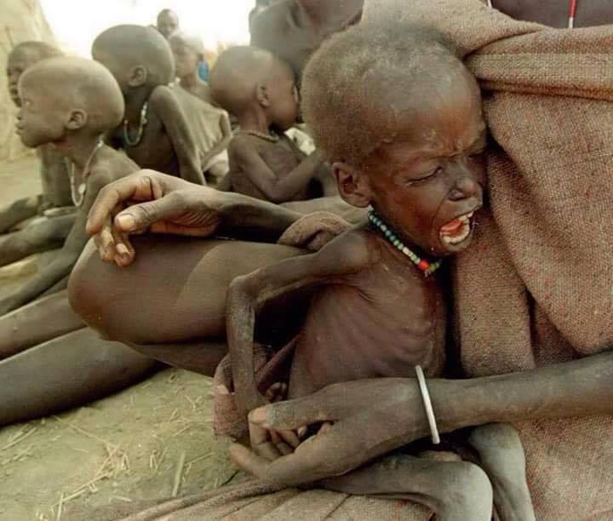
Come to save us

Slide 6
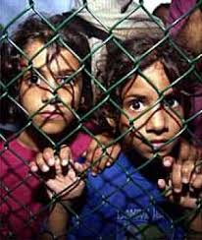
Come to save us without delay!

Slide 7
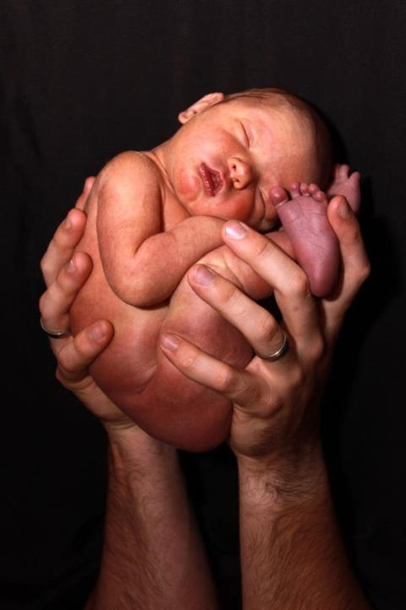
O Root of Jesse’s stem, sign of God’s love for all people: come to save us without delay!

Slide 8
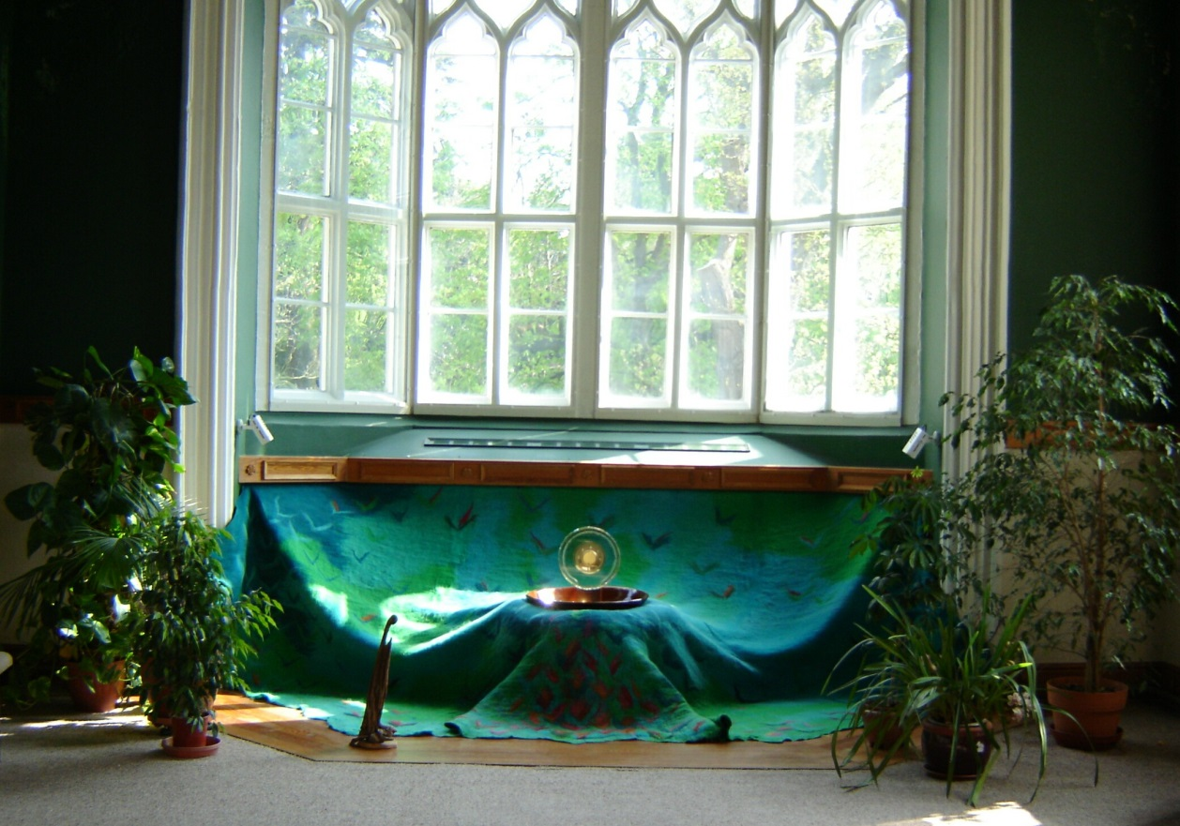
O Key of David

Slide 9
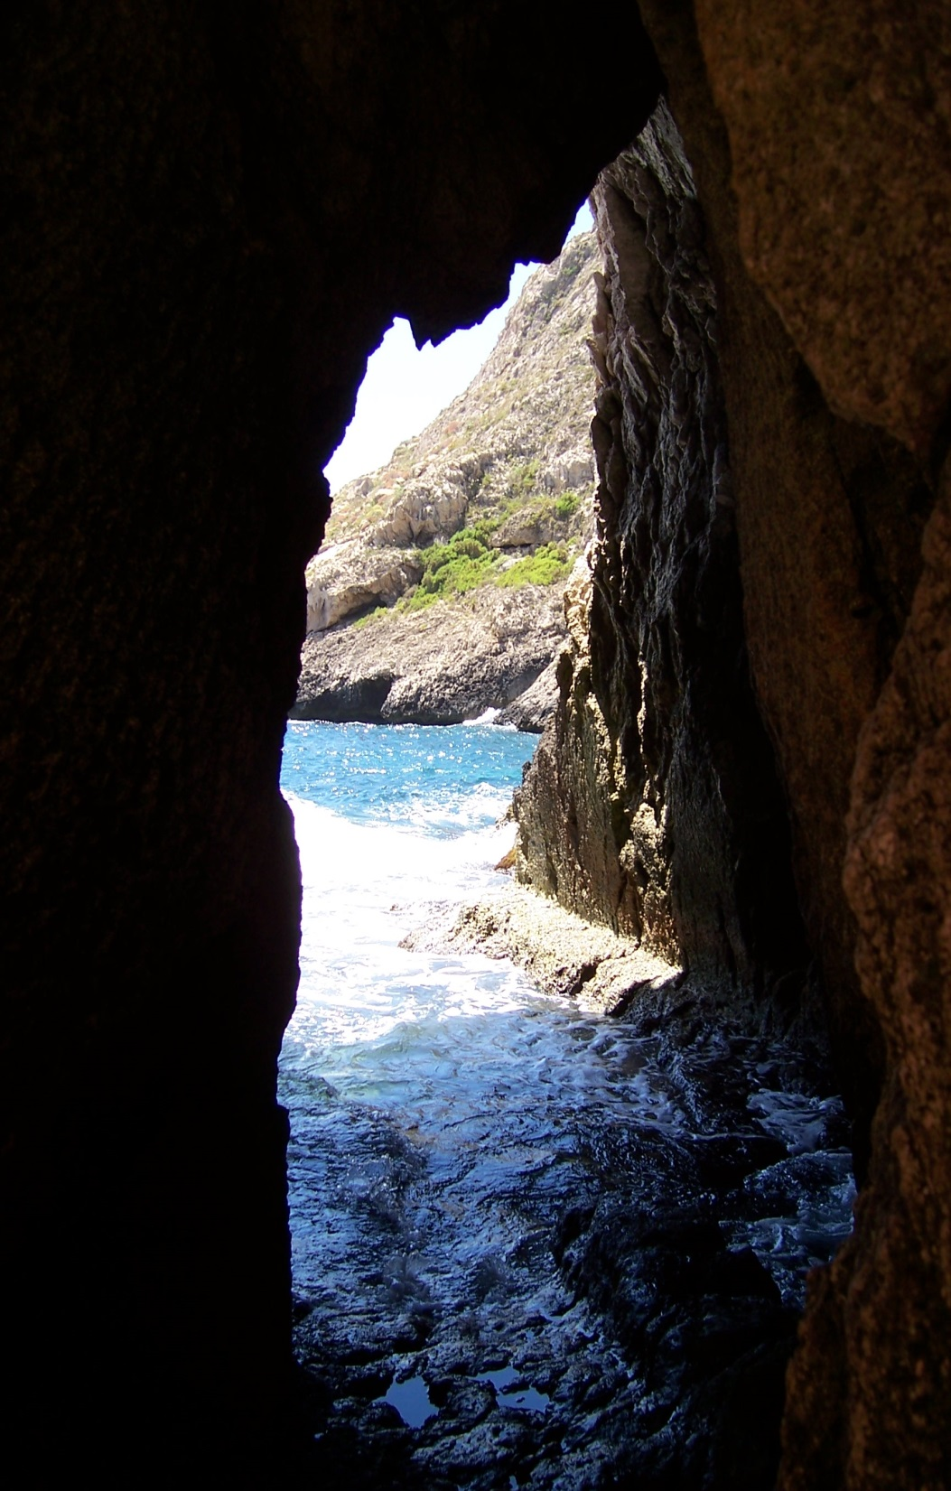
Opening the gates

Slide 10
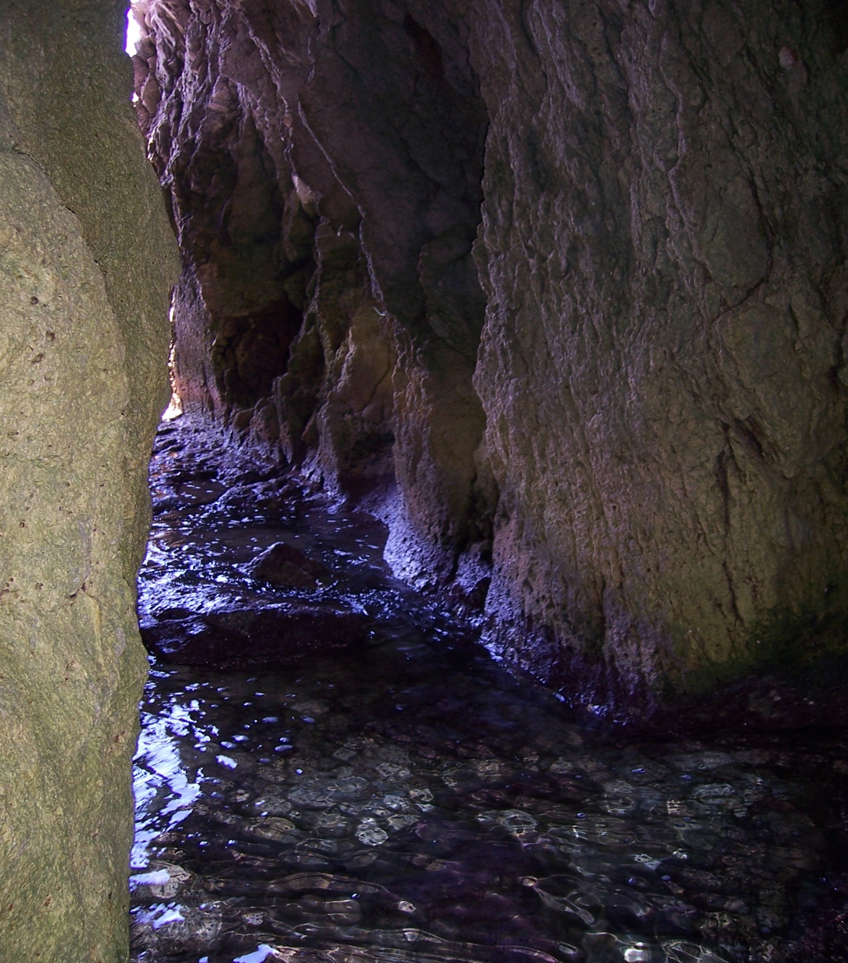
Opening the gates of God’s eternal Kingdom

Slide 11
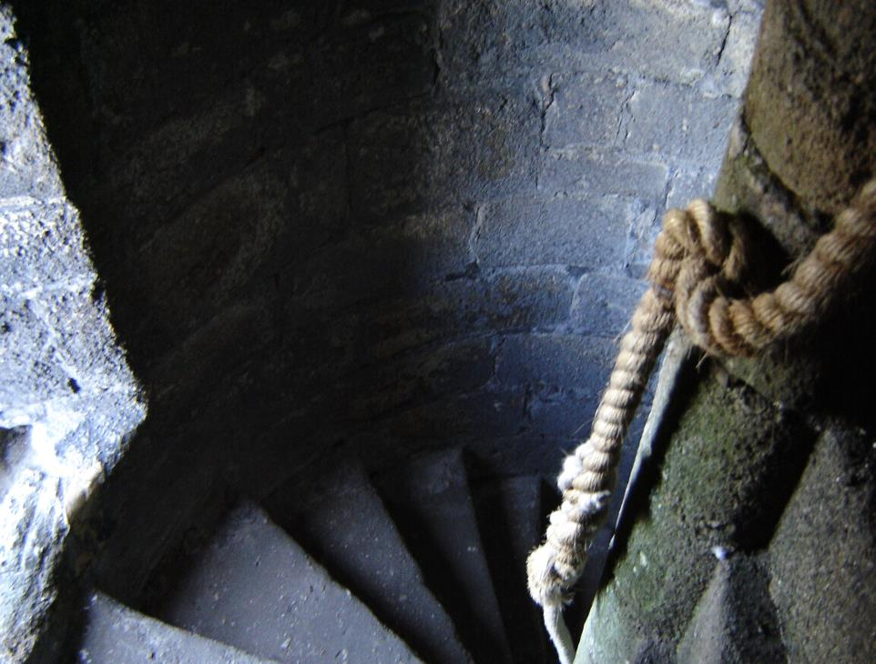
Come

Slide 12
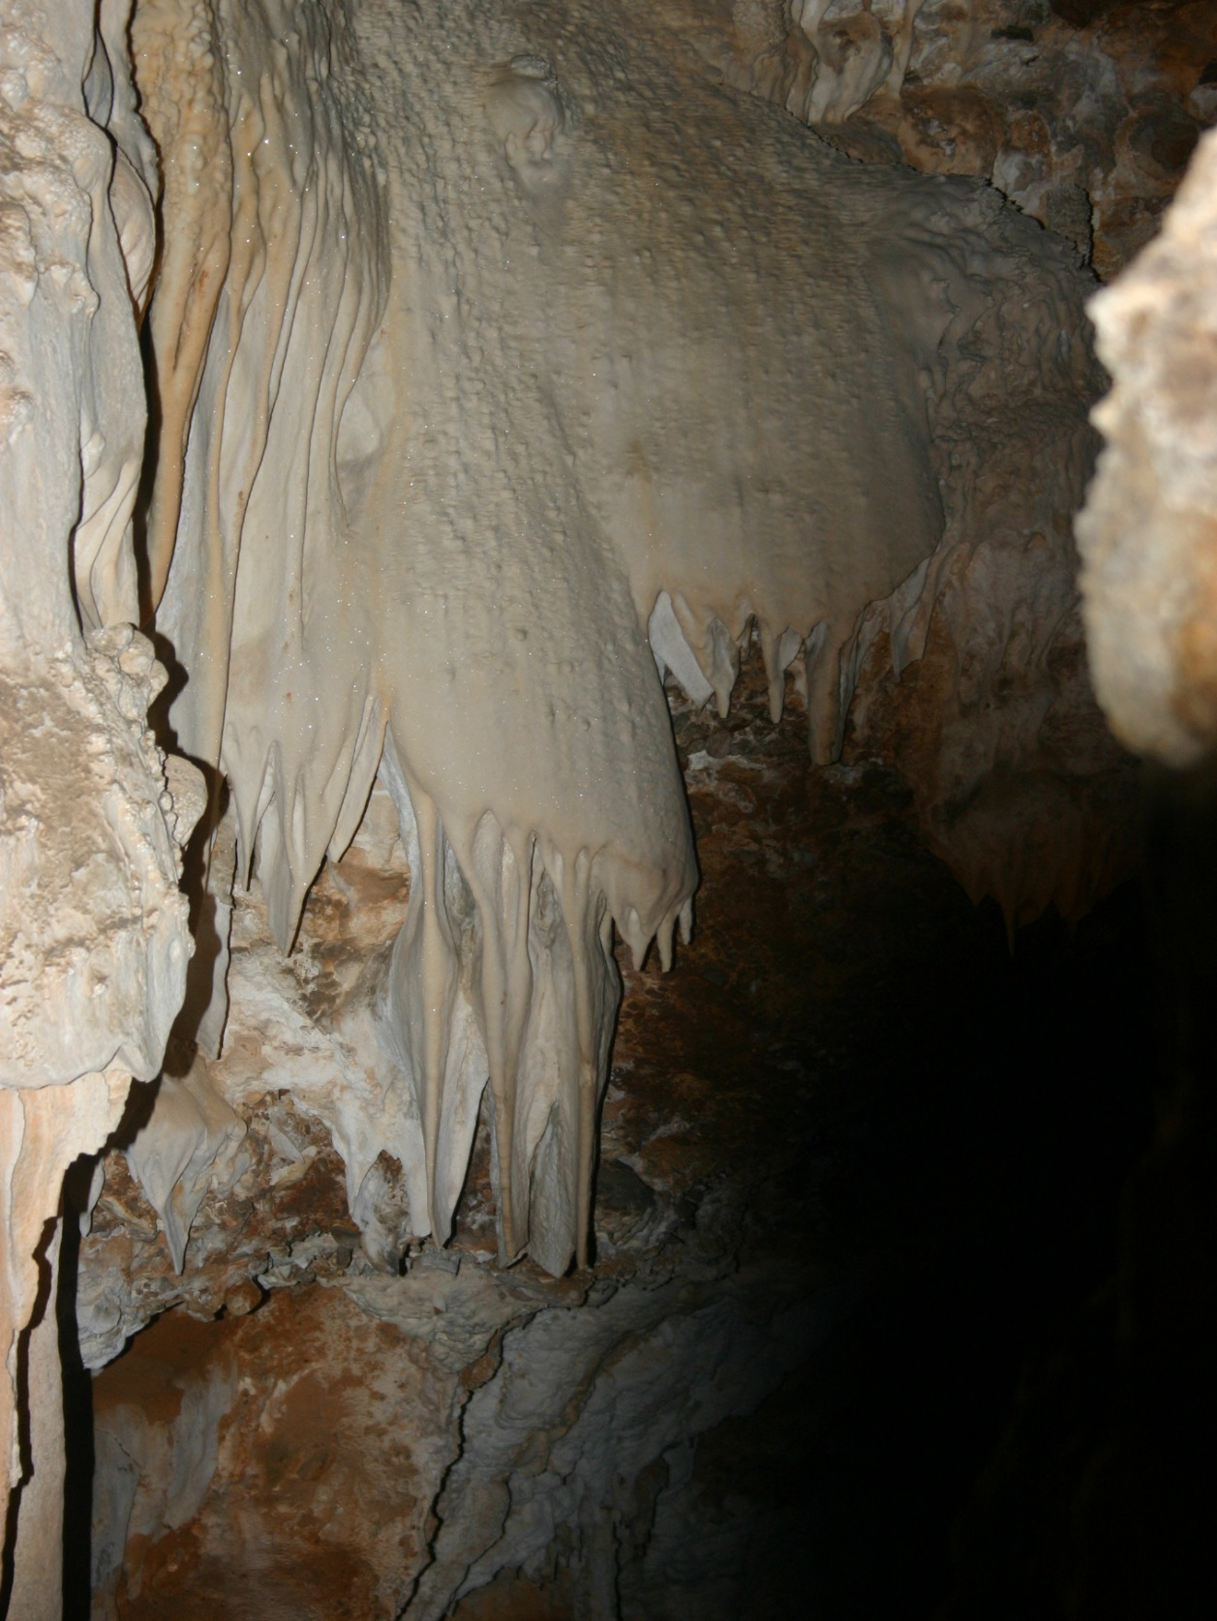
Come and free the prisoners of darkness

Slide 13
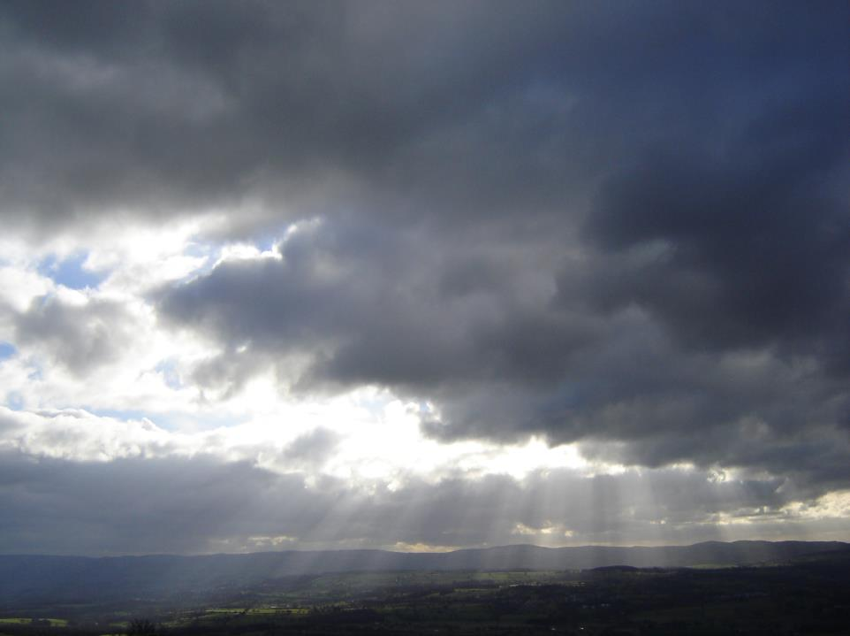
O Key of David, opening the gates of God’s eternal Kingdom: come and free the prisoners of darkness!

Slide 14
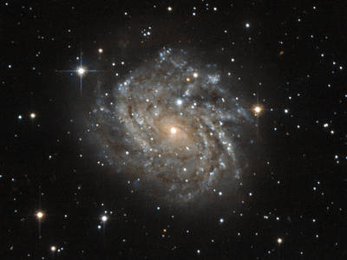
Acknowledgments and
Copyright
PowerPoint created by Niesha Allport rsj
Space images - NASA used with permission
Photos: Niesha Allport rsj, and Public Domain Web images

