Slide 1
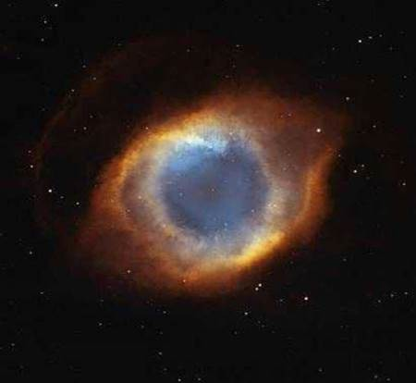

Slide 2
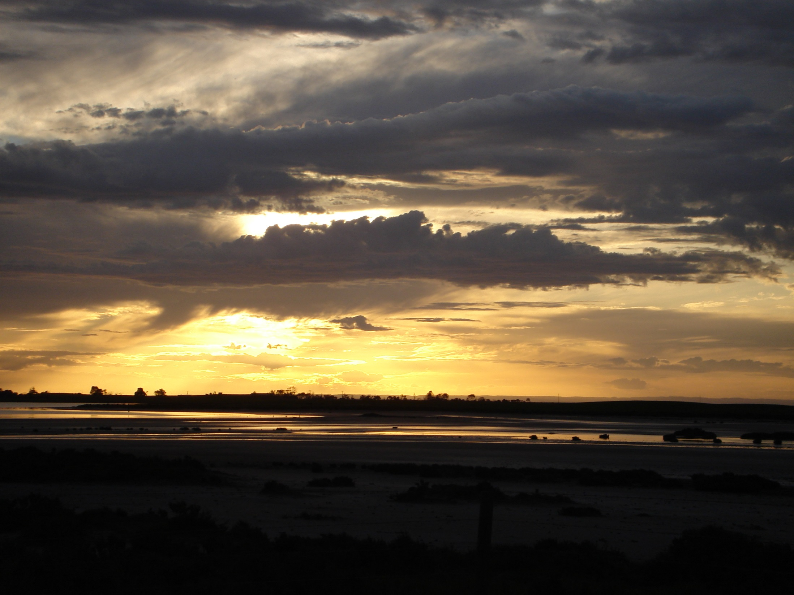
O Radiant Dawn

Slide 3
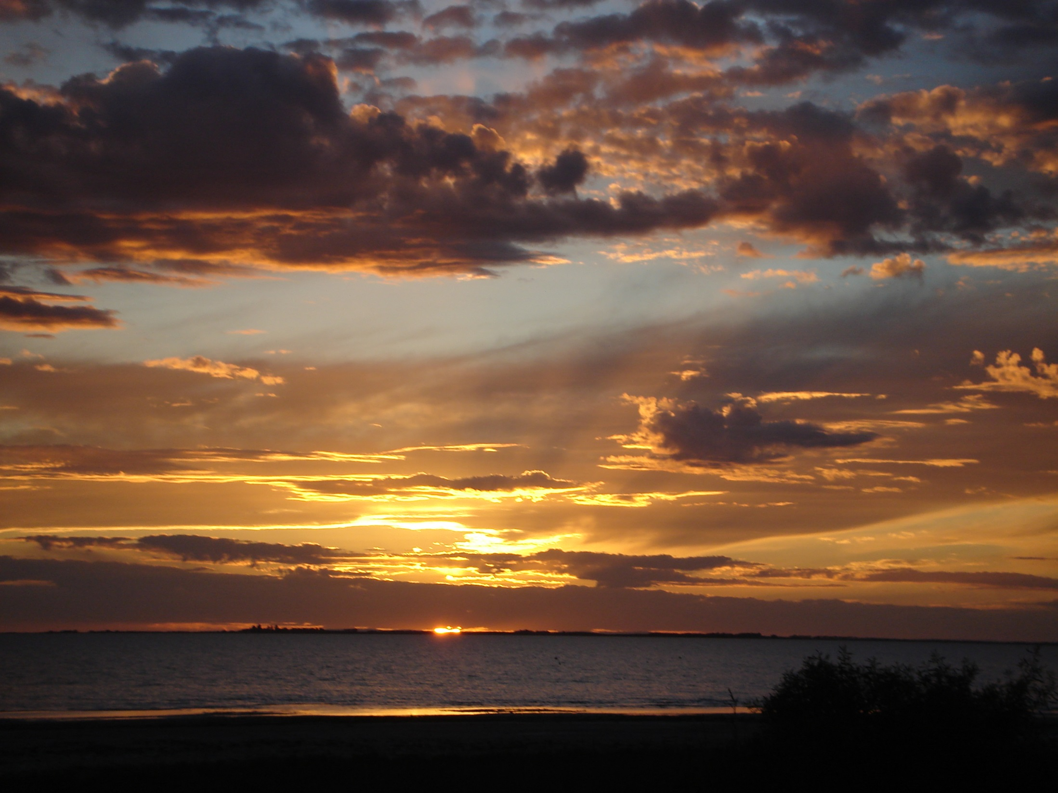
Splendour of eternal light

Slide 4
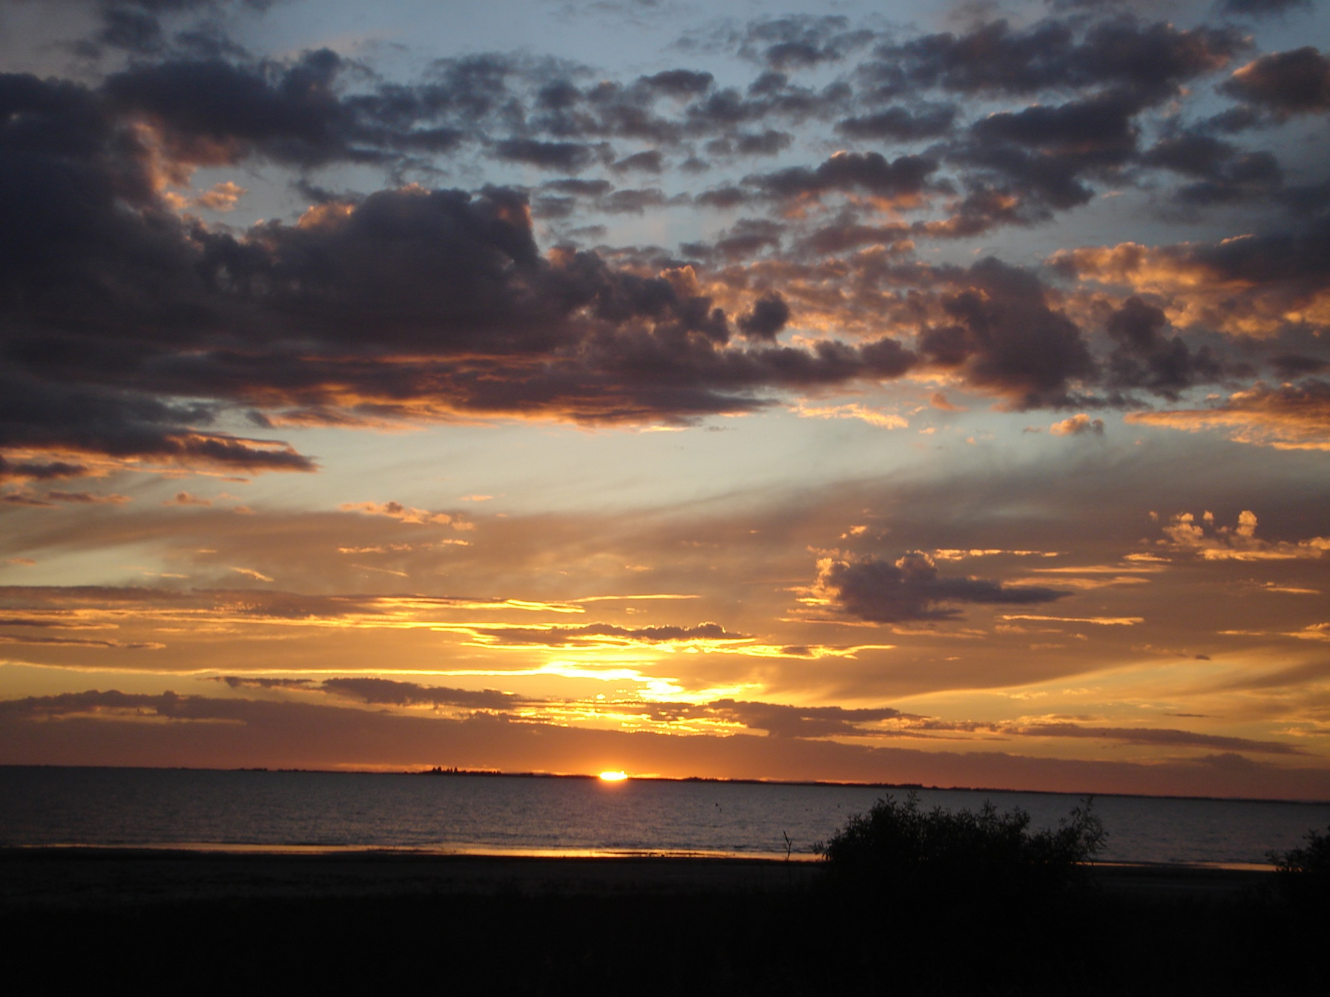
Sun of justice

Slide 5
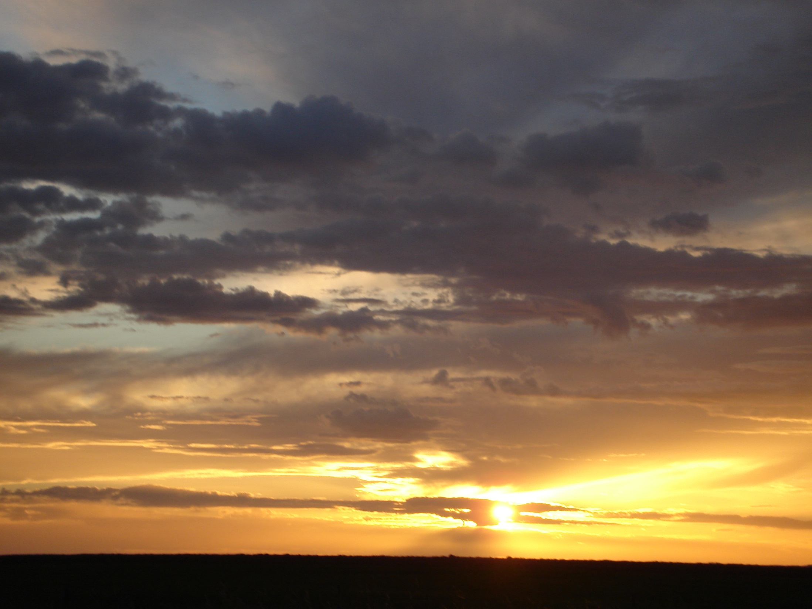
Come and shine

Slide 6
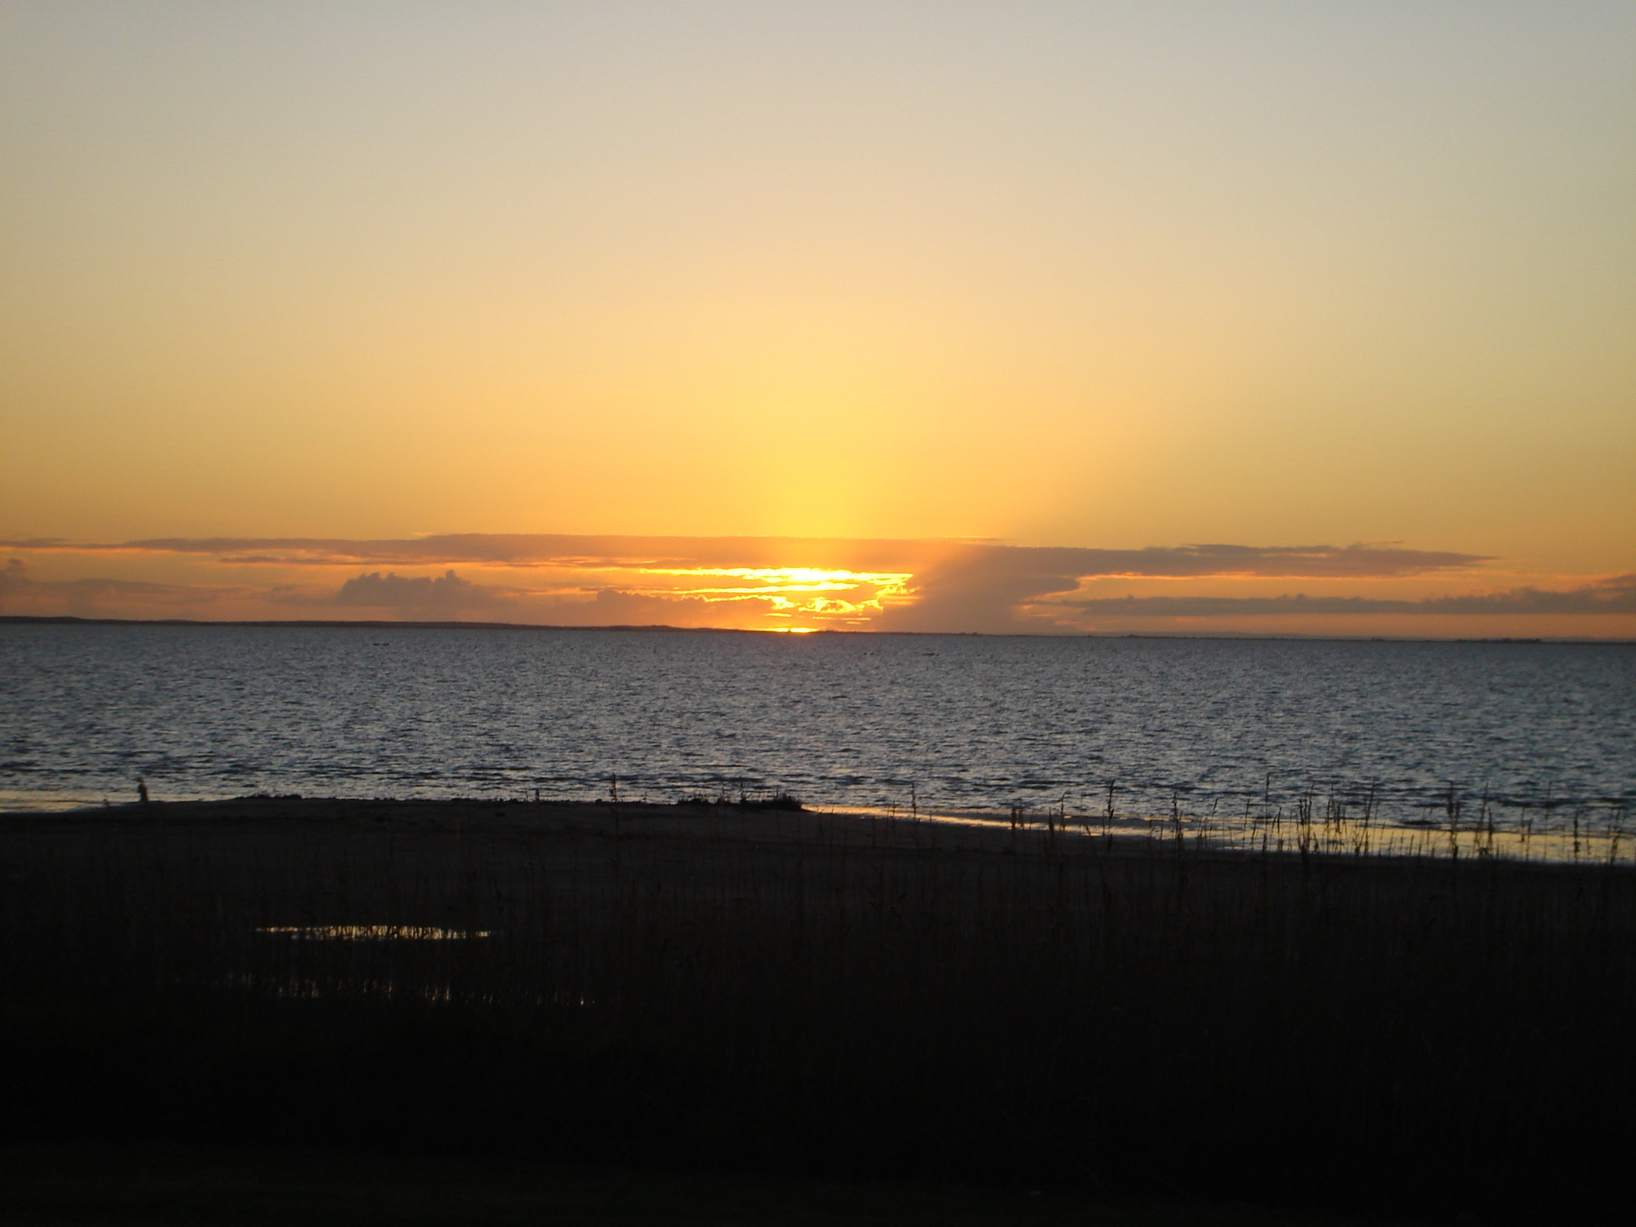
Come and shine on those who dwell in darkness

Slide 7

Come and shine on those who dwell in darkness and in the shadow of death

Slide 8
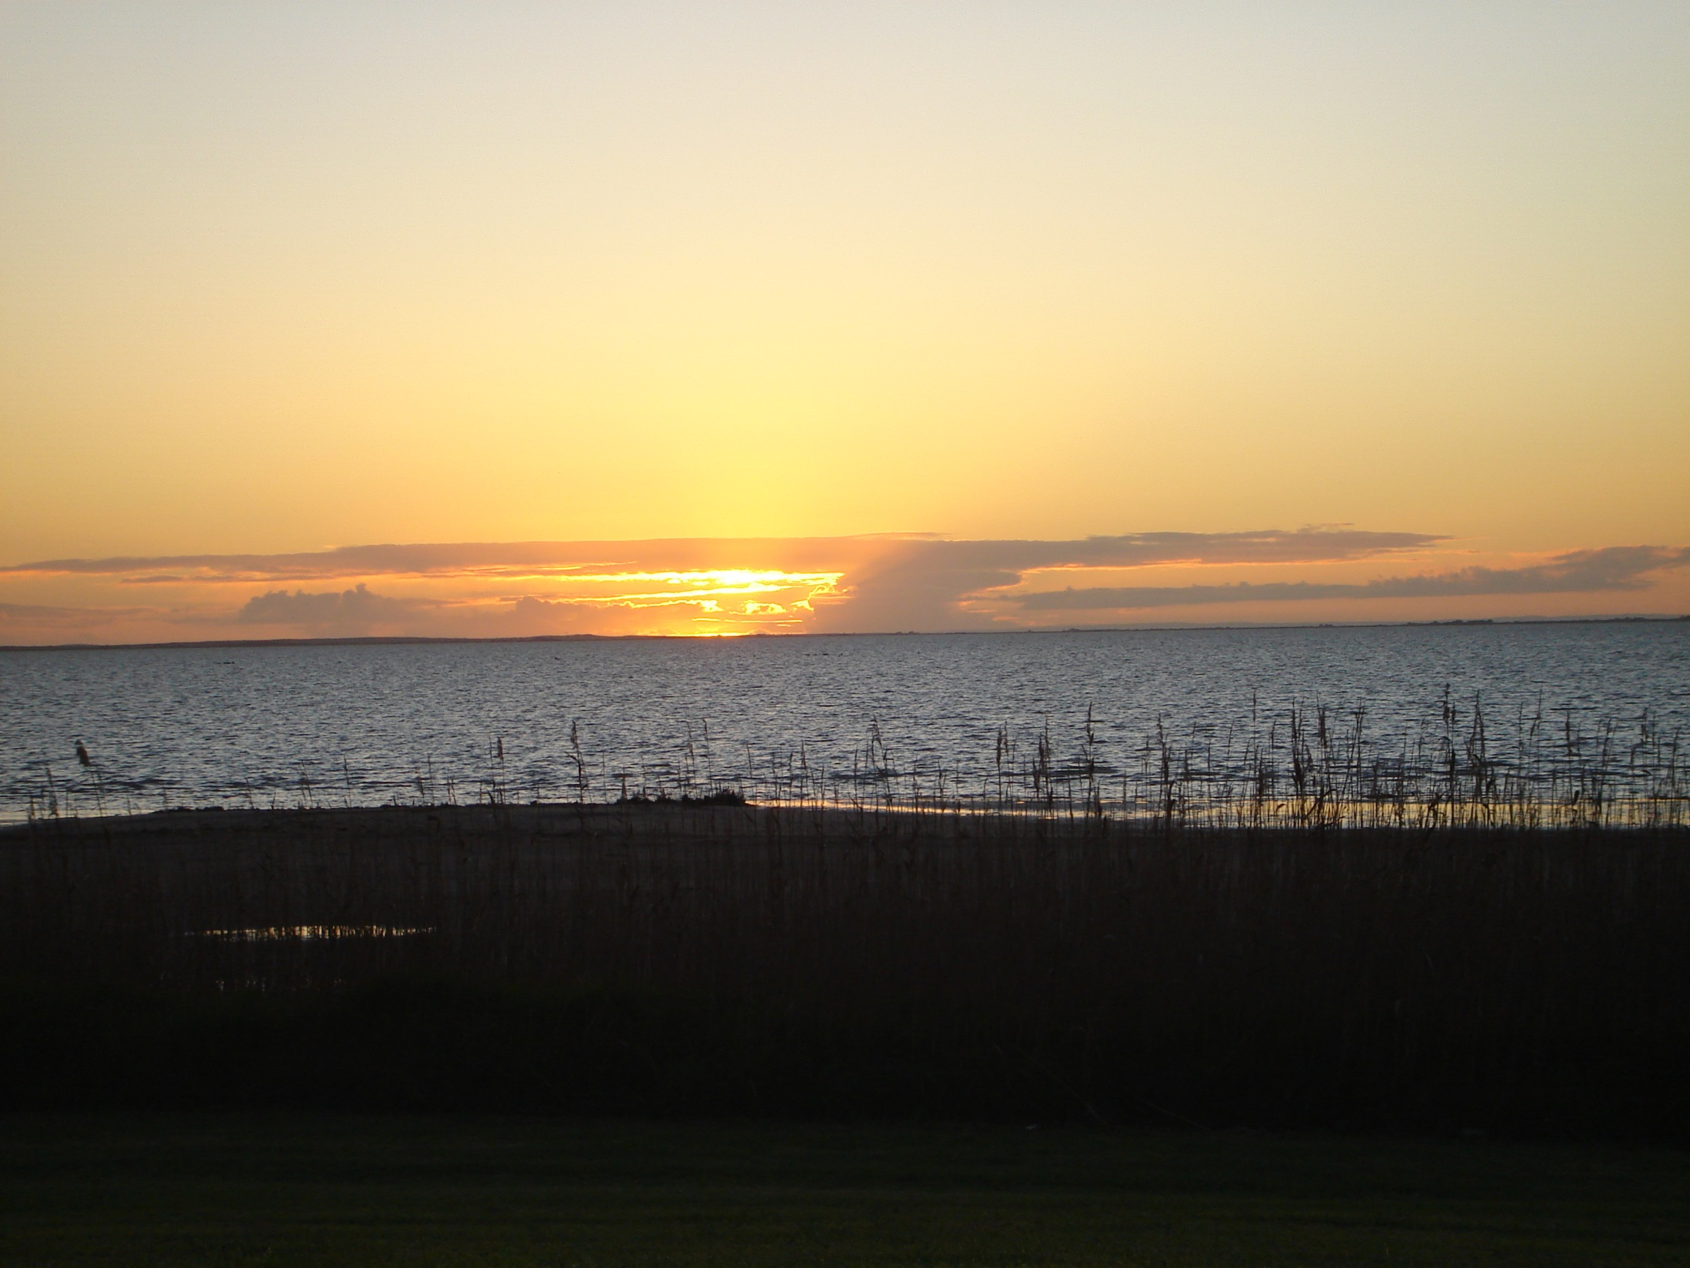
O Radiant Dawn, splendour of eternal light, sun of justice: come and shine on those who dwell in darkness and in the shadow of death.

Slide 9
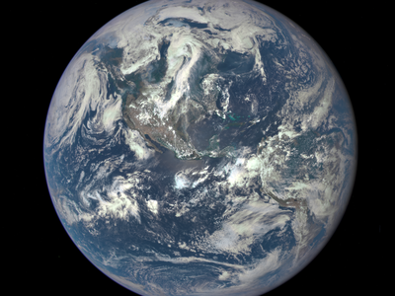
O King of all nations

Slide 10

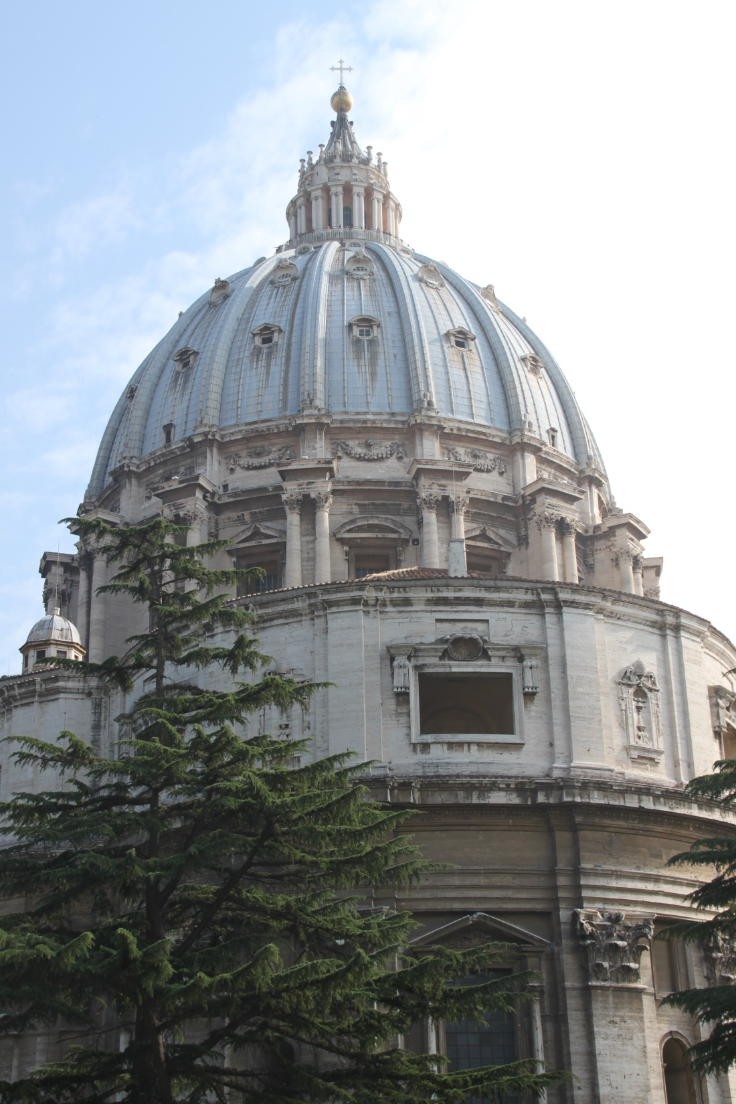
Keystone of the Church

Slide 11
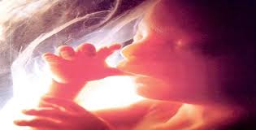
Come and save us

Slide 12
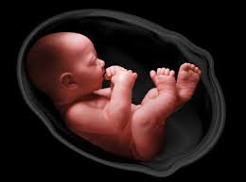
Come and save us, whom you formed from the dust!

Slide 13
O King of all nations and keystone of the Church: come and save us, whom you formed from the dust!

Slide 14
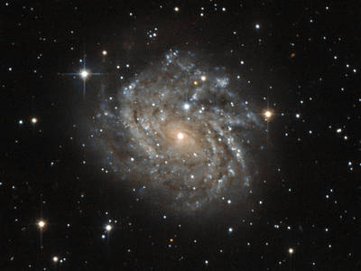
Acknowledgments and
Copyright
PowerPoint created by Niesha Allport rsj
Space images - NASA used with permission
Photos: Niesha Allport rsj, Anne Bond rsj,
Maria Hennekam rsj and Public Domain Web images

