Slide 1
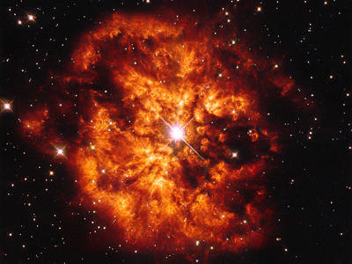

Slide 2
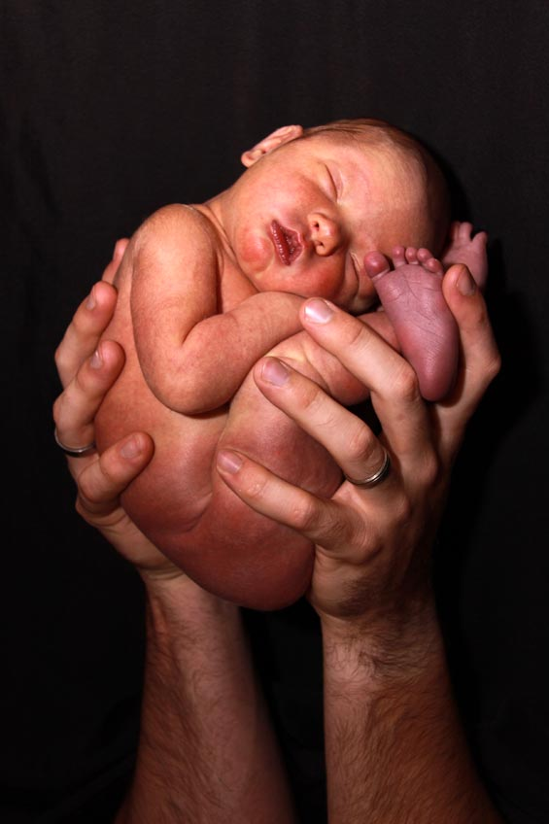
O Emmanuel

Slide 3
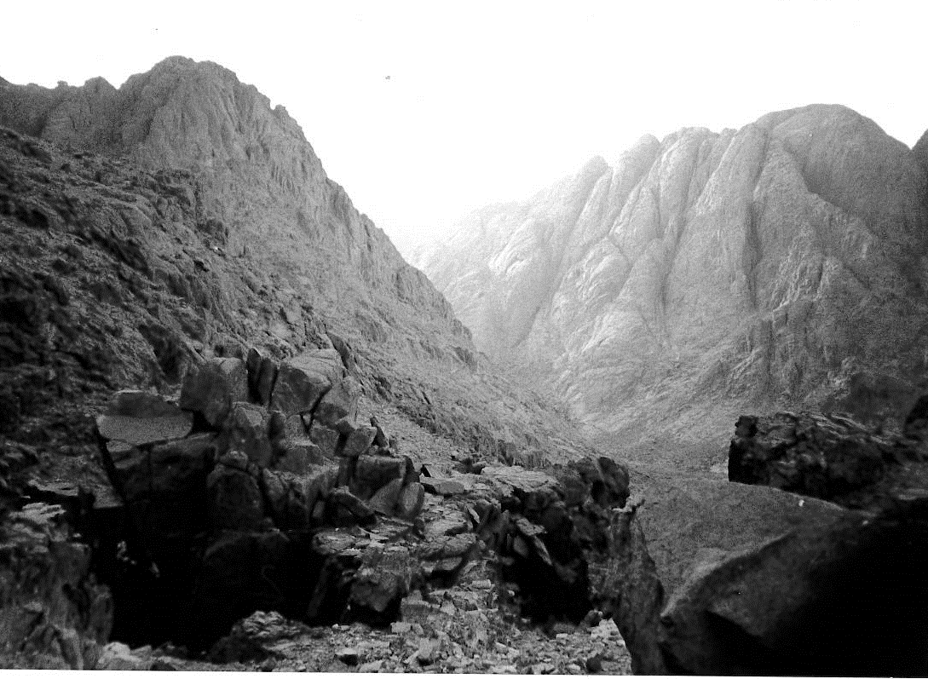
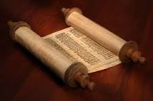
O King and
Giver of Law

Slide 4

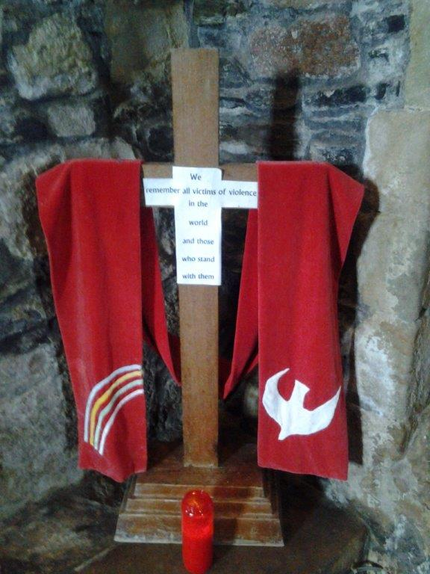
Come to save us

Slide 5
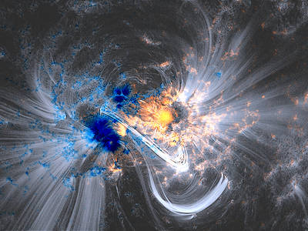
Save us Lord our God

Slide 6

O Emmanuel, our King and Giver of Law: come to save us, Lord our God!

Slide 7
Acknowledgments and
Copyright
PowerPoint created by Niesha Allport rsj
Space images - NASA used with permission
Photos:, Anne Bond rsj, Colleen Keeble rsj,
Maria Hennekam rsj, Sandy Leaitua and
Public Domain Web images

