Slide 1
Awakened by the Spirit

Slide 2
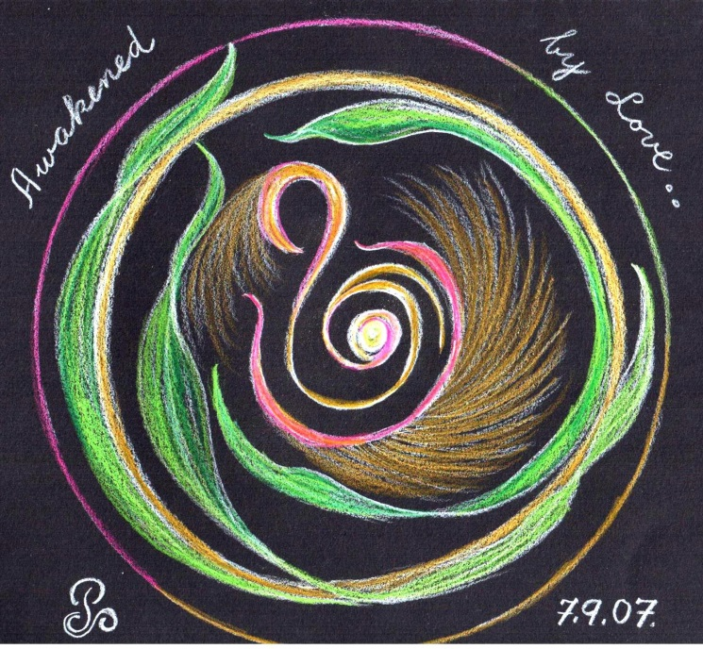
Welcome
To
Day One
(Move on when ready.)

Slide 3
A time of
Being awakened by
The Spirit of LOVE
(Move on when ready.)

Slide 4
BE STILL
Sit in the stillness and breath deeply.
Listen to your own breath coming into your own body
and leaving your own body
(Move on when ready.)

Slide 5
Welcome the One
who brings life and hope
into
the whole
of
CREATION.
(Move on when ready.)

Slide 6
Welcome the Spirit
“Come Spirit of God
come again and again
to renew us.”
(let this prayer echo in your heart.)
(Move on when ready.)

Slide 7
O breathe on me
breath of God,
till I am wholly Thine;
until this earthly part of me
glows with Thy fire divine.
(let this prayer echo in your heart.)
(Move on when ready.)

Slide 8
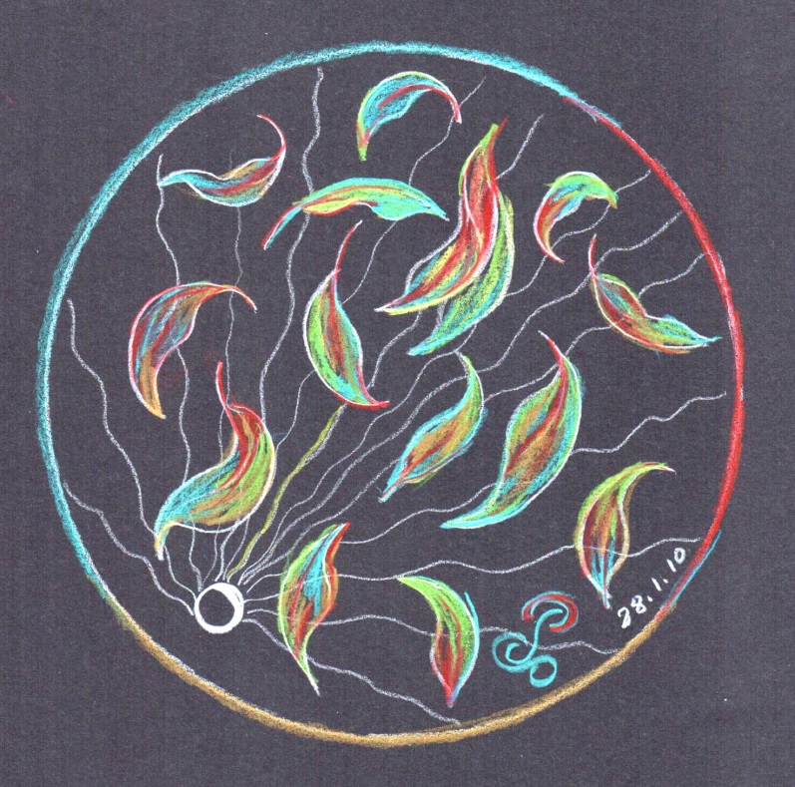
Invitation
to
pause here
So as
to Savour
the experience of opening
to the Sprit.
(Move on when ready.)

Slide 9
Welcome
The ONE
Who leads us
To trust..
(Move on when ready.)

Slide 10
Become aware
of what word or phrase
speaks to you
as you read the scripture
on the following page.
(Move on when ready.)

Slide 11
“When the day of Pentecost came, they were all together in one place. And suddenly out of the sky came a sound like a strong rushing wind and it filled the whole house where they were sitting. There appeared tongues as if of fire which parted and came to rest on each one of them. All were filled with the Holy Spirit and began to speak other languages, as the Spirit enabled them to speak.” Acts 2: 1-4
(Move on when ready.)

Slide 12
Having chosen your word
Slowly and gently taste the word
Savour the word
Respond to the word
(Move on when ready.)

Slide 13
Transformation via the word
Love’s Needle Work
As we surrender to the stillness
and to the Trust that waits attentively within
the old pattern of our lives is changed
as each thread of fear
is unpicked with care by Hand
replaced with deft artistry by threads of Love
and our new pattern of Life
begins to appear.
Noel Davis from “campfire of the Heart”
(Move on when ready.)

Slide 14
Pause here
Savour the experience of this day
(Move on when ready.)

Slide 15
BE STILL
(Move on when ready.)

Slide 16
End of Day One.
We look forward to praying Day Two with you.

