Slide 1
Awakened by the Spirit

Slide 2
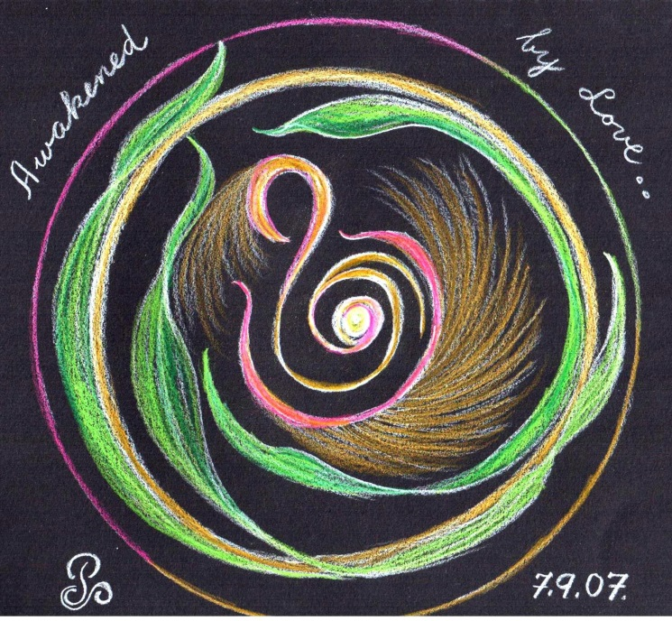
Welcome
To
Day Two
(Move on when ready.)

Slide 3
A time of
Being awakened by
The Spirit of LOVE
(Move on when ready.)

Slide 4
BE STILL
Sit in the stillness and breathe deeply.
Listen to your own breath coming into your own body
and leaving your own body.
(Move on when ready.)

Slide 5
Welcome the One
who brings life and hope
into
the whole
of
CREATION.
(Move on when ready.)

Slide 6
Welcome the Spirit
“Come Spirit of God
come again and again
to renew us.”
(let this prayer echo in your heart.)
(Move on when ready.)

Slide 7
O breathe on me
breath of God,
till I am wholly Thine;
until this earthly part of me
glows with Thy fire divine.
(let this prayer echo in your heart.)
(Move on when ready.)

Slide 8
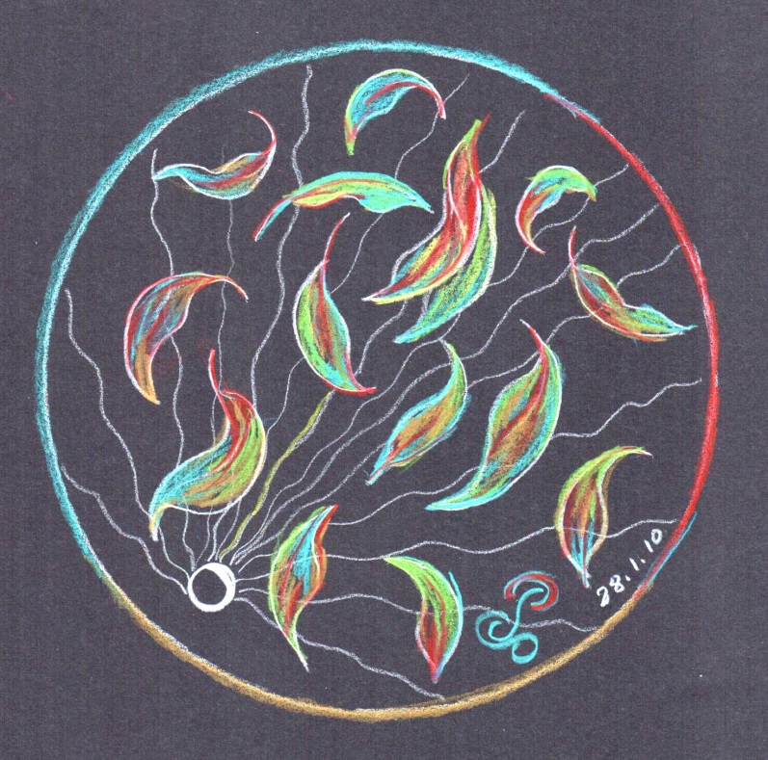
Invitation
to
pause here
So as
to Savour
the experience of opening
to the Sprit.
(Move on when ready.)

Slide 9

Welcome
The One
Who brings Wisdom
To
Hearts that are open.
(Move on when ready.)

Slide 10
Become aware
of what word or phrase
speaks to you
as you read the scripture
on the following slide.
(Move on when ready.)

Slide 11

The Wisdom of Solomon
Wisdom is the kindly Spirit
She is intelligent, holy, unique and unmistakable:
Subtle, dynamic, perceptive, pristine, unclouded ,
Unconquerable, compassionate, shrewd, compelling,
Faultless, serene, directing all, knowing all,
All pervading, ever intelligent, pure and most subtle spirit.
She is the breath of the power of God,
A pure light of the glory of the Most High
(Move on when ready.)

Slide 12
Having chosen your word
Slowly and gently taste the word
Savour the word
Respond to the word
(Move on when ready.)

Slide 13
Transformation by the word via Susan Connelly’s poem
Spirit of God, come weave your dreams
In marrow, joint and in between
And sew then in the heart
Come father mother of the poor,
My endless, overflowing store,
The source of all love’s arts
You are my comfort unsurpassed,
Contentment as when home at last
Refreshment when I thirst.
Share with me Christ’s consciousness
In whatever wilderness,
Send me, aim me true.
(Move on when ready.)

Slide 14
Pause here
Savour the experience of this day
(Move on when ready.)

Slide 15
BE STILL
(Move on when ready.)

Slide 16
End of Day Two.
We look forward to praying Day Three with you.

