Slide 1
Awakened by the Spirit

Slide 2
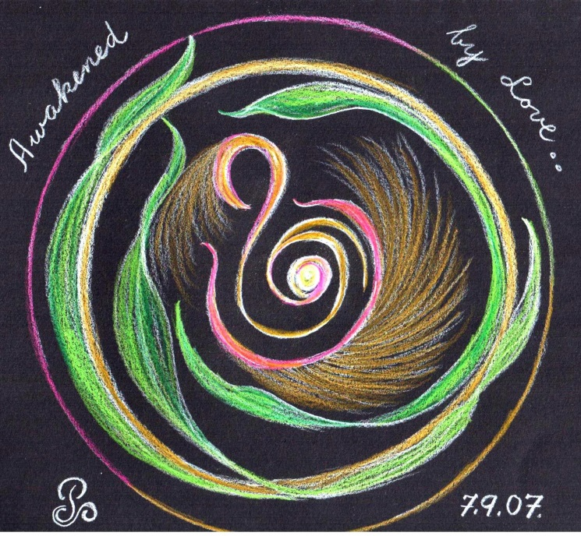
Welcome
To
Day Four
(Move on when ready.)

Slide 3
A time
of
Being awakened
by
The Spirit of Love
(Move on when ready.)

Slide 4
BE STILL
Sit in the stillness and breath deeply.
Listen to your own breath coming into your own body
and leaving your own body
(Move on when ready.)

Slide 5
Welcome the One
who brings life and hope
into
the whole
of
CREATION.
(Move on when ready.)

Slide 6
Welcome the Spirit
“Come Spirit of God
come again and again
to renew us.”
(let this prayer echo in your heart.)
(Move on when ready.)

Slide 7
O breathe on me
breath of God,
till I am wholly Thine;
until this earthly part of me
glows with Thy fire divine.
(let this prayer echo in your heart.)
(Move on when ready.)

Slide 8
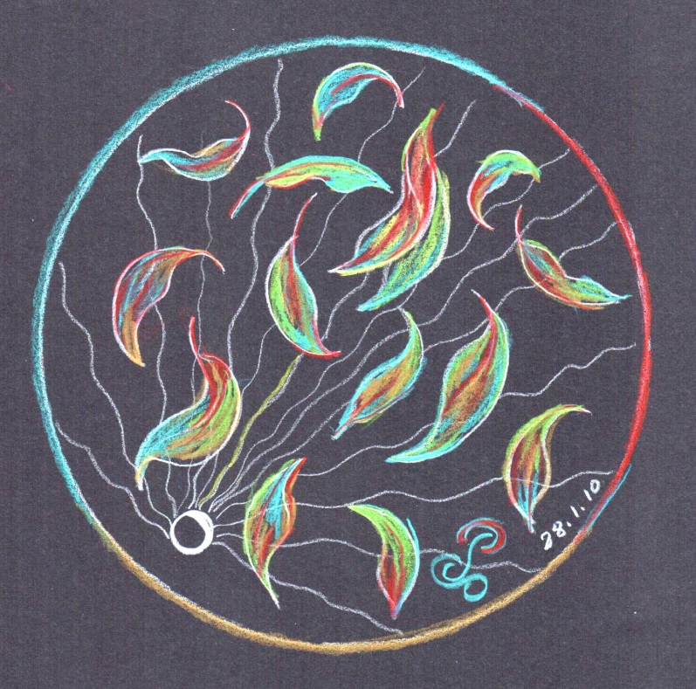
Invitation
to
pause here
So as
to Savour
the experience of opening
to the Sprit.
(Move on when ready.)

Slide 9
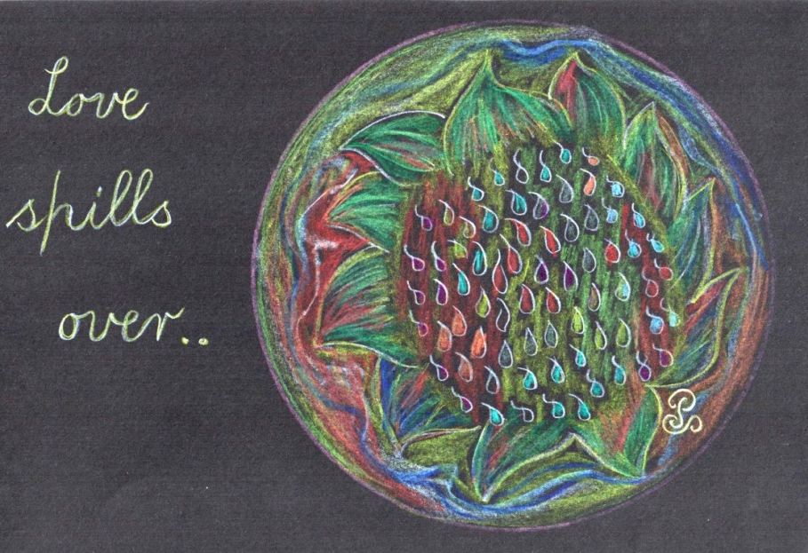
Spirit of God
Speak
To us
Of
COURAGE
(Move on when ready.)

Slide 10
Become aware
of what word of phrase
speaks to you
as you read the scripture
on the following slide.
(Move on when ready.)

Slide 11
John 20; 19-23
In the evening of the first day of the week, the doors were closed in the room where the disciples were, for fear of the Jews.
Jesus came and stood among them.
He said to them, “Peace be with you,” and showed them his hands and his side.
The disciples were filled with joy when they saw the Lord, and he said to them again, “Peace be with you.”
As the Father sent me
so I am sending you”
After saying this he breathed on them and said:
‘Receive the Holy Spirit.
For those whose sins you forgive,
they are forgiven;
for those whose sins you retain,
they are retained.”
(Move on when ready.)

Slide 12
Having chosen your word
Slowly and gently taste the word
Savour the word
Respond to the word
(Move on when ready.)

Slide 13
Transformation via the word
      Love loosening Our Fear ….. Noel Davis
So much of flesh and bone and
feeling enslave to fear –
crippled paralysed
tight closed
Suffocating hurting
Striking out!
O for the light to see….
The courage to realise … for a baby in touch
a heart remembering
The bottom line of our lives
the wide awake of our awakening ….
we are ever in Your hands.
(Move on when ready.)

Slide 14
Invitation
to
pause here
Savour the experience of this day
(Move on when ready.)

Slide 15
BE STILL
(Move on when ready.)

Slide 16
End of Day Four.
We look forward to praying Day Five with you.

