Slide 1
Awakenedby the Spirit

Slide 2
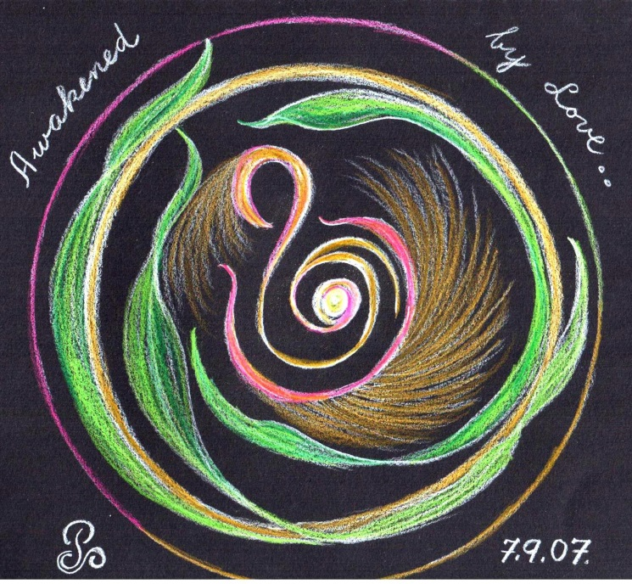
Welcome
To
Day Five
(Move on when ready.)

Slide 3
A time
of
Being awakened
by
The Spirit of Love
(Move on when ready.)

Slide 4
BE STILL
Sit in the stillness and breath deeply.
Listen to your own breath coming into your own body
and leaving your own body
(Move on when ready.)

Slide 5
Welcome the One
who brings life and hope
into
the whole
of
CREATION.
(Move on when ready.)

Slide 6
Welcome the Spirit
“Come Spirit of God
come again and again
to renew us.”
(let this prayer echo in your heart.)
(Move on when ready.)

Slide 7
O breathe on me
breath of God,
till I am wholly Thine;
until this earthly part of me
glows with Thy fire divine.
(let this prayer echo in your heart.)
(Move on when ready.)

Slide 8
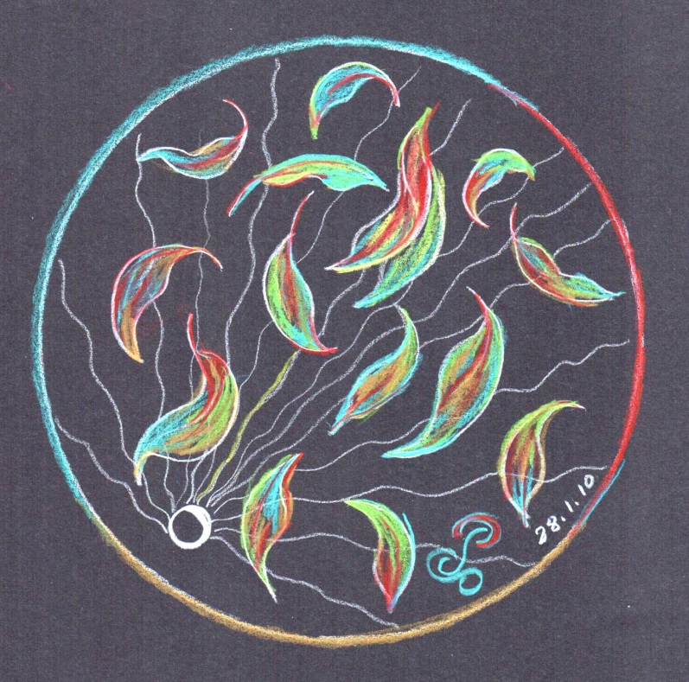
Invitation
to
pause here
So as
to Savour
the experience of opening
to the Sprit.
(Move on when ready.)

Slide 9
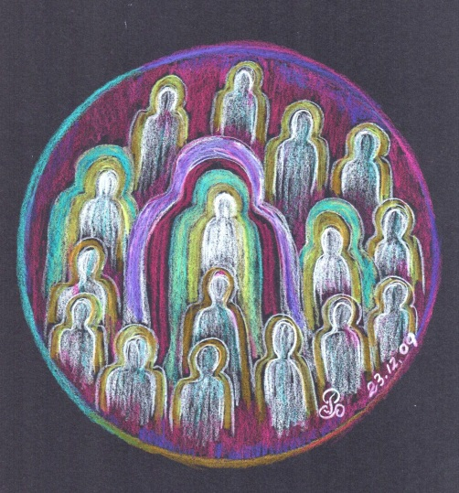
As
at
the First Pentecost
Mary,
the Mother of Jesus
is with us now.
(Move on when ready.)

Slide 10
In “The Joy of the Gospel”
Pope Francis says:
Mary let herself be guided by the Holy Spirit on a journey of faith towards a destiny of service and fruitfulness.
(Move on when ready.)

Slide 11
With Pope Francis we pray:
Mary, Virgin and Mother,
You who, moved by the Holy Spirit,
welcomed the Word of Life
in the depth of your humble faith:
as you gave yourself completely to the Eternal One
help us to say our own “yes”
to the urgent call, as pressing as ever,
to proclaim to good news of Jesus.
(Move on when ready.)

Slide 12
Star of the new evangelisation,
help us to bear radiant witness to
communion,
service,
ardent and generous faith,
justice and love of the poor,
that the joy of the Gospel
may reach the ends of the earth,
illuminating even the fringe of the world.
Mother of the living Gospel,
wellspring of happiness for God’s little ones,
pray for us.
(Move on when ready.)

Slide 13
Invitation
to
pause here
Savour the experience of this day.
(Move on when ready.)

Slide 14
BE STILL
(Move on when ready.)

Slide 15
End of Day Five.
We look forward to praying with you again in the future.
May the Spirit of Love continue to be awakened in you each day.

