Slide 1
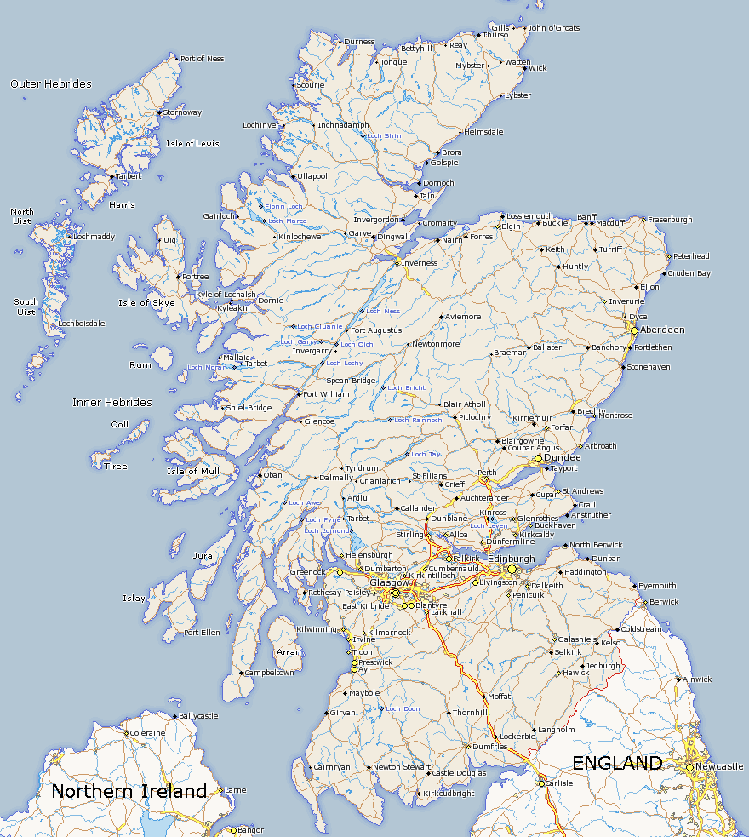
Mary MacKillop’s
Travels
In
Scotland
October 1873 - February 1874

Slide 2
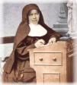
Mary’s letter, written from London on 16th Feb.1874, gives us her own description and details of her visit to Scotland.
Page 53 of ‘Mother Mary’s Circulars to the Sisters’

Slide 3
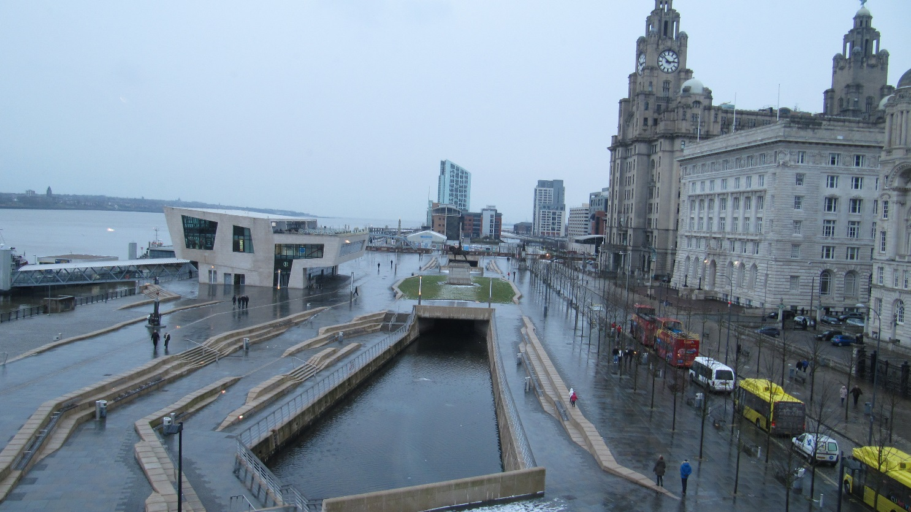
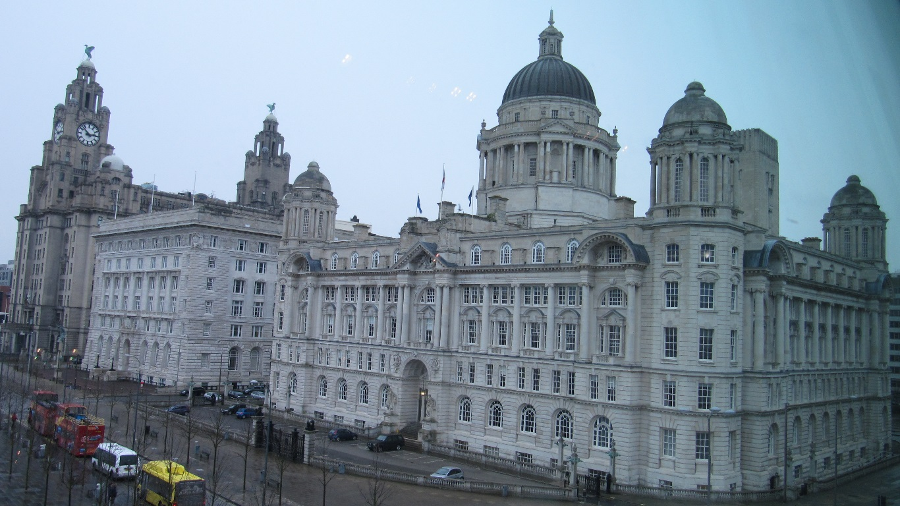
City of Liverpool
where Mary began her journey to Scotland

Slide 4
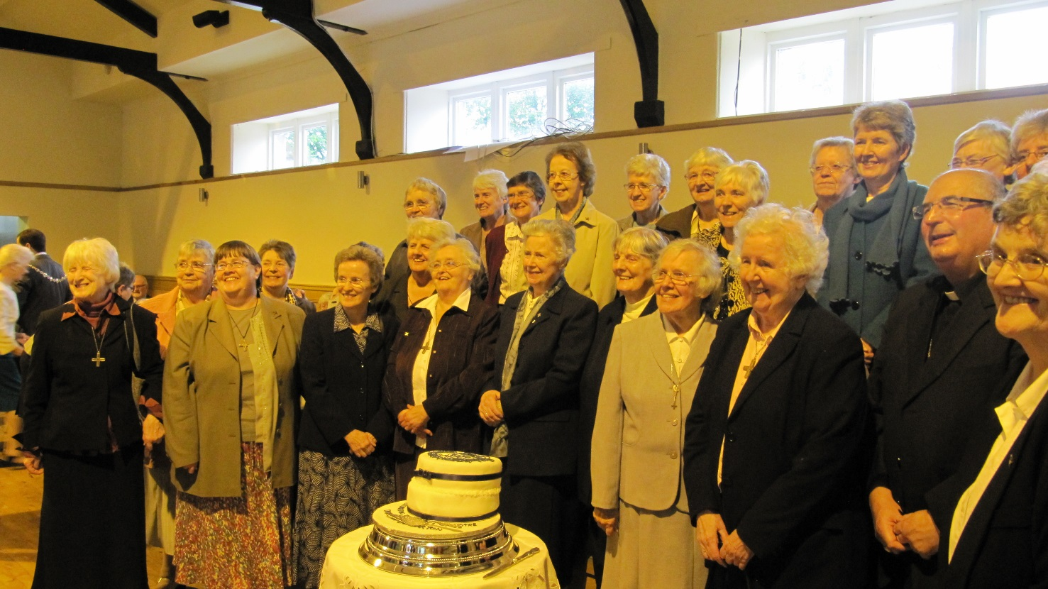
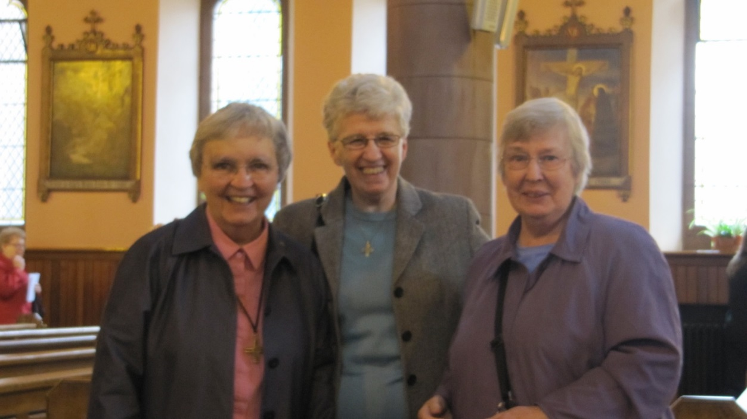
The Sisters of
Notre Dame
de Namur
These Sisters gave great
hospitality to Mary in Liverpool & Preston as well
advice on teaching methods

Slide 5
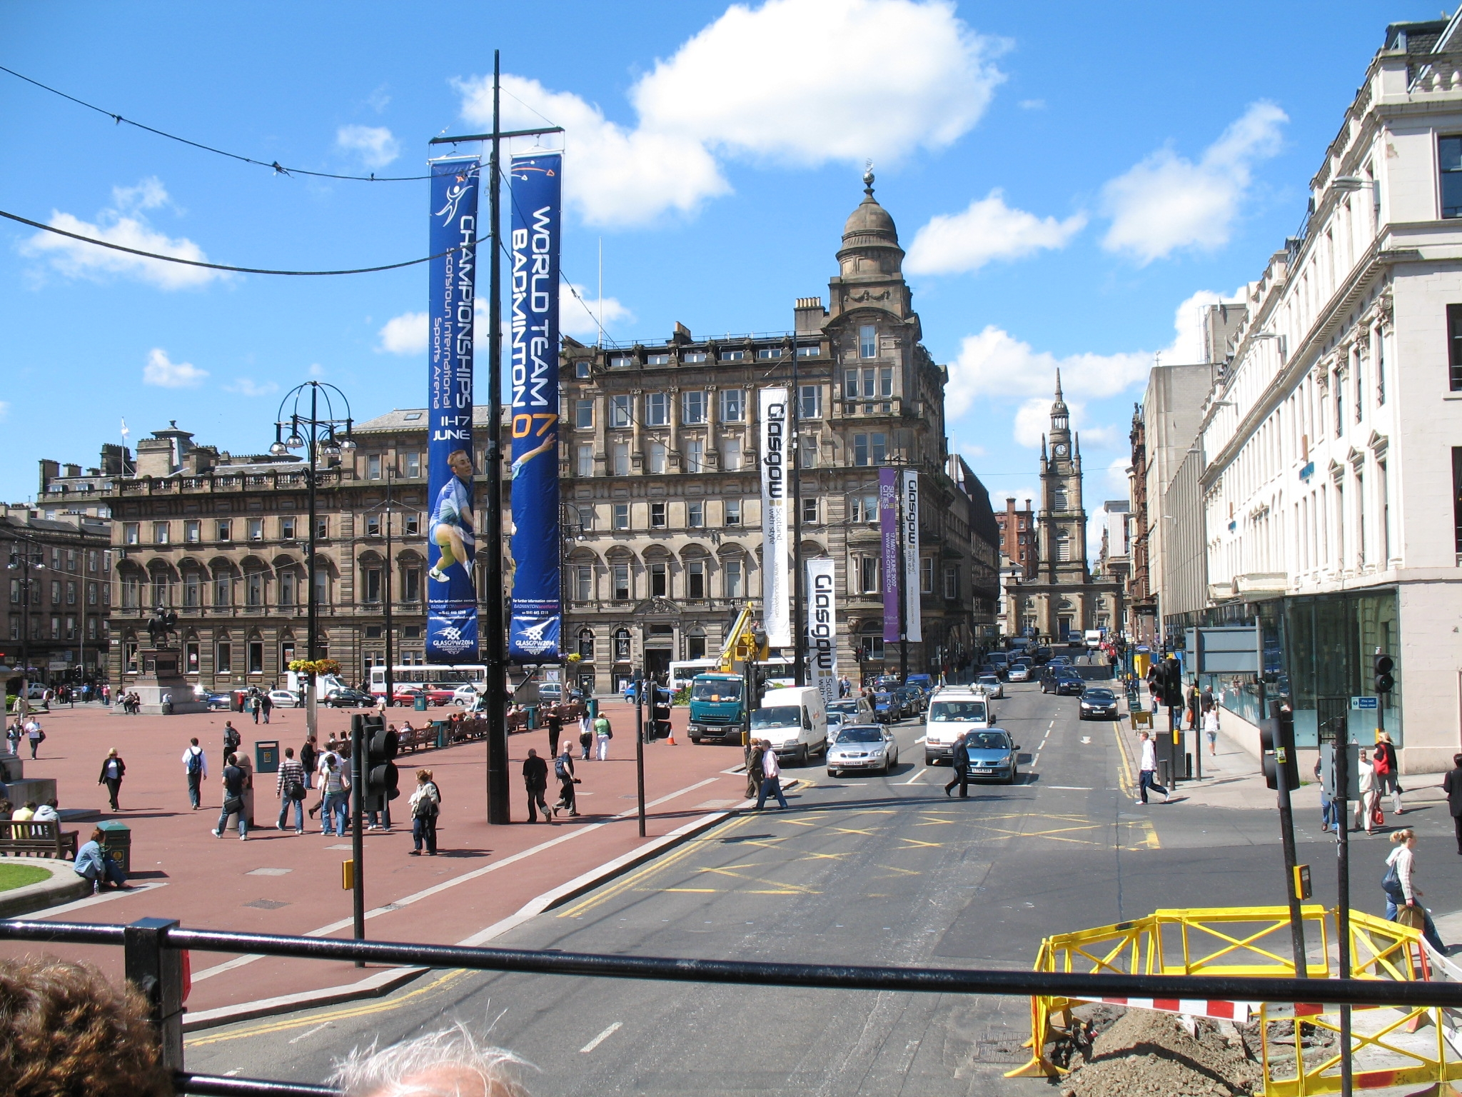
GLASGOW

Slide 6
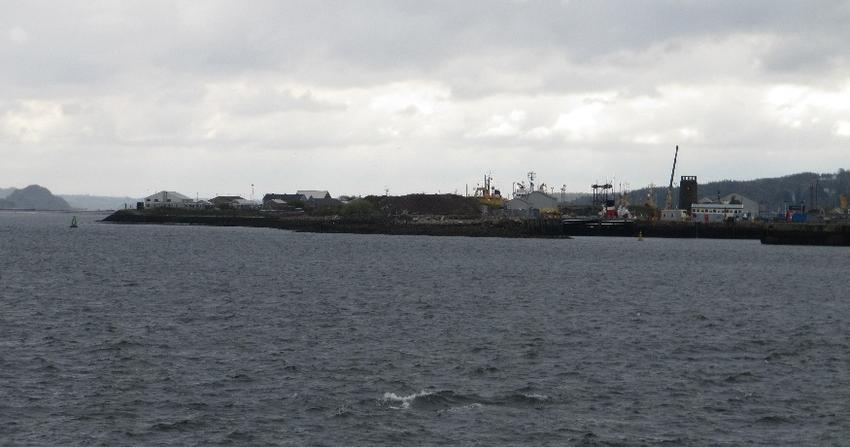
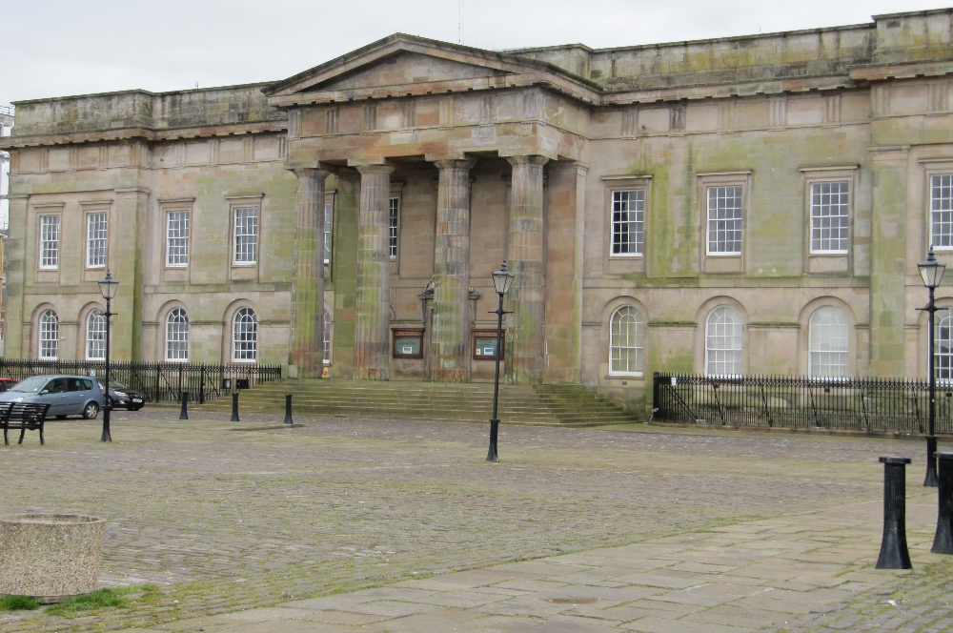
PORT OF GREENOCK
OLD CUSTOMS
HOUSE

Slide 7
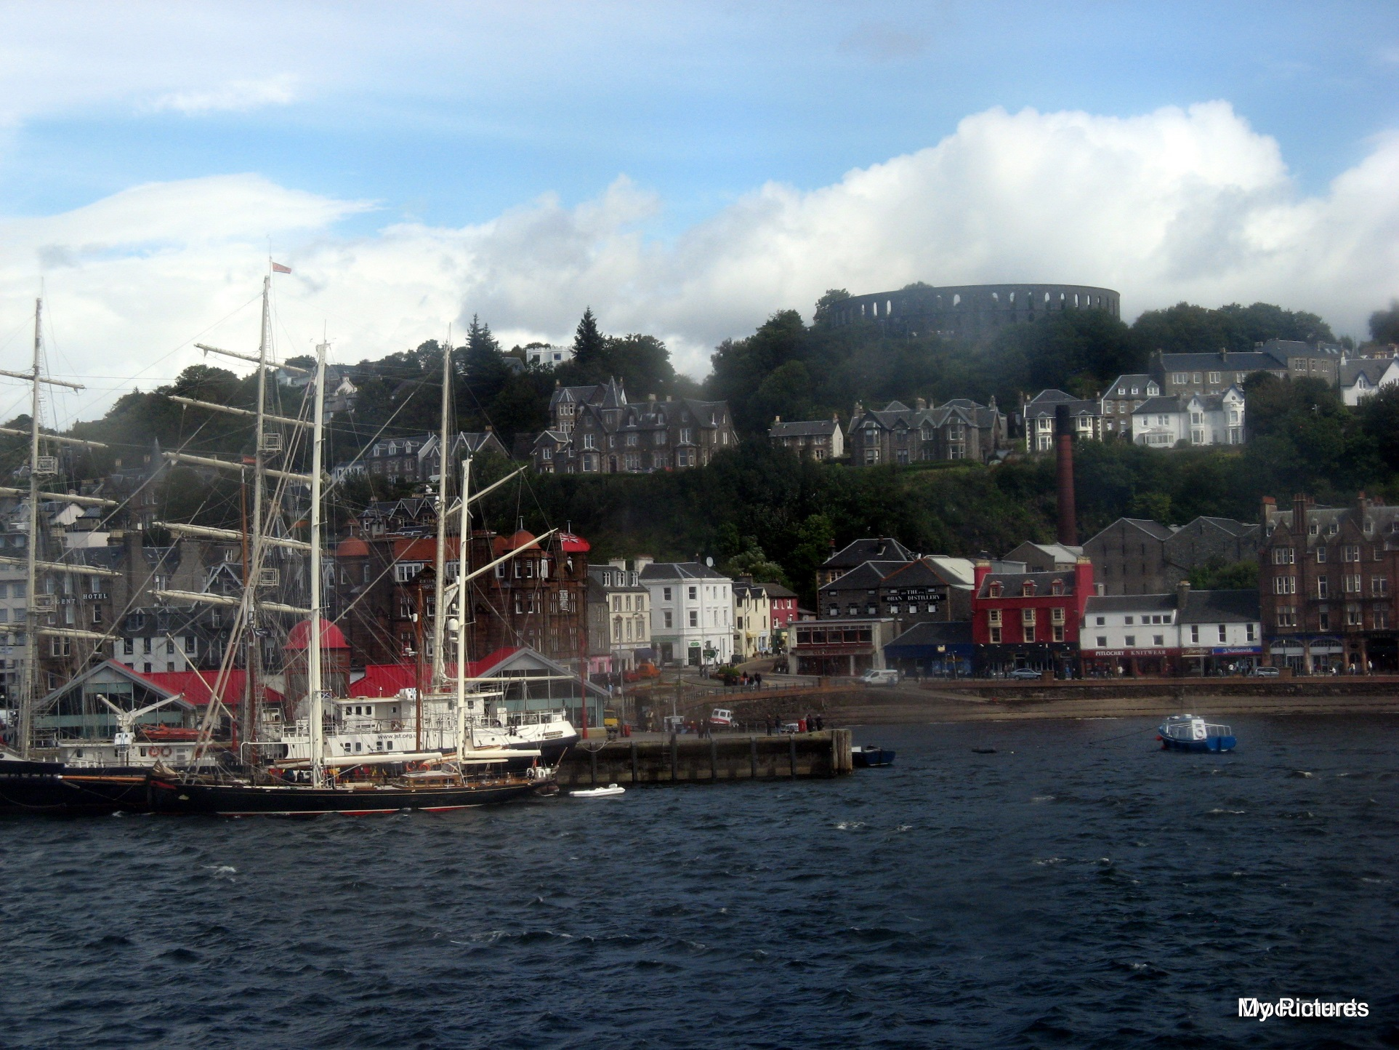
Port City
of
OBAN

Slide 8
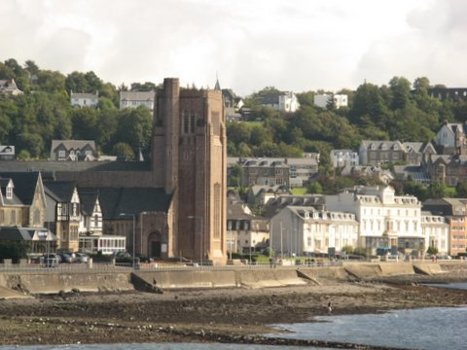
City of Oban – St Columba’s Cathedral in foreground

Slide 9
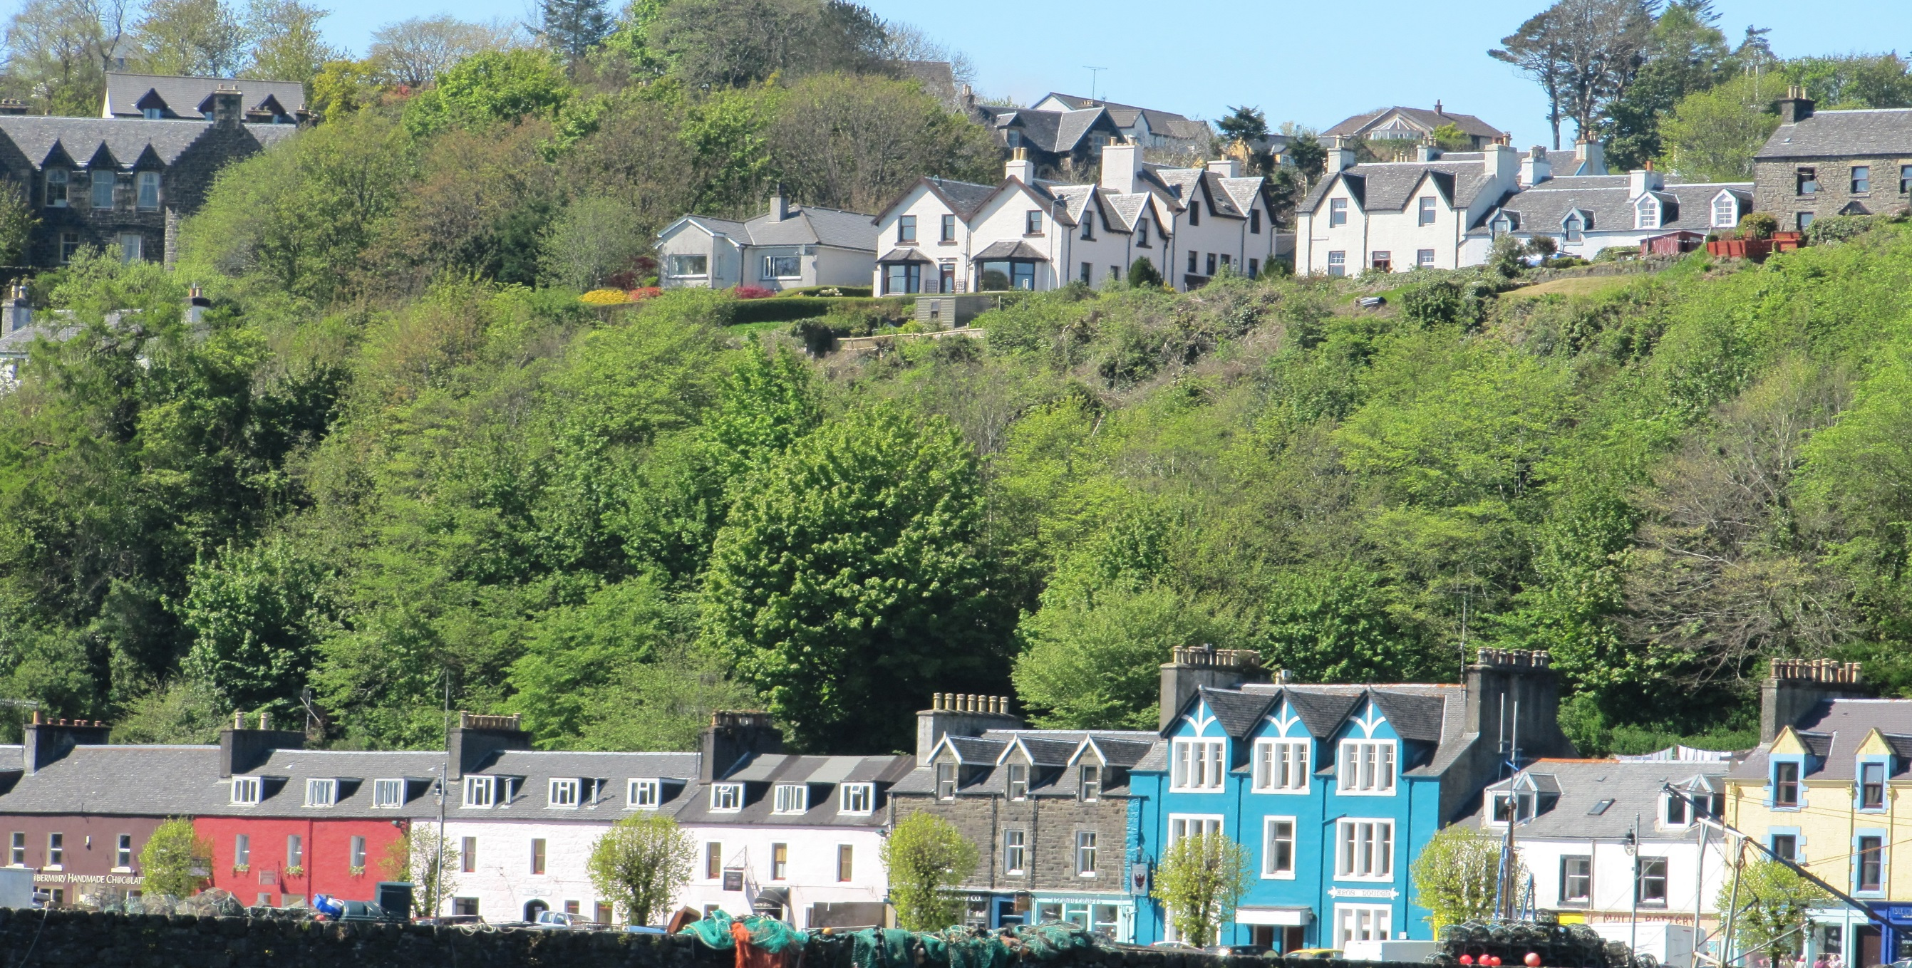
Tobermory – Isle of Mull

Slide 10
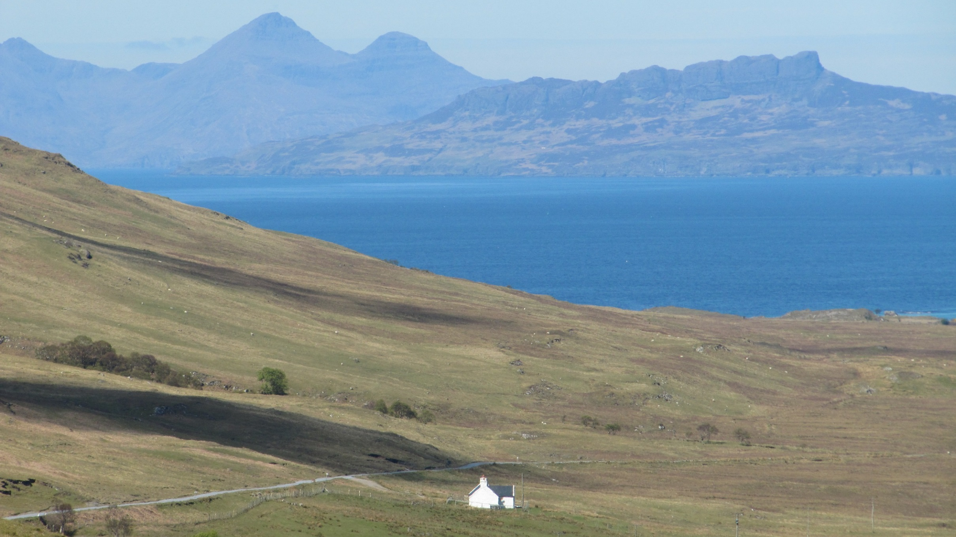
ARDNAMURCHAN PENINSULA

Slide 11
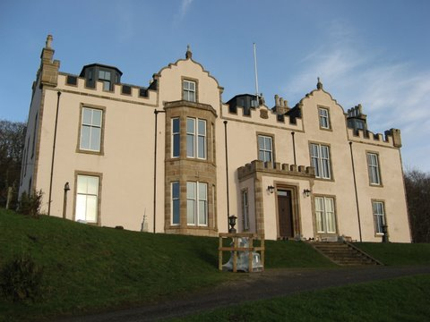
Drimnin House
Home of Lady Gordon

Slide 12
Chapel
At
Drimnin
House

Slide 13
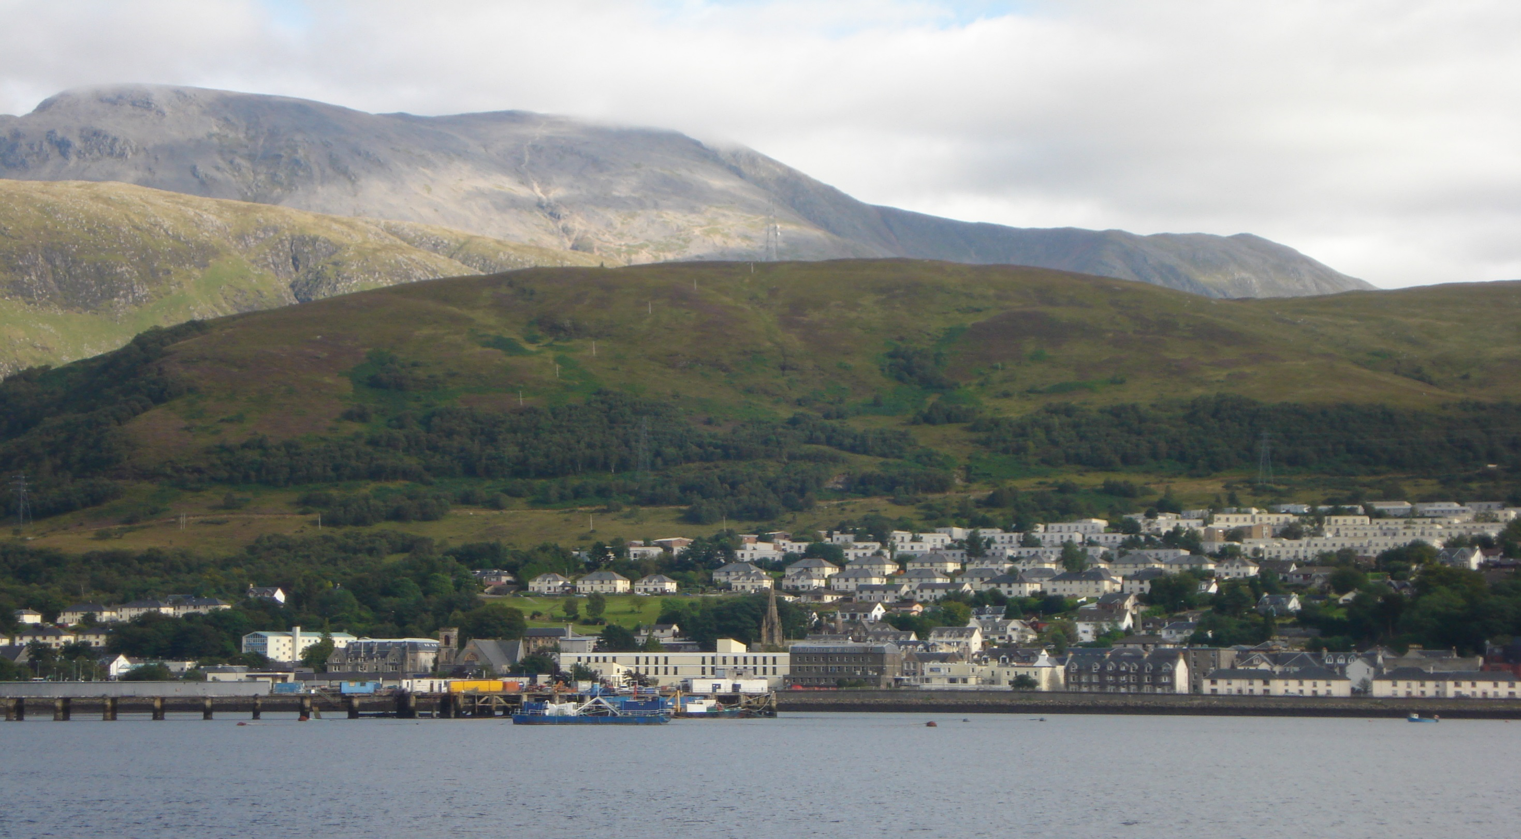
FORT WILLIAM

Slide 14
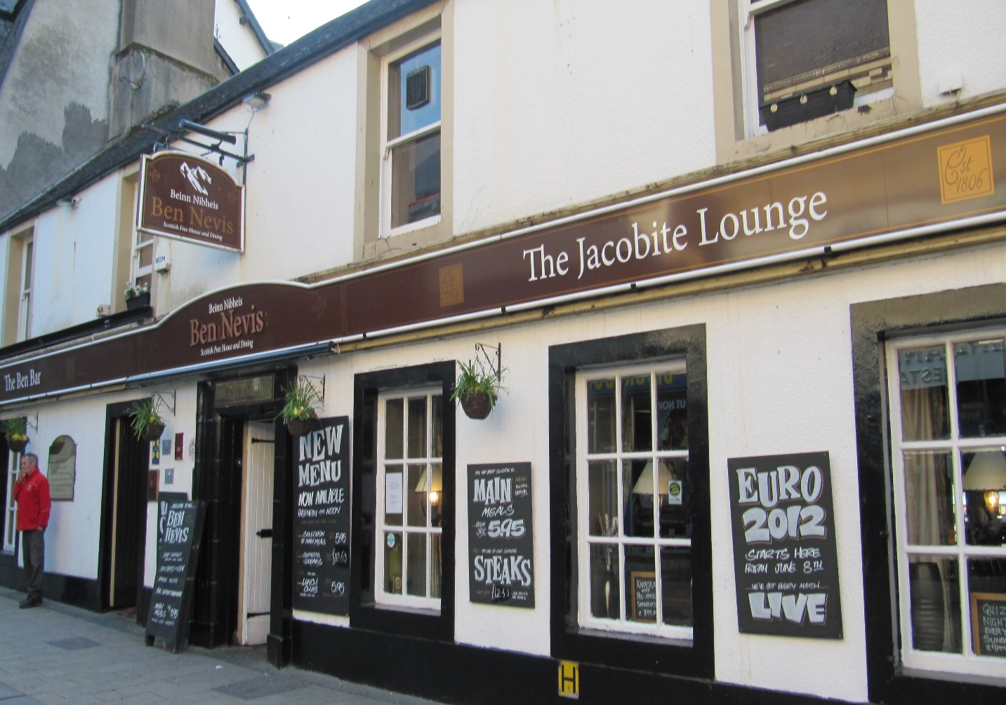
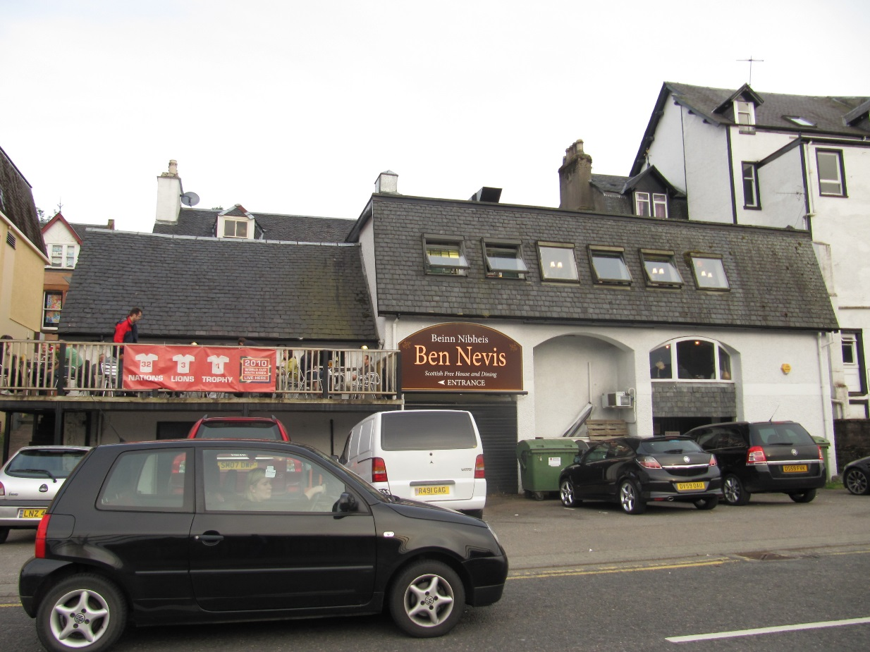
BEN NEVIS BAR
BIRTH SITE OF MARY’S MOTHER
FLORA MacDONALD

Slide 15
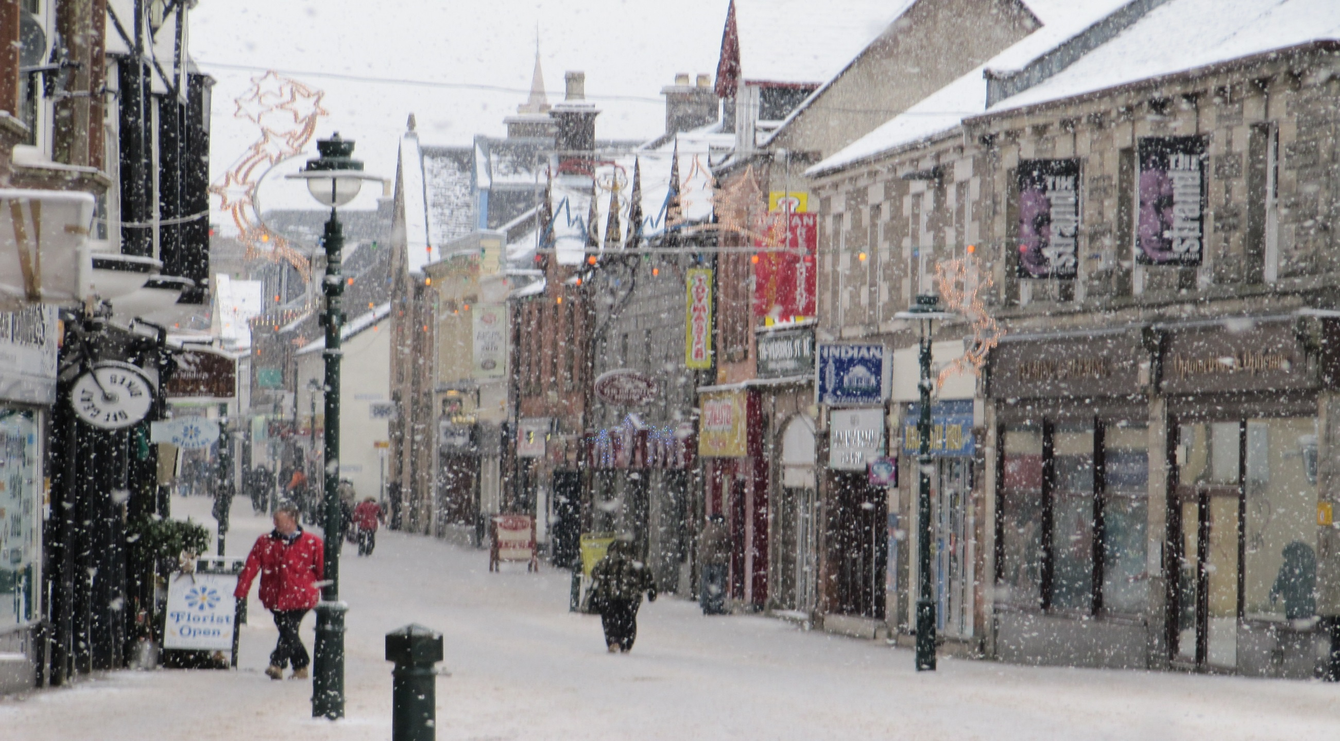
THE HIGH STREET FORT WILLIAM

Slide 16
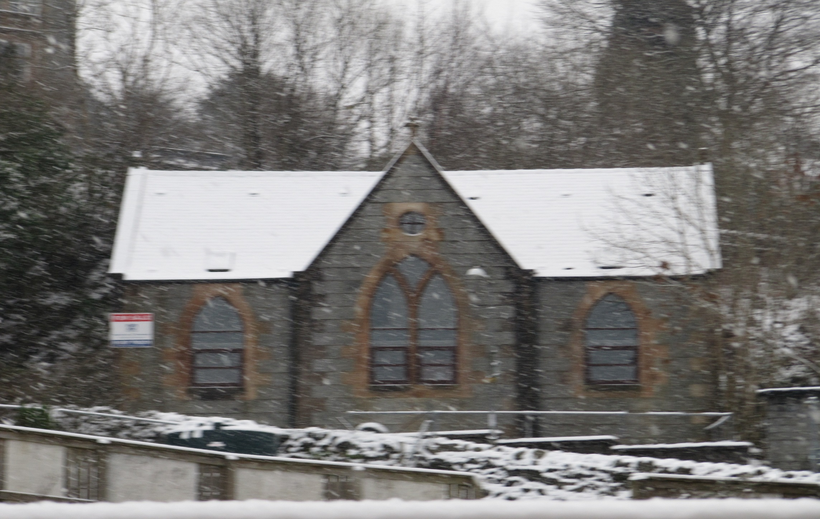
ORIGINAL PARISH CHURCH FORT WILLIAM

Slide 17
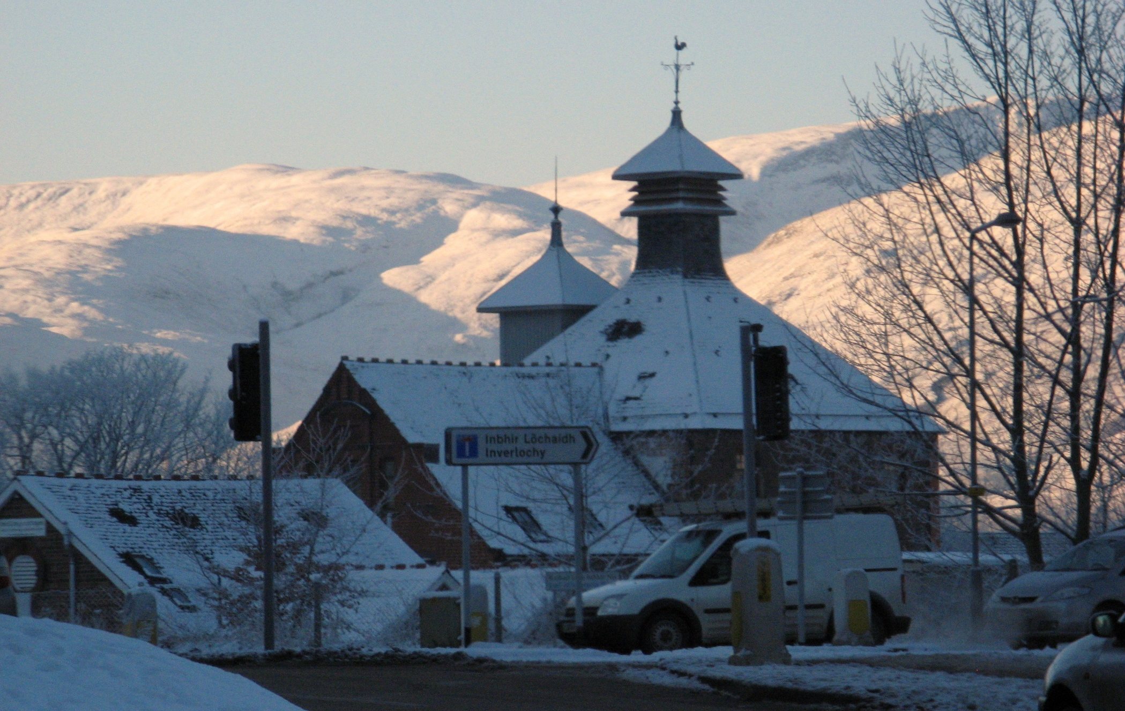
Former whisky distillery – one of four owned by
‘Long John’ MacDonald

Slide 18
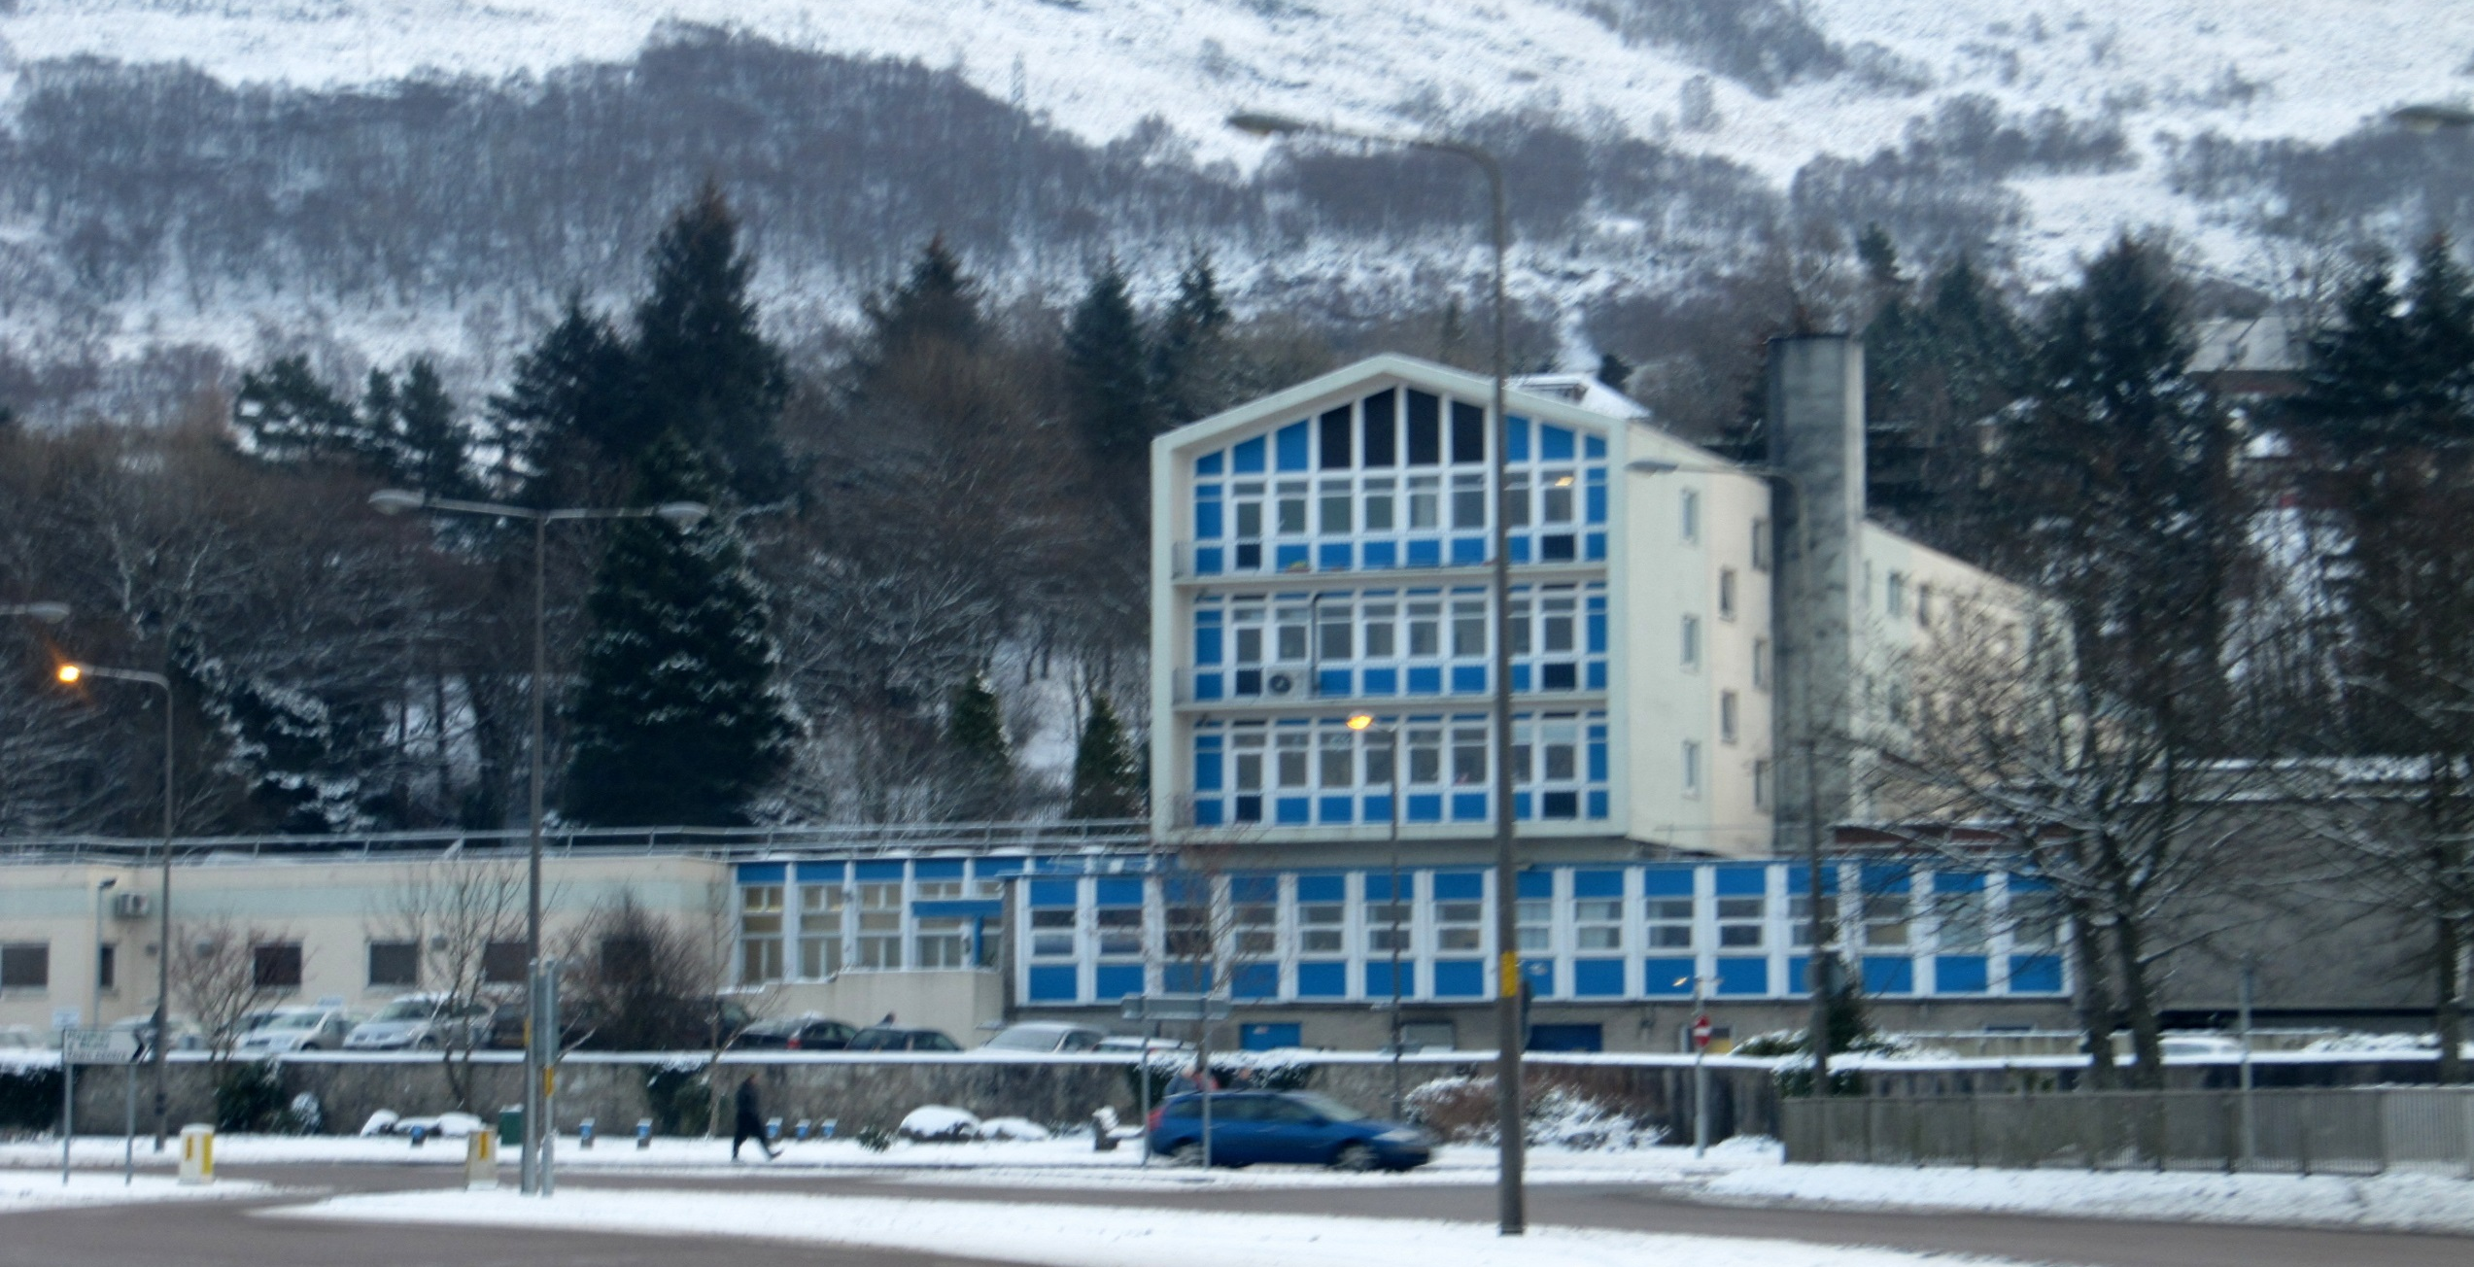
Belford Hospital, Fort William – former site of
Invernevis House where Mary stayed with her cousin

Slide 19
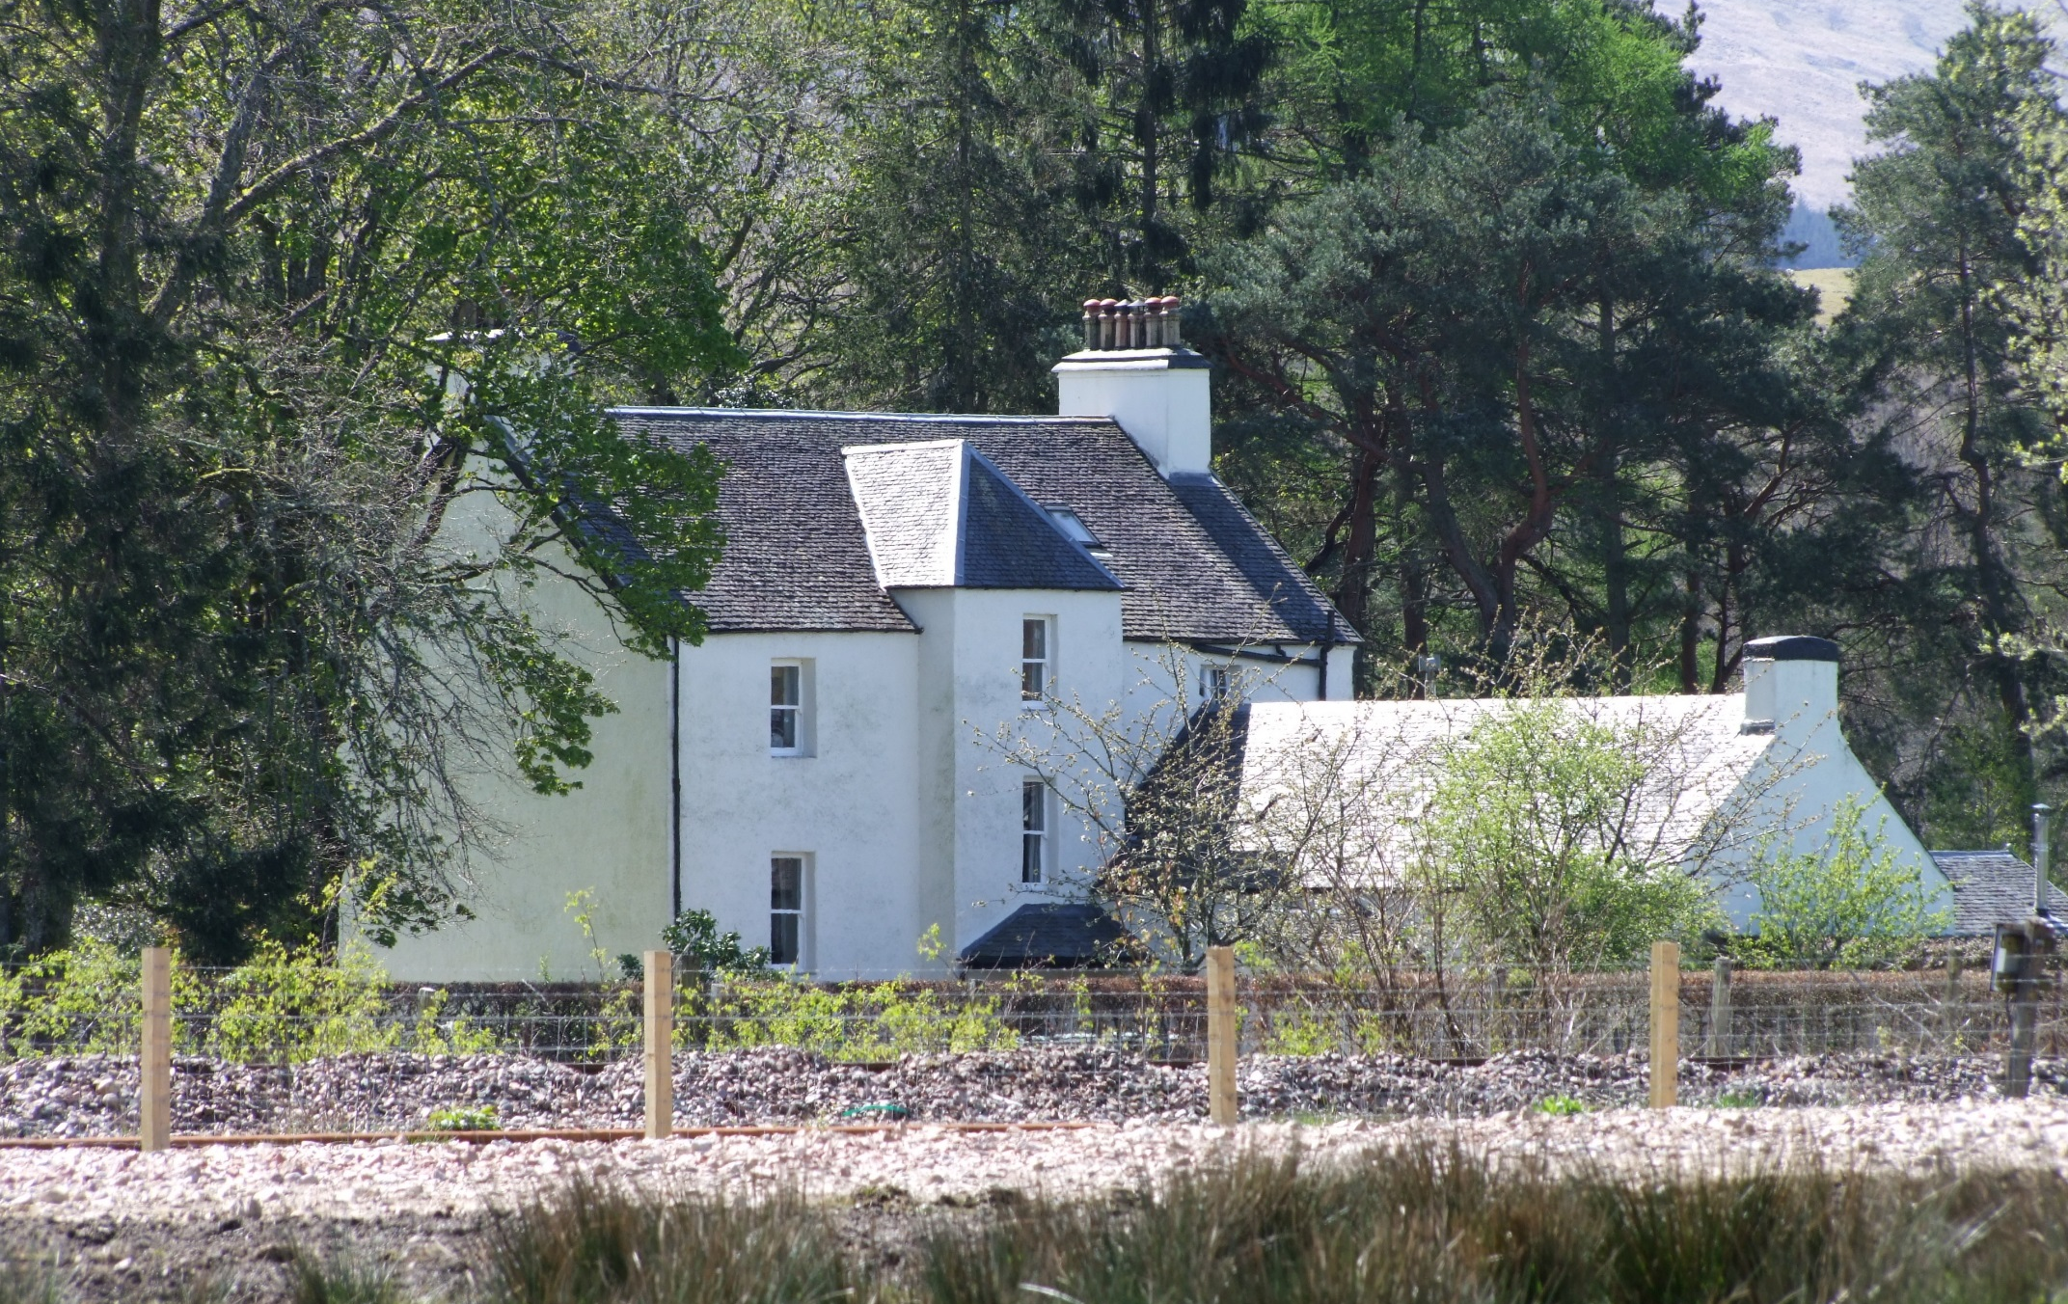
Keppock House, Roy Bridge, where Mary stayed

Slide 20
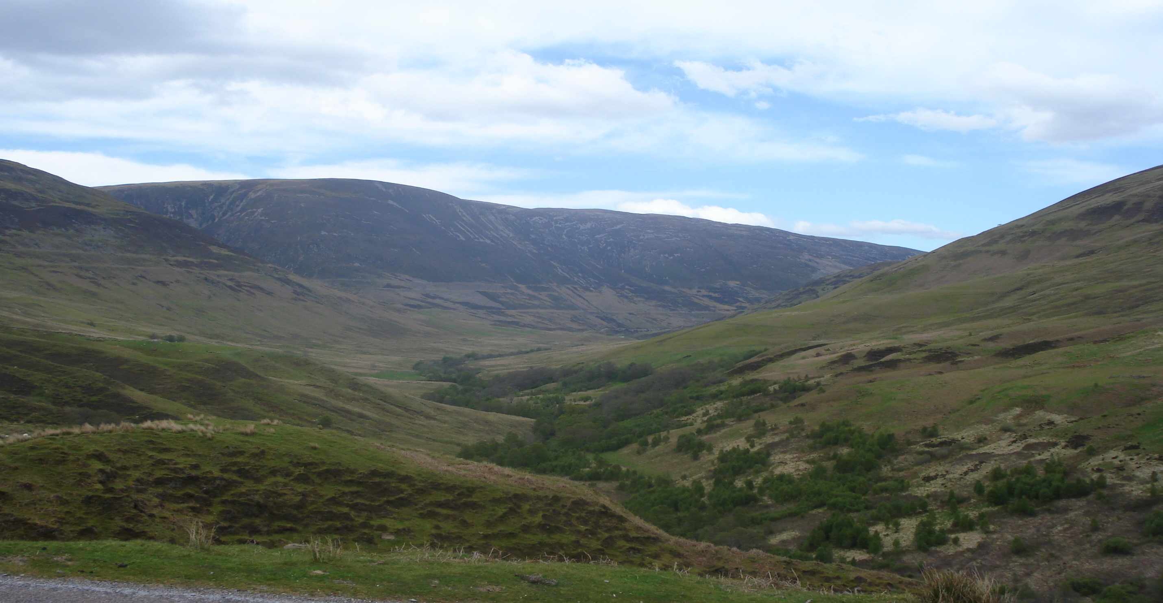
Glen Roy – Ancestral Lands of the Keppock MacDonald Clan

Slide 21
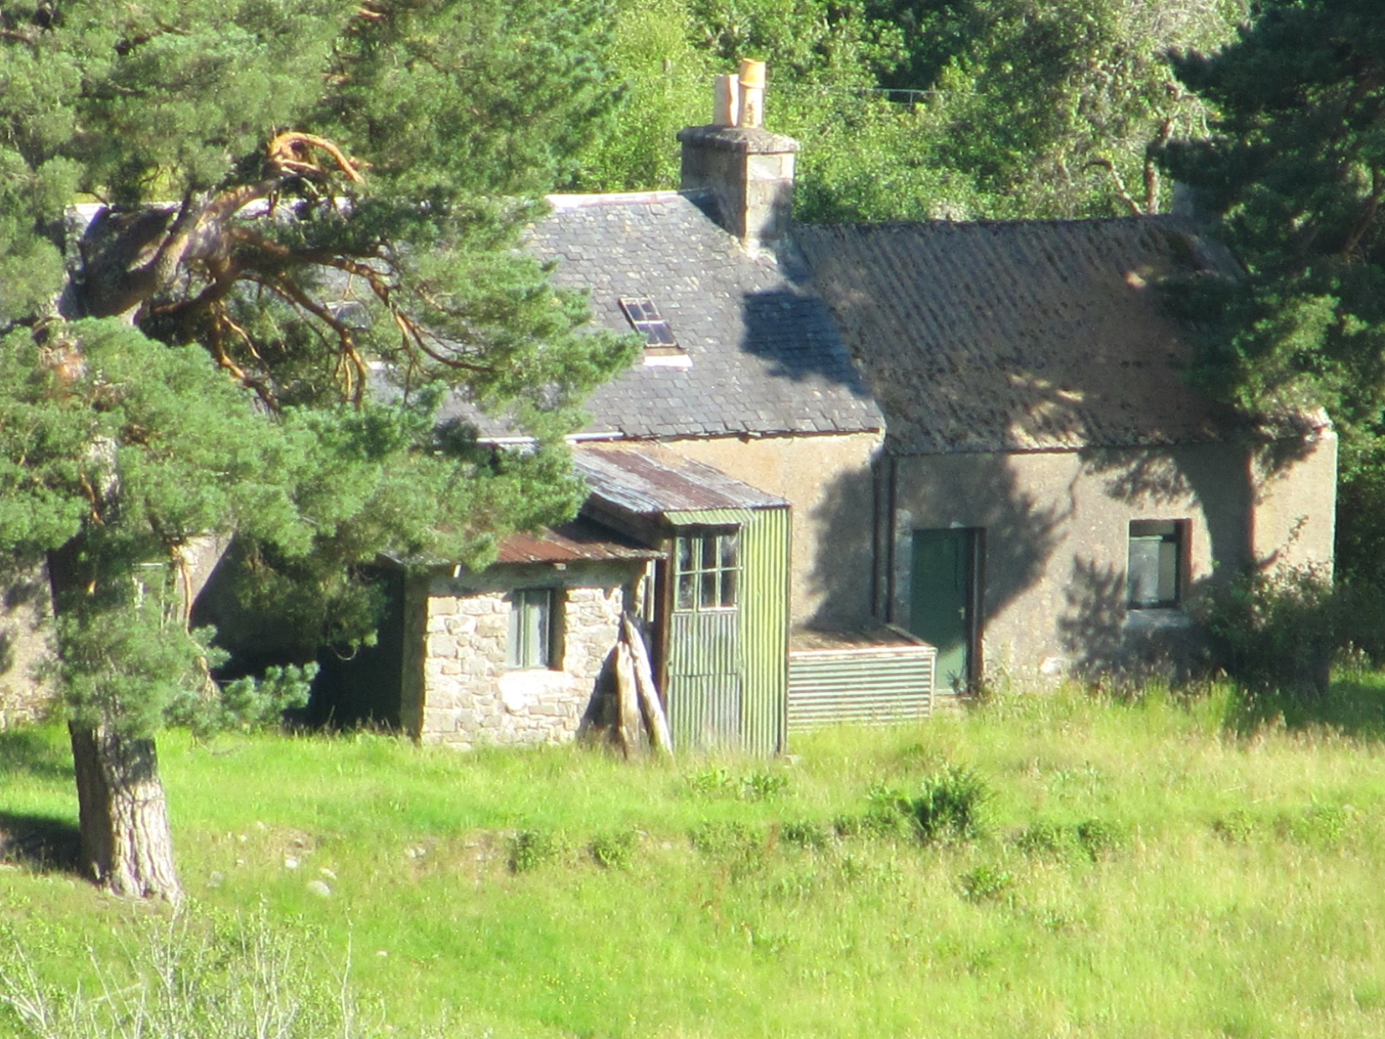
House at Cranachan – home of 5 ‘wonderful, eccentric Highlanders’

Slide 22
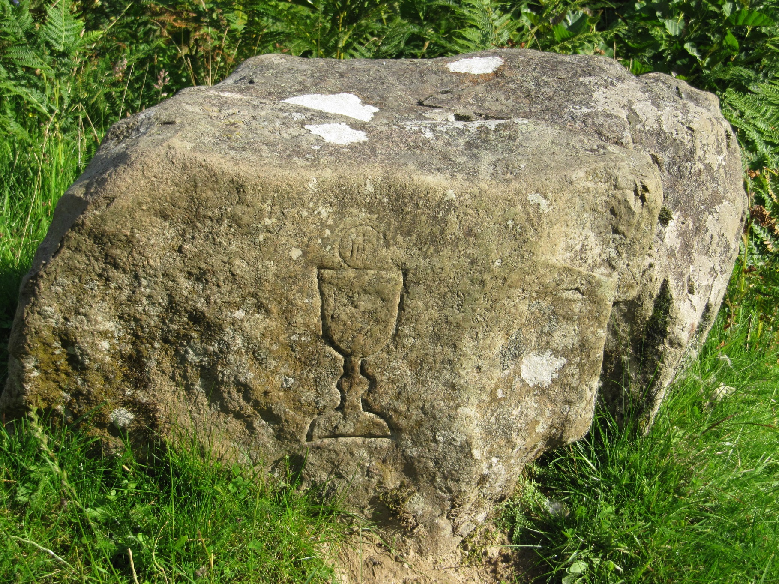
Mass Stone
in the glen
at
Cranachan

Slide 23
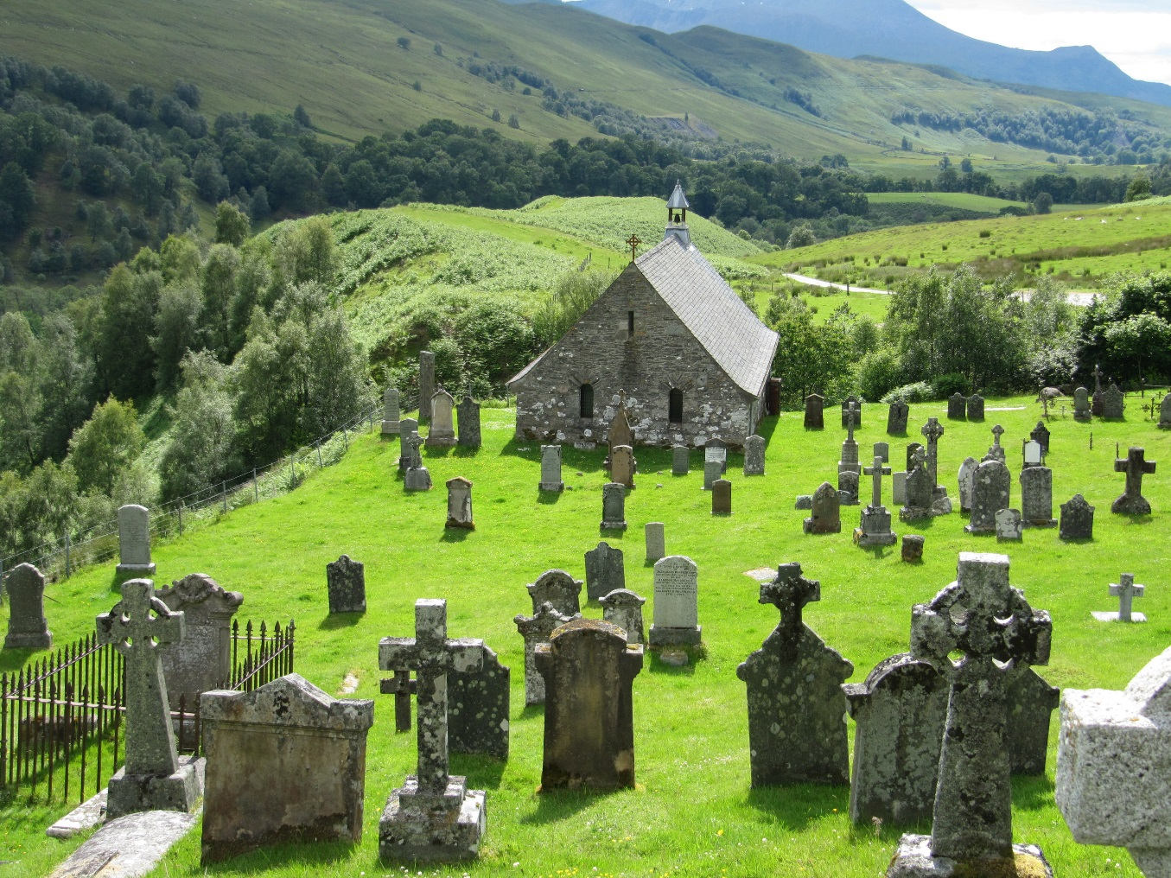
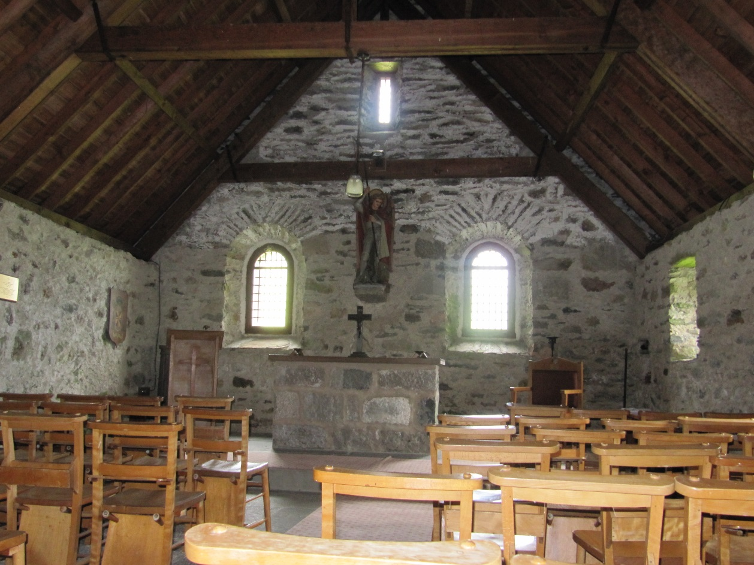
Cille Choirill – Historic 15th Century Catholic Cemetery

Slide 24
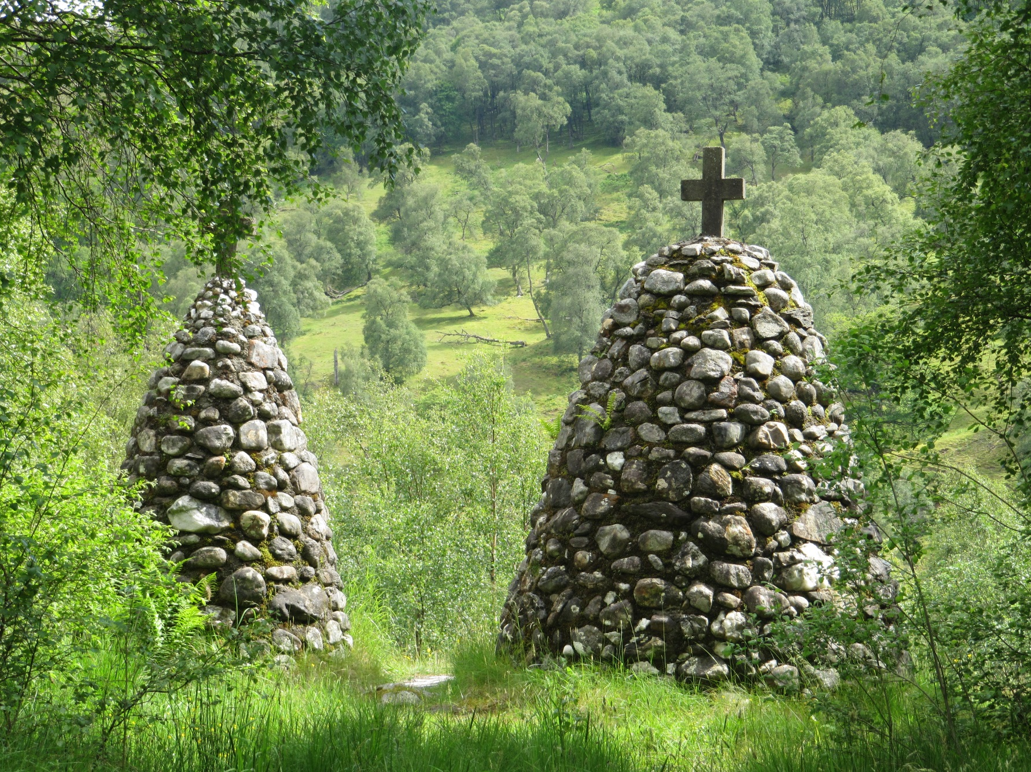
Cairns
at entrance
to
Cille Choirill

Slide 25
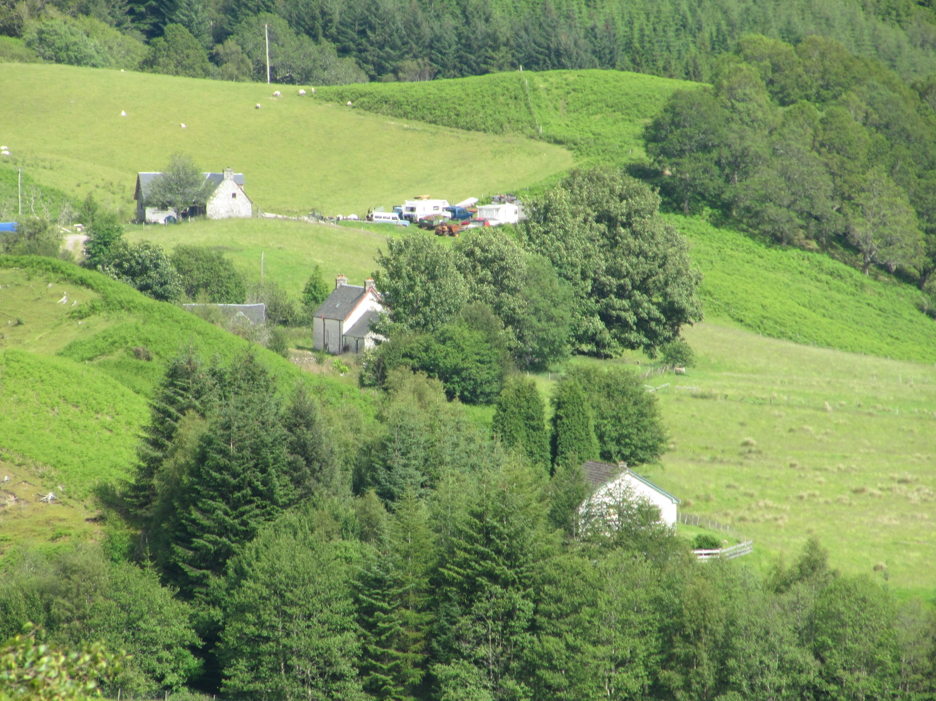
Site of the home
of Alexander’s
Grandparents
at Murlaggan

Slide 26
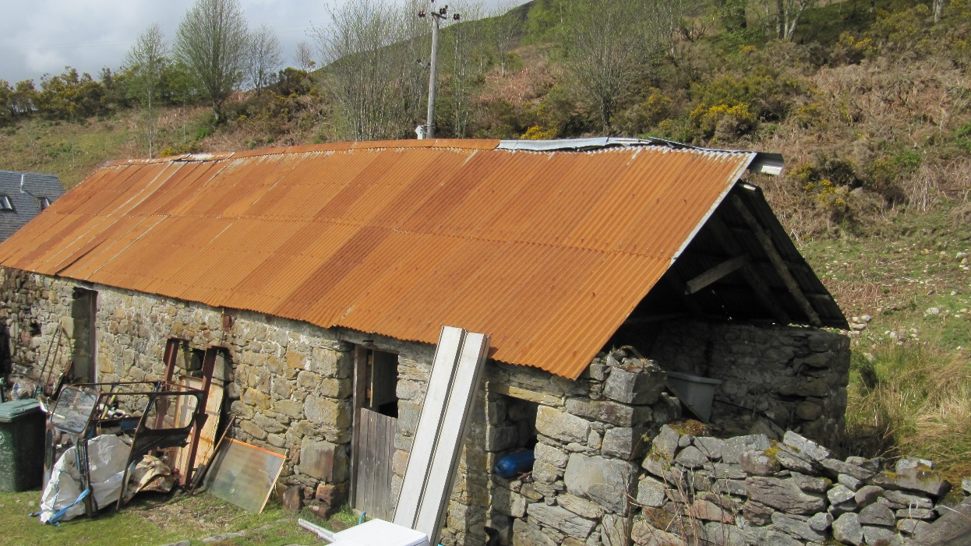
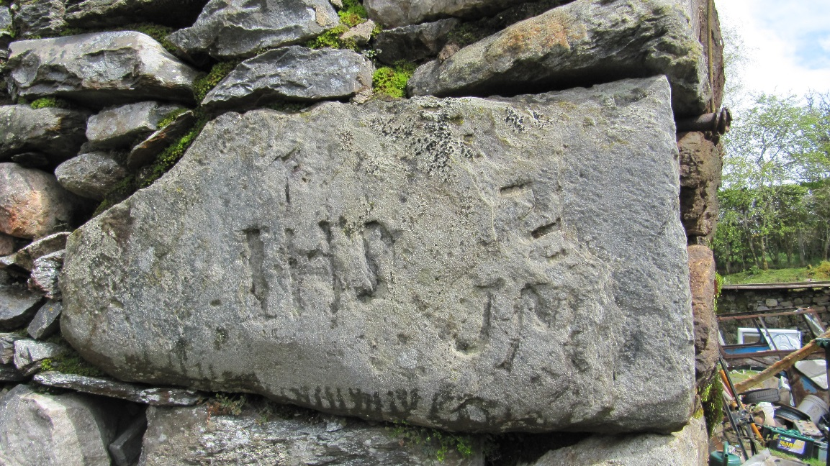
Inscription on corner-stone of MacKillop house
Remains of Alexander’s grandparents’ home at Murlaggan

Slide 27
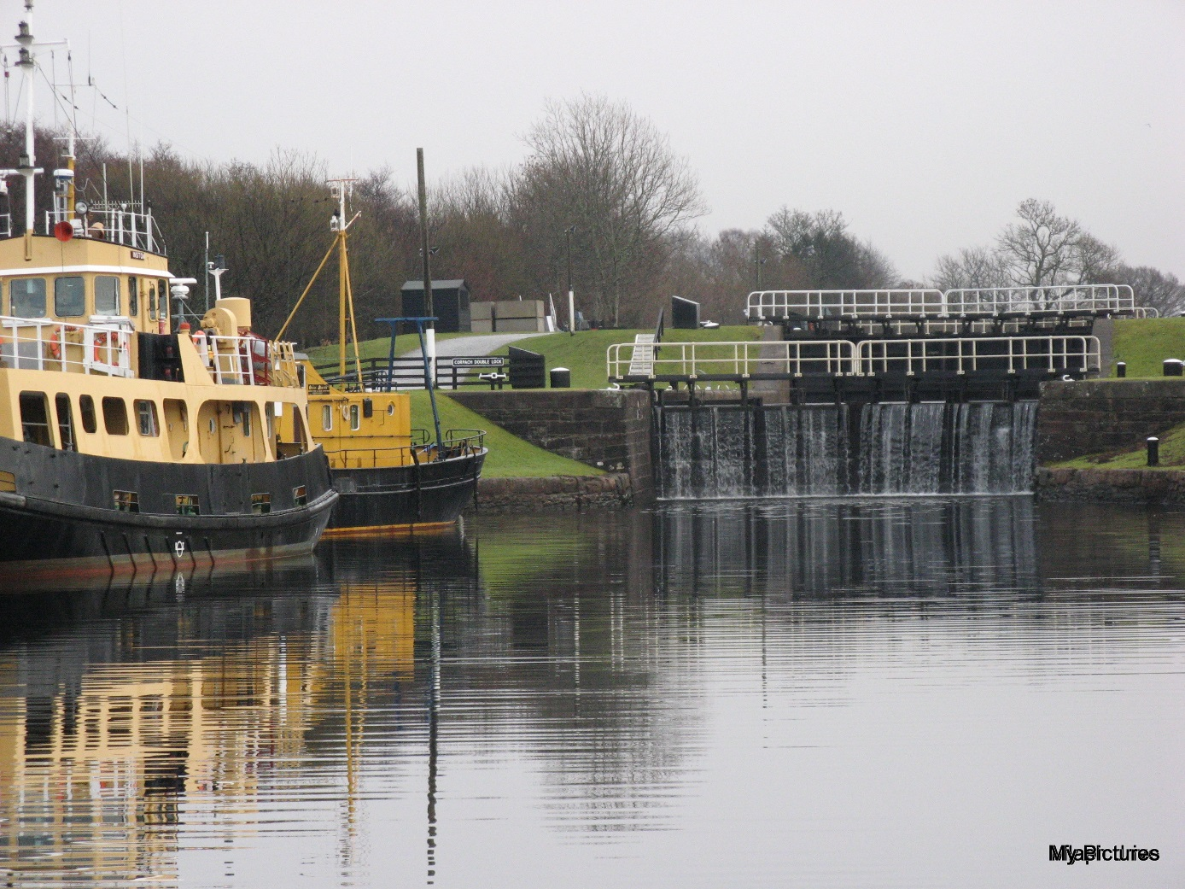
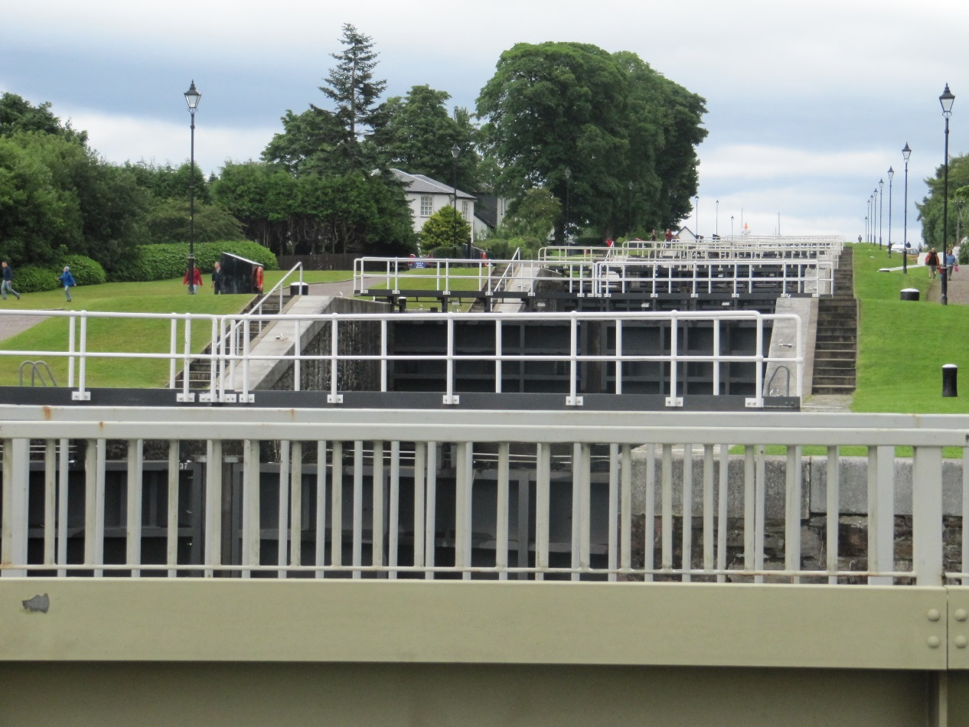
Neptune’s Staircase
Caledonian Canal

Slide 28
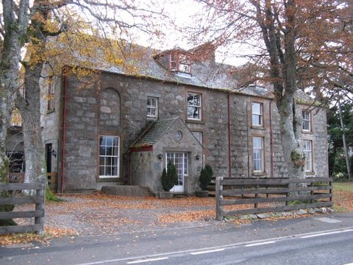
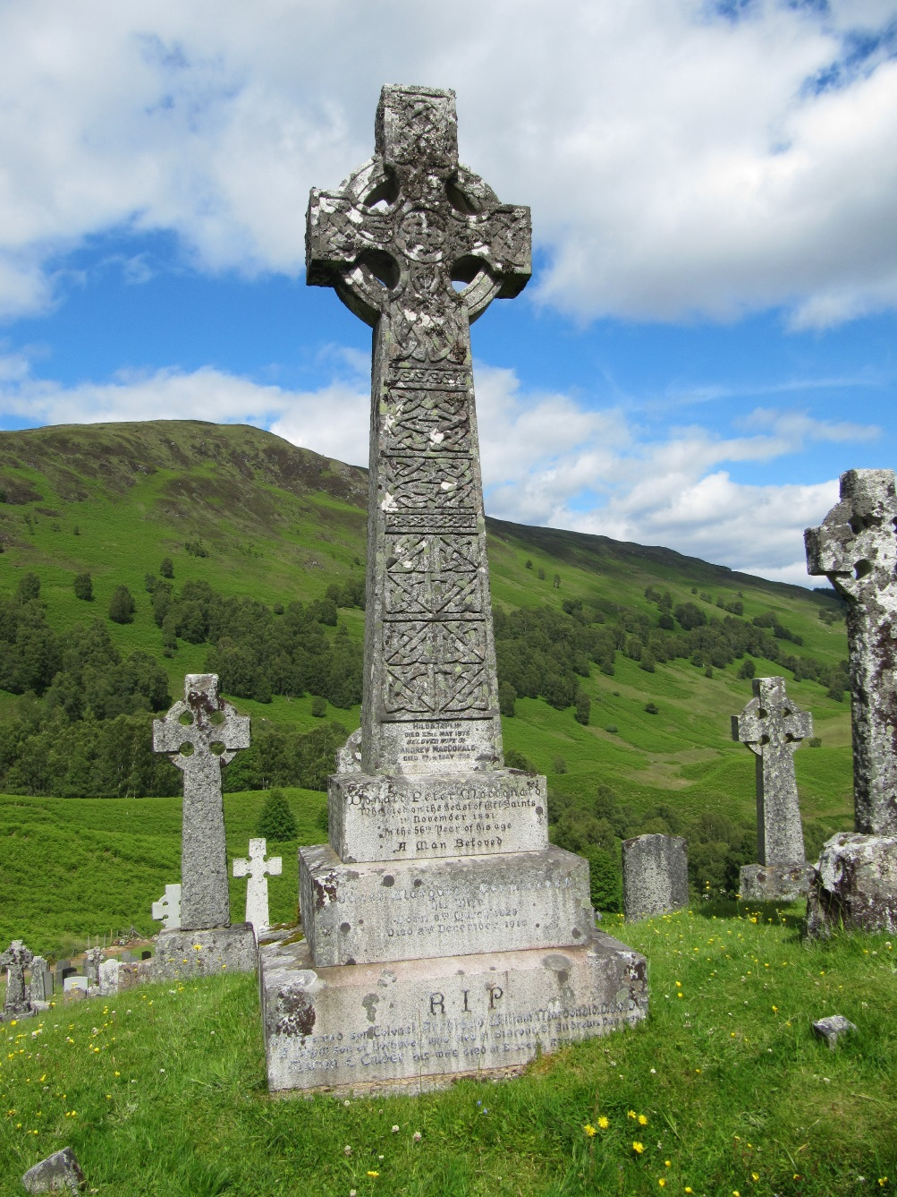
Fr Coll’s Grave
Cille Choirill
Fr Coll’s Home
Fort Augustus

Slide 29
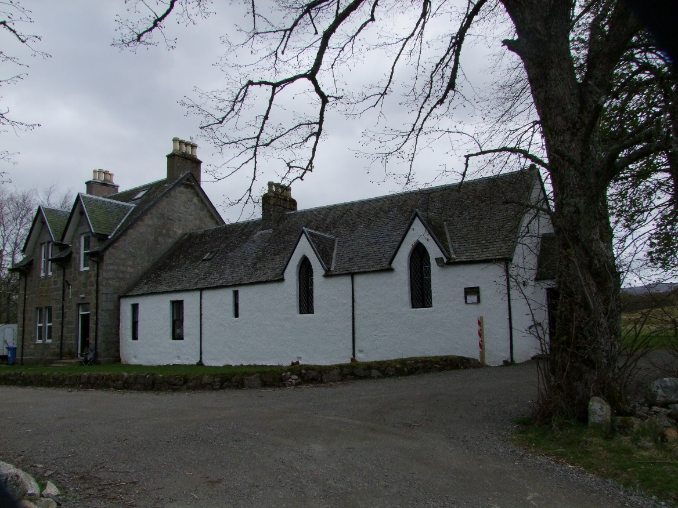
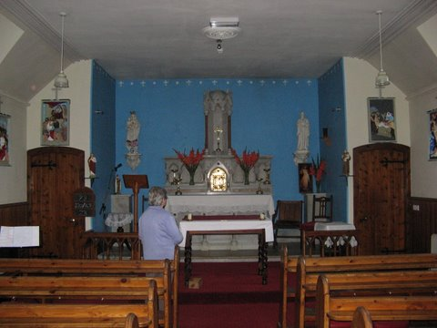
Interior of church
At Stratherick
Church and Chapel
House at
Stratherick

Slide 30
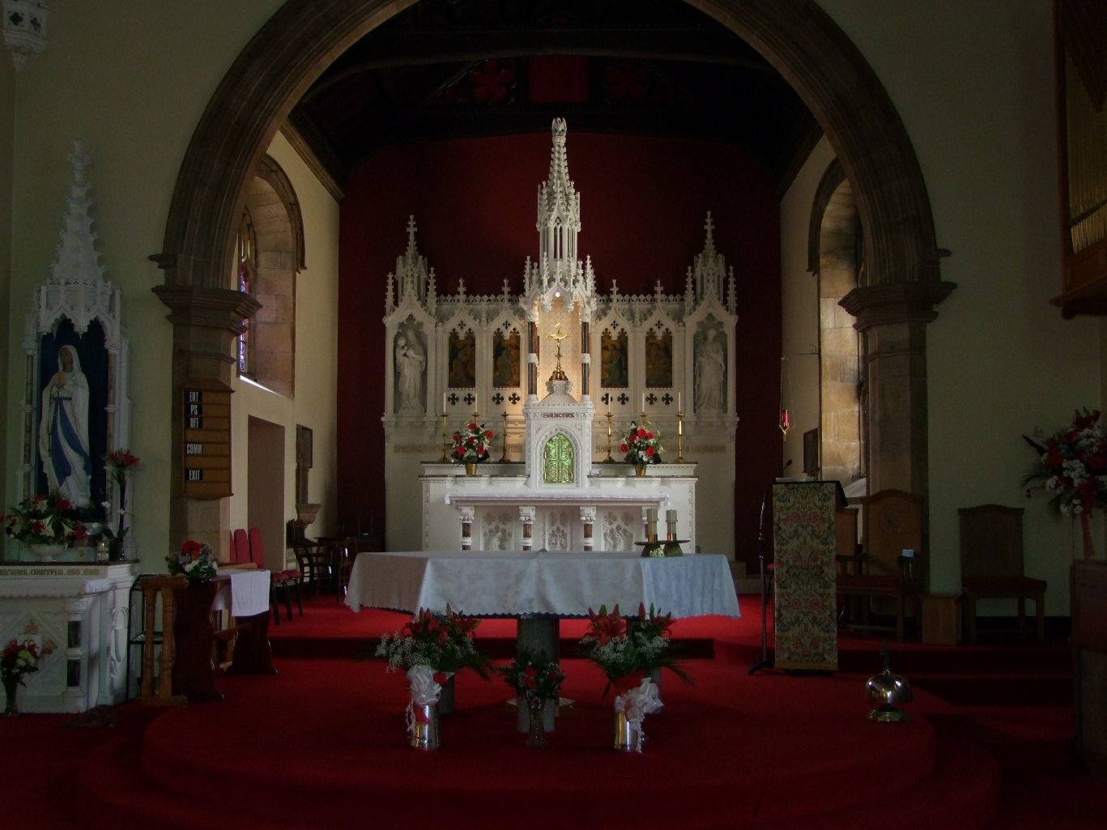
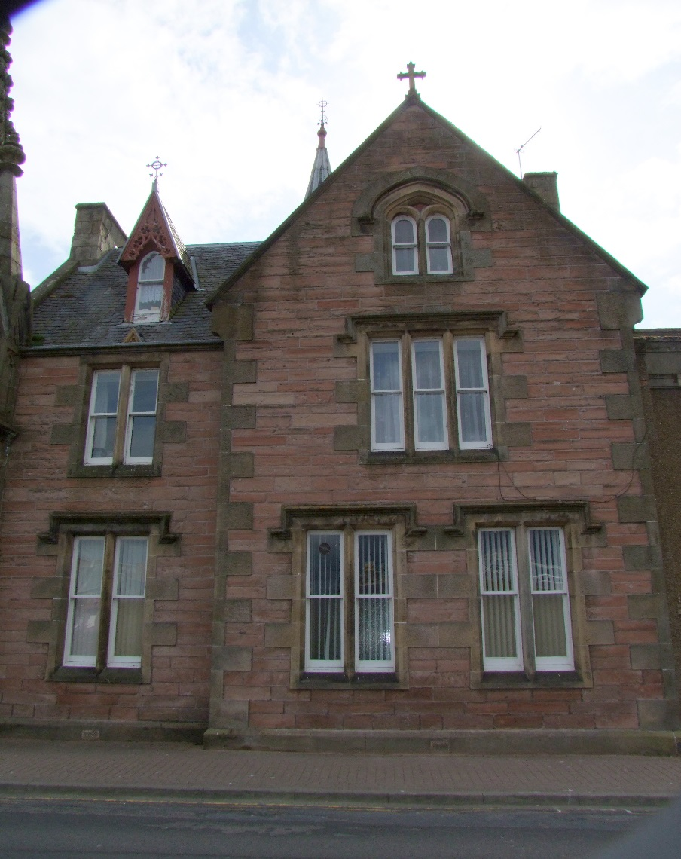
Former Convent
Inverness
St Mary’s Church
Inverness

Slide 31
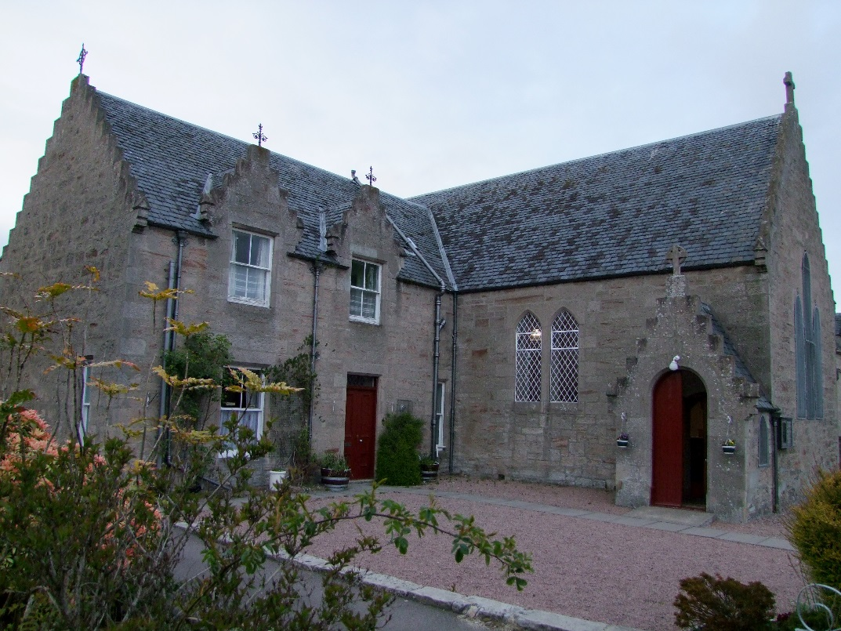
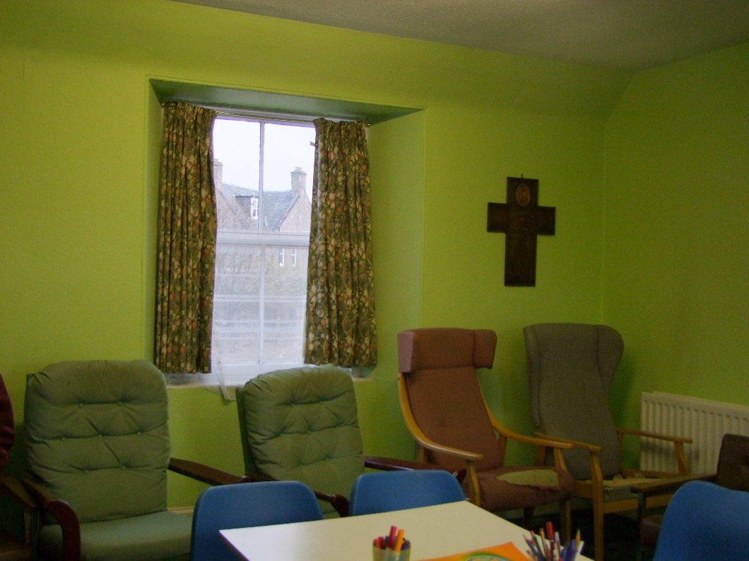
St Mary’s Church
Nairn
Room where Mary
slept while in Nairn

Slide 32
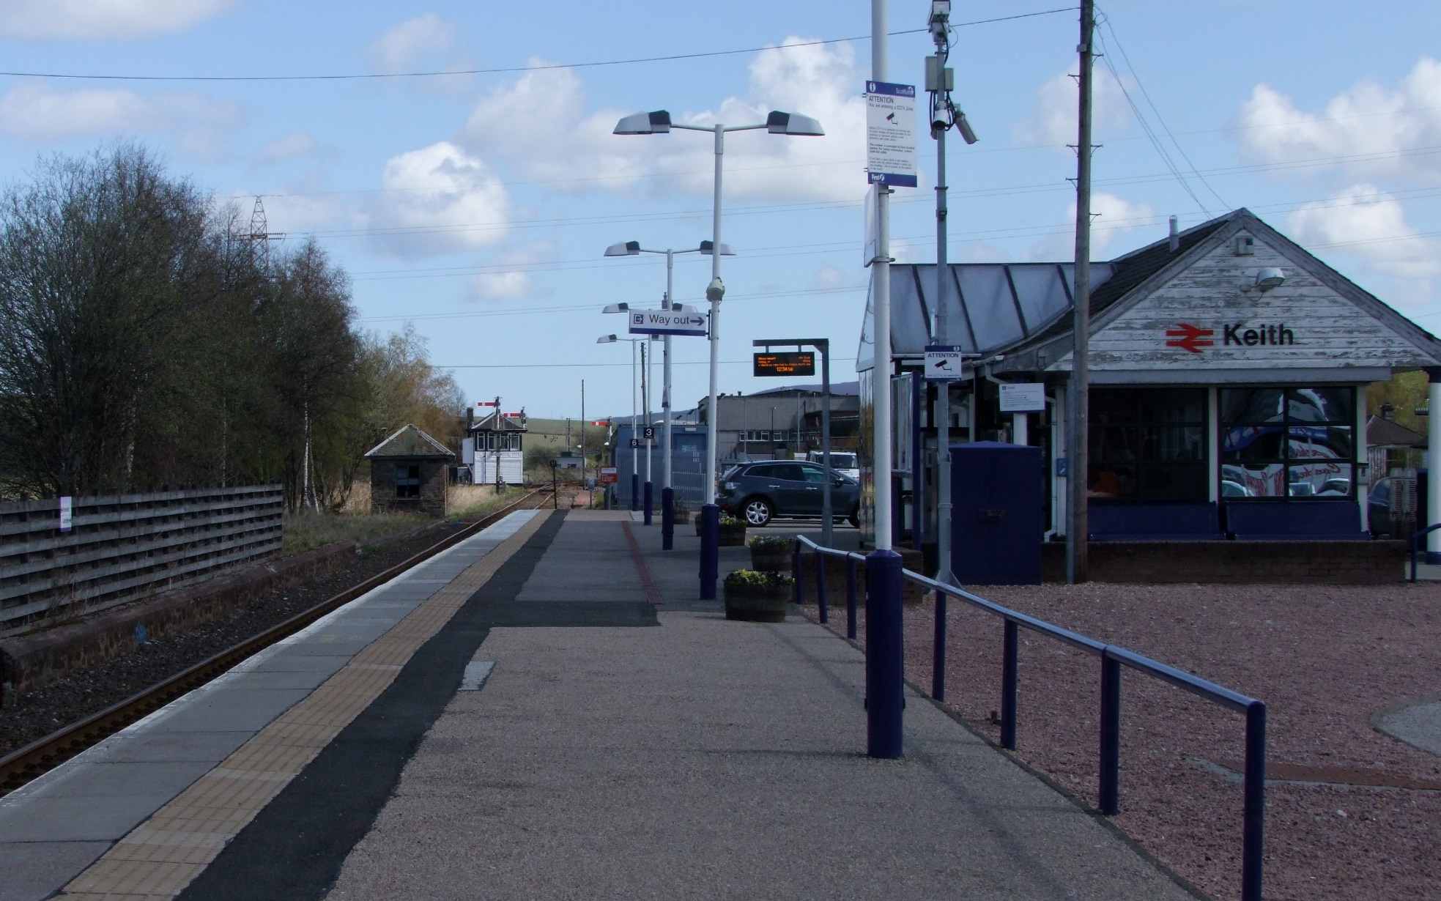
Railway station
at
KEITH
where Mary
stayed overnight in the waiting room while en route to Aberdeen

Slide 33
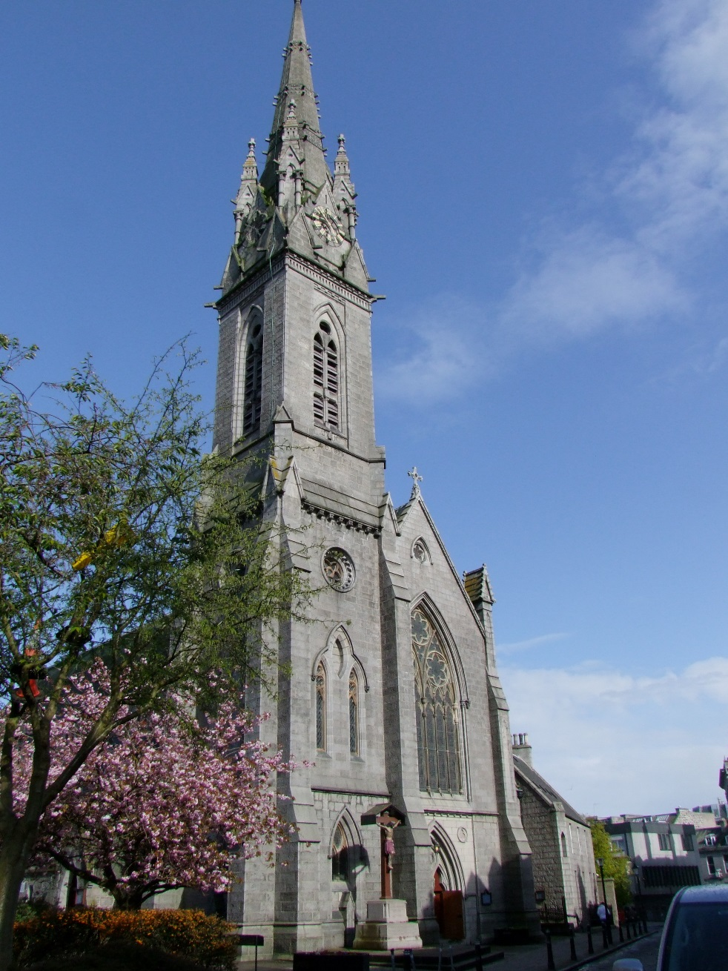
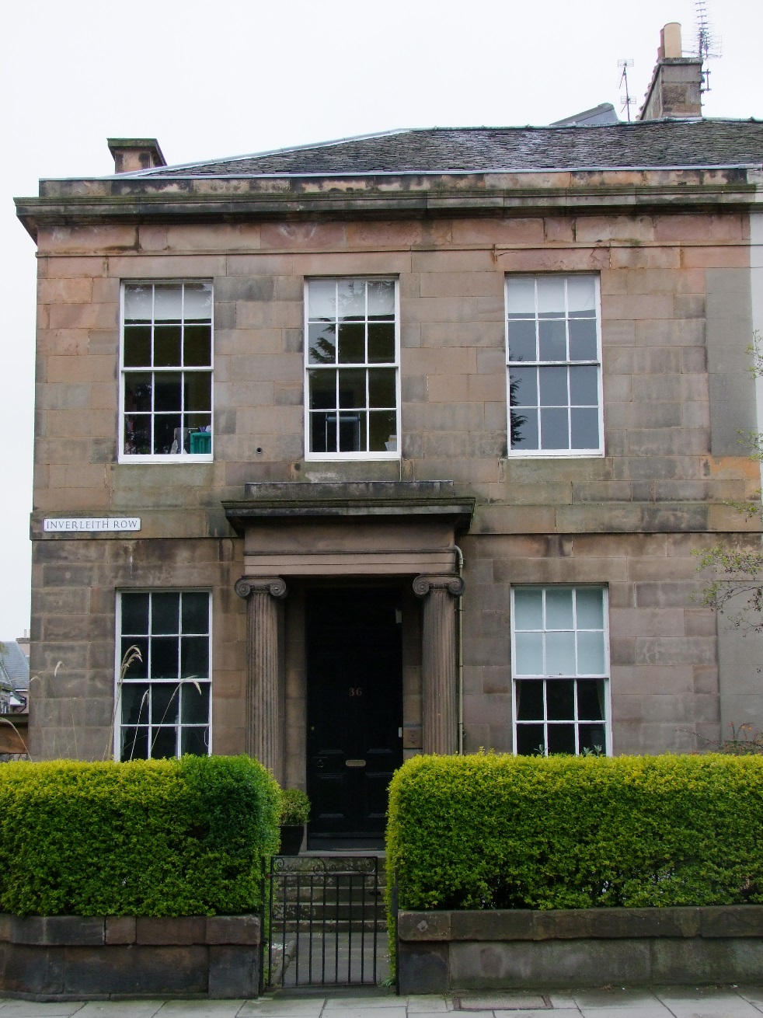
Aberdeen Cathedral
Former Convent

Slide 34
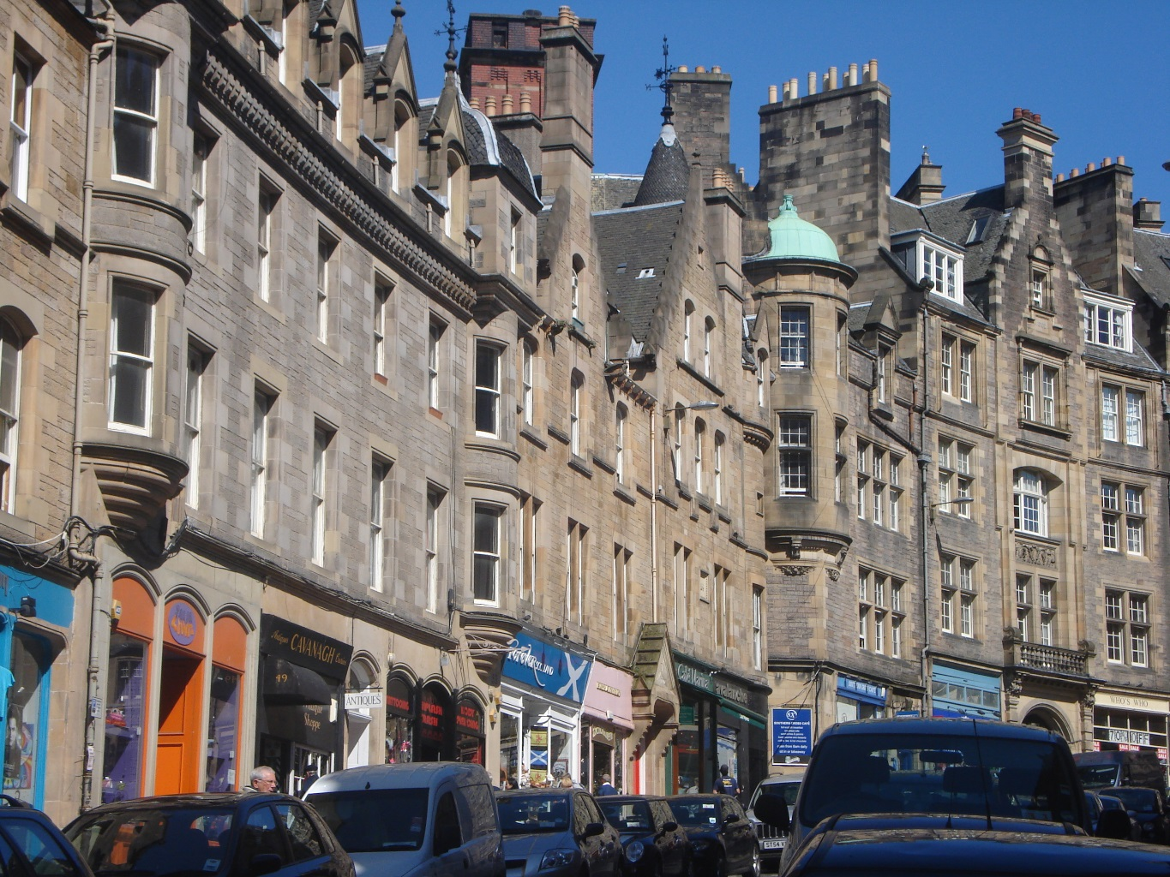
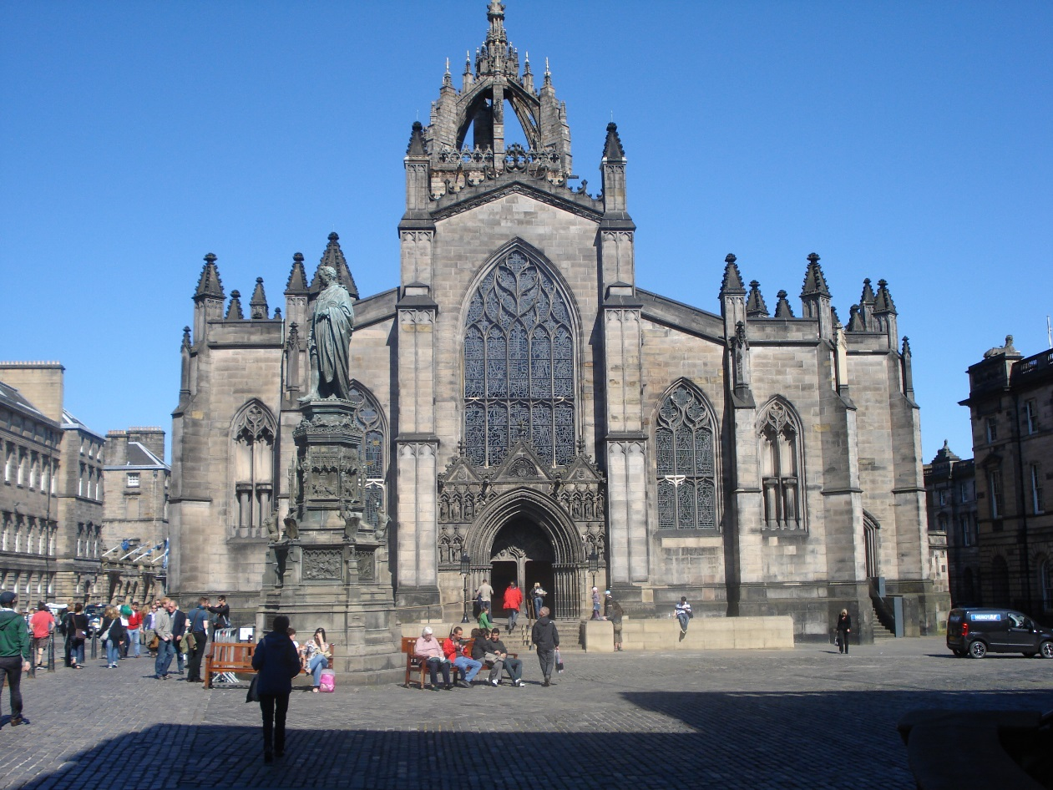
St Giles Cathedral
Typical street in
Edinburgh

Slide 35
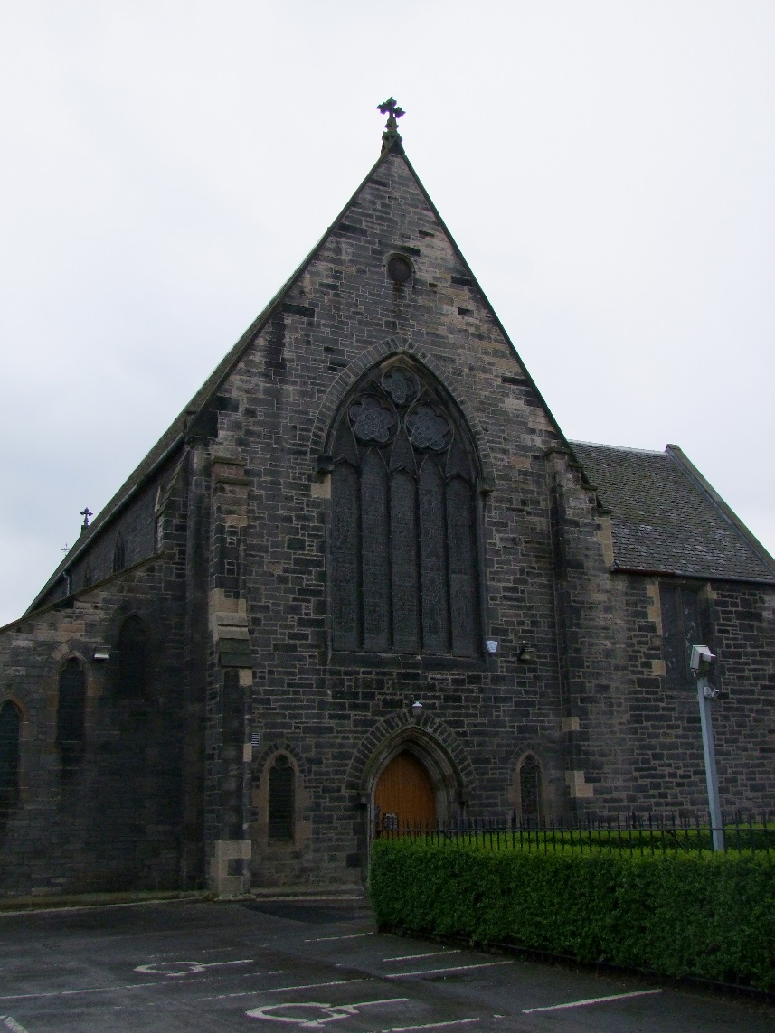
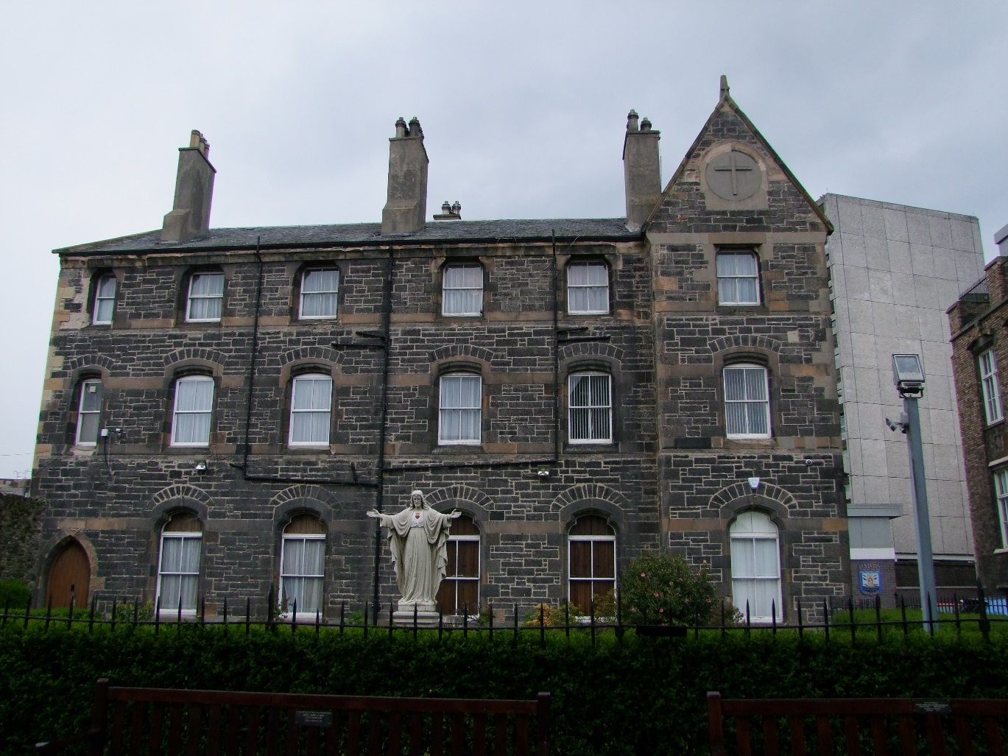
Our Lady Star of the Sea – Oblate Fathers

Slide 36
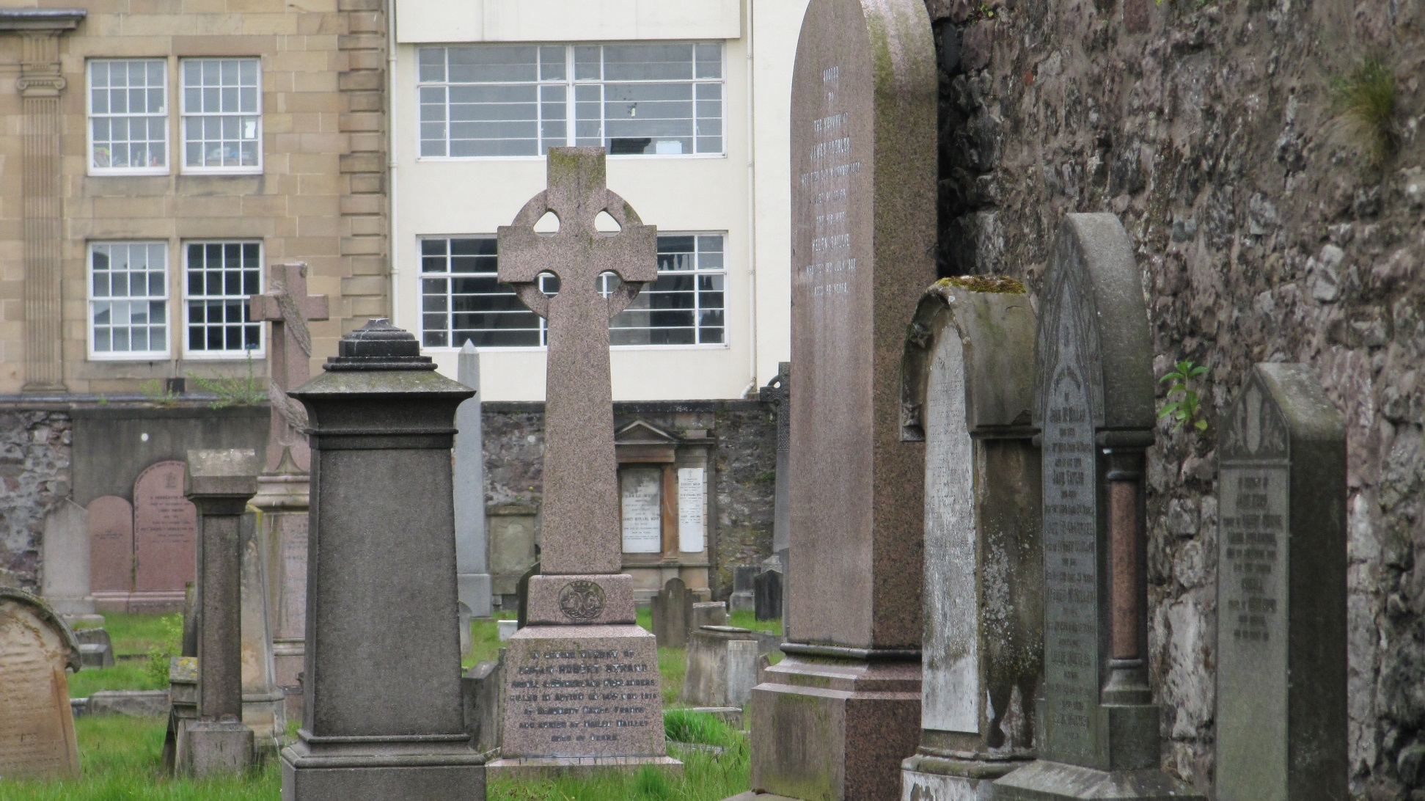
Greenside Cemetery, Alloa, where
Uncle Archie MacKillop is buried

Slide 37
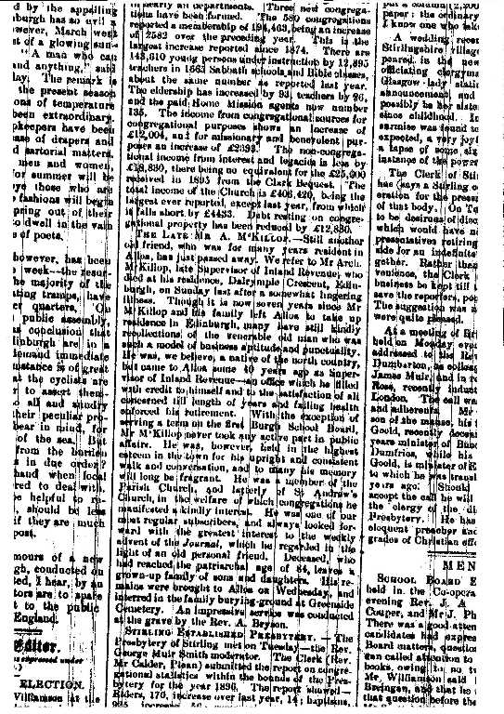

Slide 38
KERR FAMILY
ALAN, 2nd on left, the great grandson of Uncle Archie
with wife, Joyce,
son Neil and
daughter Gillian

Slide 39
Shrine & Inscription in
St Mary’s Church
Fort William

